Slide 1
Partner Technical Boot Camp
Alex Mang

Slide 2
Alex Mang
@iAmAlexMang
www.linkedin.com/in/mangalex

Slide 3
Partner Technical Boot Camp Agenda
Day 2: Serverless
Modernize Applications With Azure Serverless
Serverless Challenge
Designing For Scale With Azure Messaging
Day 3: Security
Azure Identity For Developers
Whiteboard Design Session on Building Secure Apps
Architecting And Securing Web Apps
Web AppSecurity Challenge
Day 4: Containers
Building Apps With Azure Kubernetes Service
Running Serverless With AKS Hands-on Lab
Service Mesh
Day 5: DevOps
GitHub Actions
DevOps Challenge Using GitHub Actions

Slide 4
Partner Technical Boot Camp Agenda
Day 2: Serverless
Modernize Applications With Azure Serverless
Serverless Challenge
Designing For Scale With Azure Messaging
Day 3: Security
Azure Identity For Developers
Whiteboard Design Session on Building Secure Apps
Architecting And Securing Web Apps
Web AppSecurity Challenge
Day 4: Containers
Building Apps With Azure Kubernetes Service
Running Serverless With AKS Hands-on Lab
Service Mesh
Day 5: DevOps
GitHub Actions
DevOps Challenge Using GitHub Actions

Slide 5
What Is A Challenge?
Developer-focused engagement
Wide variety of participants
Learn through hands-on experimentation
Challenges based on scenarios mimicking the developer journey

Slide 6
E-Commerce Challenge Scenario
15y old e-commerce application
Application will be redesigned/rewritten
They’re looking for distributed apps using Azure Functions
Fictional: we want you to experiment Azure Functions at its best
Notes:
Contoso Coffee Ltd., a popular supplier of goods for baristas has decided that it's time to move their 15 years old e-commerce application to the cloud. Nonetheless, their CTO, John Wash, wants to leverage their cloud migration as an opportunity to modernize their core business logic backend as well. Specifically, they've looked at how they could take advantage of Azure Functions to achieve a higher degree scalability whenever their application is under high load.
That said, whilst technically they could certainly implement the greatest and latest services to achieve the craziest of scalabilities, their current customer portfolio and market share doesn't validate the use of many specific and expensive services. Sure enough, they are looking to minimize their operational Azure costs doing the same.

Slide 7
Modernize Your App with Azure Serverless
Alex Mang

Slide 8
Agenda
Application Modernization
Azure Serverless
Reference Serverless Application
Functions
Durable Functions
Durable Entities
Security

Slide 9
What is modernization?

Slide 10
Modernization
Which apps require transformation?
Which apps need to be only partially modernized?
Which apps can be “lifted and shifted”?
Notes:
When you decide to modernize your web applications or services and move them to the cloud, you don't necessarily have to fully rearchitect your apps. Rearchitecting an application by using an advanced approach like microservices isn't always an option because of cost and time restraints. Depending on the type of application, rearchitecting an app also might not be necessary. To optimize the cost-effectiveness of your organization's cloud migration strategy, it's important to consider the needs of your business and requirements of your apps. You'll need to determine:
Which apps require a transformation or rearchitecting.
Which apps need to be only partially modernized.
Which apps you can "lift and shift" directly to the cloud.

Slide 11
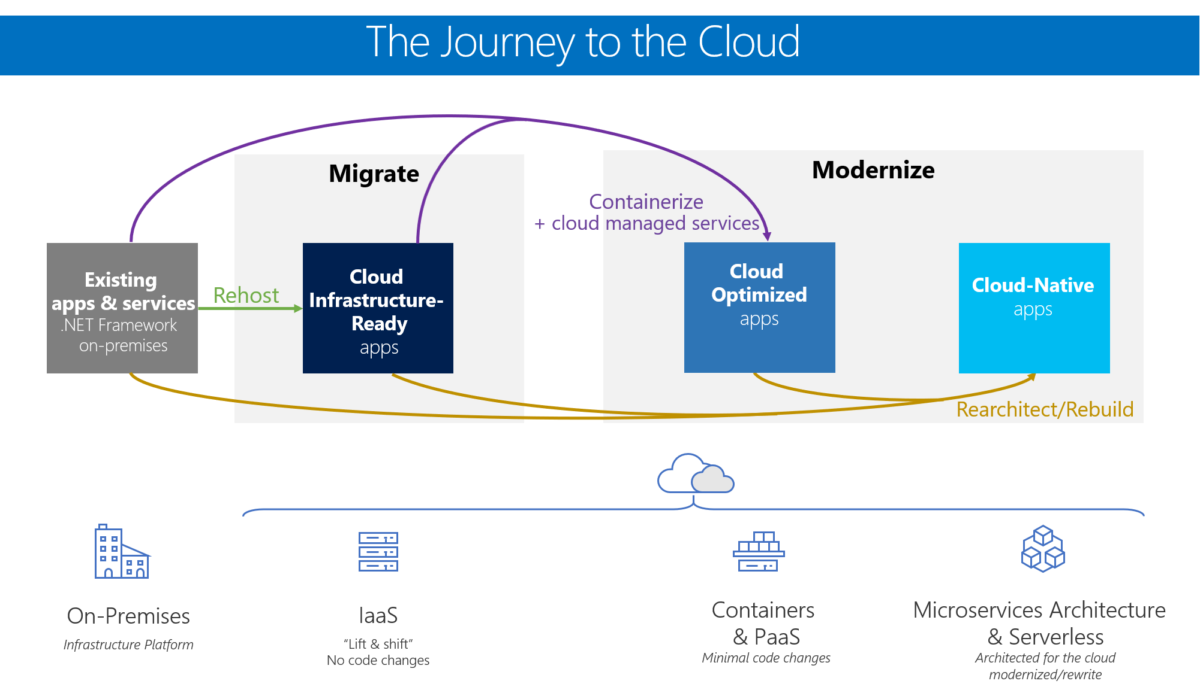
Notes:
Organizations typically choose to move to the cloud for the agility and speed they can get for their applications. You can set up thousands of servers (VMs) in the cloud in minutes, compared to the weeks it typically takes to set up on-premises servers.
There isn't a single, one-size-fits-all strategy for migrating applications to the cloud. The right migration strategy for you will depend on your organization's needs and priorities, and the kind of applications you are migrating. Not all applications warrant the investment of moving to a platform as a service (PaaS) model or developing a cloud-native application model. In many cases, you can take a phased or incremental approach to invest in moving your assets to the cloud, based on your business needs.
For modern applications with the best long-term agility and value for the organization, you might benefit from investing in cloud-native application architectures. However, for applications that are existing or legacy assets, the key is to spend minimal time and money (no rearchitecting or code changes) while moving them to the cloud, to realize significant benefits.
The figure shows the possible paths you can take when you move existing .NET applications to the cloud in incremental phases.
Each migration approach has different benefits and reasons for using it. You can choose a single approach when you migrate apps to the cloud, or choose certain components from multiple approaches. Individual applications aren't limited to a single approach or maturity state. For instance, a common hybrid approach would have certain on-premises components plus other components in the cloud.
Level 1: Cloud Infrastructure-Ready applications: In this migration approach, you simply migrate or rehost your current on-premises applications to an infrastructure as a service (IaaS) platform. Your apps have almost the same composition as before, but now you deploy them to VMs in the cloud. This simple type of migration is typically known in the industry as "Lift & Shift."
Level 2: Cloud Optimized applications: At this level and still without rearchitecting or altering significant code, you can gain additional benefits from running your app in the cloud with modern technologies like containers and additional cloud-managed services. You improve the agility of your applications to ship faster by refining your enterprise development operations (DevOps) processes. You achieve this by using technologies like Windows Containers, which is based on Docker Engine. Containers remove the friction that's caused by application dependencies when you deploy in multiple stages. In this maturity model, you can deploy containers on IaaS or PaaS while using additional cloud-managed services related to databases, cache as a service, monitoring, and continuous integration/continuous deployment (CI/CD) pipelines.
The third level of maturity is the ultimate goal in the cloud, but it's optional for many apps and not the main focus of this guide:
Level 3: Cloud-Native applications: This migration approach typically is driven by business need and targets modernizing your mission-critical applications. At this level, you use PaaS services to move your apps to PaaS computing platforms. You implement cloud-native applications and microservices architecture to evolve applications with long-term agility, and to scale to new limits. This type of modernization usually requires architecting specifically for the cloud. New code often must be written, especially when you move to cloud-native application and microservice-based models. This approach can help you gain benefits that are difficult to achieve in your monolithic and on-premises application environment.

Slide 12
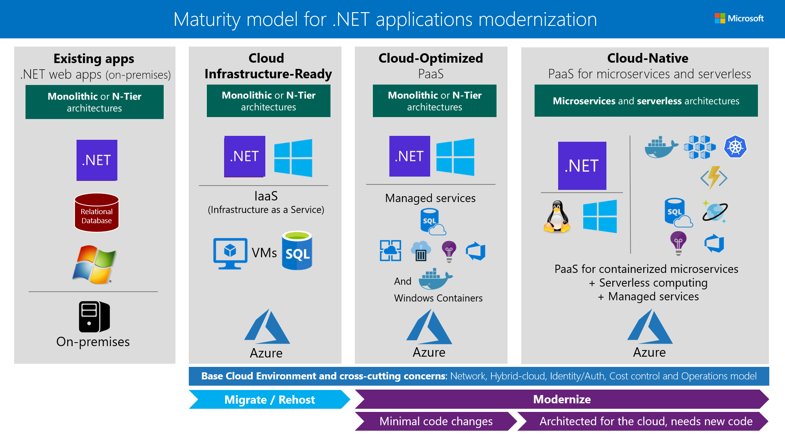
Notes:
.NET Framework applications initially started with the .NET Framework version 1.0, which was released in late 2001. Then, companies moved towards newer versions (such as 2.0, 3.5 and .NET 4.x). Most of those applications ran on Windows Server and Internet Information Server (IIS), and used a relational database, like SQL Server, Oracle, MySQL, or any other RDBMS.
Most existing .NET applications might nowadays be based on .NET Framework 4.x, or even on .NET Framework 3.5, and use web frameworks like ASP.NET MVC, ASP.NET Web Forms, ASP.NET Web API, Windows Communication Foundation (WCF), ASP.NET SignalR, and ASP.NET Web Pages. These established .NET Framework technologies depend on Windows. That dependency is important to consider if you are simply migrating legacy apps and you want to make minimal changes to your application infrastructure.
This figure shows the primary technologies and architecture styles used at each of the three cloud maturity levels.
It highlights the most common scenarios, but many hybrid and mixed variations are possible when it comes to architecture. For example, the maturity models apply not only to monolithic architectures in existing web apps, but also to service orientation, N-Tier, and other architecture style variations. The higher focus or percentage on one or another architecture type and related technologies determines the overall maturity level of your applications

Slide 13
What is serverless?

Slide 14
Serverless
Abstraction of servers
Event-driven
Pay the duration of business logic
Notes:
Serverless models abstract the underlying compute infrastructure. This allows developers to focus on business logic without needing extensive startup or maintenance cost to set up the solution. Serverless reduces the overall costs since you pay only for the duration the code was executed. This event-driven model is suitable for situations where some event triggers a defined action. For example, receiving an incoming device messages to store for later use, or a database update that needs some further processing.

Slide 15
“
Serverless computing is a cloud-computing execution model in which the cloud provider runs the server, and dynamically manages the allocation of machine resources. Pricing is based on the actual amount of resources consumed by an application, rather than on pre-purchased units of capacity.[1] It can be a form of utility computing.
https://en.wikipedia.org/wiki/Serverless_computing

Slide 16
“Serverless” = Platform-as-a-Service
Platform as a Service
Serverless is PaaS
Virtualization is IaaS
Applications
Data
Runtime
Middleware
O/S
Virtualization
Servers
Storage
Networking
Managed by you
Microsoft managed
Serverless means
you supply the code
Notes:
Serverless is PaaS
The promise of Platform as a service is to liberate you from managing low-level infrastructure and focus on apps and data
Virtualization is IaaS
Containers and container orchestrators are a very flexible way to share, configure and reuse portions of virtualized infrastructure
Container platforms may form a complete virtualization layer, including software-defined networking

Slide 17
Three Degrees Of Serverless
Managed Cluster
Managed Middleware
Managed Functions
Notes:
Managed Cluster
You supply applications that are deployed on a cluster that allows or placement, replication, ownership consensus and management of stateful resources
Managed Middleware
You supply applications that are deployed on sets of independent, “stateless” middleware servers, like web servers or pure compute hosts
Applications may be always on or start on demand; typically maintain shared cache state and resources
Managed Functions
You supply (small groups of) function implementations that are run for your when triggered by a configured condition.

Slide 18
Azure Serverless
As per https://azure.microsoft.com:
Compute
Workflows and integration
DevOps and developer tools
AI and ML
Database
Storage
Monitoring
Analytics
Notes:
Azure serverless compute
Build applications faster by eliminating the need to manage the infrastructure that runs your code and containers
Compute
Serverless Kubernetes
Elastically provision pods inside container instances that start in seconds without the need to manage additional compute resources. Create serverless, Kubernetes-based applications using the orchestration capabilities of Azure Kubernetes Service (AKS) and AKS virtual nodes, which are built on the open-source Virtual Kubelet project. Get the best of an event-driven approach by adding KEDA event-driven autoscaling to your AKS cluster. KEDA is an open-source component that enables containers to process events directly from event sources, and it provides the ability to scale to zero.
Serverless functions
Execute code—written in the language of your choice—with Azure Functions, an event-driven compute experience. Scale on demand and pay only for the time your code is executed. Available as a managed service in Azure and Azure Stack, the open source Functions runtime also works on multiple destinations, including Kubernetes, Azure IoT Edge, on-premises, and even in other clouds.
Serverless application environments
Run and scale web, mobile, and API applications on the platform of your choice—in a high-productivity, fully managed environment—with Azure App Service.
Azure serverless workflows and integration
Create new apps by orchestrating event-based serverless architectures. Build connected services more easily using a simple API facade that abstracts API implementation complexity.
Serverless workflow orchestration
Integrate data and apps instead of writing complex glue code between disparate systems. Visually create serverless workflows with Azure Logic Apps and use your own APIs, serverless functions, or out-of-the-box software as a service (SaaS) connectors, including Salesforce, Microsoft Office 365, and Dropbox.
Serverless API management
Publish, secure, transform, maintain, and monitor APIs with Azure API Management, a fully managed service that offers a usage model designed and implemented to be an organic fit for serverless applications.
Serverless messaging
Simplify event-based application scenarios with Azure Event Grid. Connect serverless logic to events coming from multiple Azure services and external sources using the CloudEvents schema. Build distributed and scalable cloud solutions with connections across private and public cloud environments with the Azure Service Bus messaging infrastructure.
DevOps and developer tools for serverless
Create serverless apps using familiar tools right from your own developer environment and on your favorite operating system. Get first-class services to build, test and deploy functions, containers, and Kubernetes-based applications
CI/CD for serverless
Get unlimited, cloud-hosted private git repos with Azure DevOps. Easily set up continuous integration/continuous delivery (CI/CD), add automatic package management, automatically trigger builds, and deploy to Kubernetes, Azure Functions, Azure Web Apps, or any cloud.
App development tools
Build, run, and debug serverless applications with a comprehensive set of developer tools. Use emulators to develop your apps locally for advanced scenarios like Functions and Kubernetes, then easily target them to Azure when you’re ready to deploy.
AI and machine learning for serverless
Infuse your serverless applications with ready-to-use AI and machine learning algorithms. Improve productivity and reduce costs with autoscaling compute and DevOps for machine learning.
Cognitive computing
Enable your serverless apps to see, hear, speak, understand and interpret your user needs through natural methods of communication using Azure Cognitive Services via an API or deployed as containers on Kubernetes.
Conversation bots
Use Azure Bot Service to build intelligent bots that interact naturally with your users through channels such as text/SMS, Skype, Microsoft Teams, Slack, Office 365, and Twitter.
Machine learning models
Build, train, and deploy models on Azure Machine Learning, from the cloud to the edge.
Build serverless apps with relational and non-relational databases
Azure SQL Database serverless
Build apps faster, optimize price-performance, and simplify performance management for relational databases using Azure SQL Database serverless. Automatically scale compute based on workload demand and pay only for compute used per second. For further cost savings, automatically pause serverless databases and pay only for storage during inactive periods, then automatically resume when workload activity returns. All databases in Azure SQL Database including those using serverless are automatically updated, come with built-in high availability, and feature built-in machine learning for added security and performance.
Azure Cosmos DB
Use Azure Cosmos DB, a globally distributed, massively scalable, multi-model database service, to create database triggers, input bindings, and output bindings.
Azure serverless storage
Build static web applications on Azure Blob storage or use it as massively scalable storage for unstructured data. Leverage storage events to respond to operations on blobs with multiple serverless architectures. Blob events are pushed through Event Grid to subscribers using Functions, Logic Apps, or even your own custom HTTP listener.
Azure serverless monitoring
As serverless eliminates traditional infrastructure management tasks, it’s more important than ever that developers have the right instrumentation in place to help debug serverless apps. Gain full observability into your serverless apps using Azure Monitor, an extensible application performance management service to monitor your applications. Collect, analyze, and act on telemetry from your cloud and on-premises environments to maximize the availability and performance of your apps.
Azure serverless analytics
Easily develop and run massively parallel real-time analytics on multiple streams of data—including IoT—using Azure Stream Analytics. With no infrastructure to manage, process data on demand, scale instantly, and only pay per job. Quickly build real-time dashboards with Microsoft Power BI for a live command and control view.

Slide 19
Reference for a Serverless web application

Slide 20
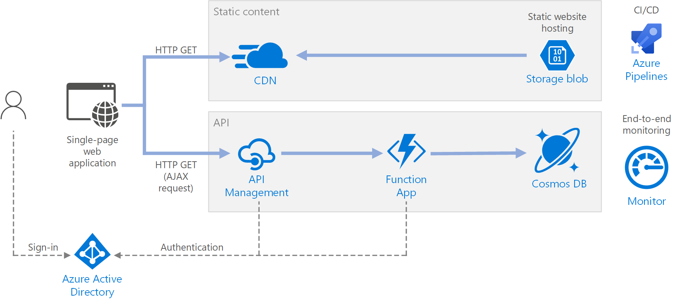
Serverless Web Application On Azure
https://github.com/mspnp/serverless-reference-implementation/tree/v0.1.0-update
Notes:
This reference architecture shows a serverless web application. The application serves static content from Azure Blob Storage, and implements an API using Azure Functions. The API reads data from Cosmos DB and returns the results to the web app.
The term serverless has two distinct but related meanings:
Backend as a service (BaaS). Back-end cloud services, such as databases and storage, provide APIs that enable client applications to connect directly to these services.
Functions as a service (FaaS). In this model, a "function" is a piece of code that is deployed to the cloud and runs inside a hosting environment that completely abstracts the servers that run the code.
Both definitions have in common the idea that developers and DevOps personnel don't need to deploy, configure, or manage servers. This reference architecture focuses on FaaS using Azure Functions, although serving web content from Azure Blob Storage could be an example of BaaS. Some important characteristics of FaaS are:
Compute resources are allocated dynamically as needed by the platform.
Consumption-based pricing: You are charged only for the compute resources used to execute your code.
The compute resources scale on demand based on traffic, without the developer needing to do any configuration.
Functions are executed when an external trigger occurs, such as an HTTP request or a message arriving on a queue. This makes an event-driven architecture style natural for serverless architectures. To coordinate work between components in the architecture, consider using message brokers or pub/sub patterns. For help with choosing between messaging technologies in Azure, see Choose between Azure services that deliver messages.
The architecture consists of the following components:
Blob Storage. Static web content, such as HTML, CSS, and JavaScript files, are stored in Azure Blob Storage and served to clients by using static website hosting. All dynamic interaction happens through JavaScript code making calls to the back-end APIs. There is no server-side code to render the web page. Static website hosting supports index documents and custom 404 error pages.
CDN. Use Azure Content Delivery Network (CDN) to cache content for lower latency and faster delivery of content, as well as providing an HTTPS endpoint.
Function Apps. Azure Functions is a serverless compute option. It uses an event-driven model, where a piece of code (a "function") is invoked by a trigger. In this architecture, the function is invoked when a client makes an HTTP request. The request is always routed through an API gateway, described below.
API Management. API Management provides an API gateway that sits in front of the HTTP function. You can use API Management to publish and manage APIs used by client applications. Using a gateway helps to decouple the front-end application from the back-end APIs. For example, API Management can rewrite URLs, transform requests before they reach the back end, set request or response headers, and so forth.
API Management can also be used to implement cross-cutting concerns such as:
Enforcing usage quotas and rate limits
Validating OAuth tokens for authentication
Enabling cross-origin requests (CORS)
Caching responses
Monitoring and logging requests
If you don't need all of the functionality provided by API Management, another option is to use Functions Proxies. This feature of Azure Functions lets you define a single API surface for multiple function apps, by creating routes to back-end functions. Function proxies can also perform limited transformations on the HTTP request and response. However, they don't provide the same rich policy-based capabilities of API Management.
Cosmos DB. Cosmos DB is a multi-model database service. For this scenario, the function application fetches documents from Cosmos DB in response to HTTP GET requests from the client.
Azure Active Directory (Azure AD). Users sign into the web application by using their Azure AD credentials. Azure AD returns an access token for the API, which the web application uses to authenticate API requests (see Authentication).
Azure Monitor. Monitor collects performance metrics about the Azure services deployed in the solution. By visualizing these in a dashboard, you can get visibility into the health of the solution. It also collected application logs.
Azure Pipelines. Pipelines is a continuous integration (CI) and continuous delivery (CD) service that builds, tests, and deploys the application.
Recommendations
Function App plans
Azure Functions supports two hosting models. With the consumption plan, compute power is automatically allocated when your code is running. With the App Service plan, a set of VMs are allocated for your code. The App Service plan defines the number of VMs and the VM size.
Note that the App Service plan is not strictly serverless, according to the definition given above. The programming model is the same, however — the same function code can run in both a consumption plan and an App Service plan.
Here are some factors to consider when choosing which type of plan to use:
Cold start. With the consumption plan, a function that hasn't been invoked recently will incur some additional latency the next time it runs. This additional latency is due to allocating and preparing the runtime environment. It is usually on the order of seconds but depends on several factors, including the number of dependencies that need to be loaded. For more information, see Understanding Serverless Cold Start. Cold start is usually more of a concern for interactive workloads (HTTP triggers) than asynchronous message-driven workloads (queue or event hubs triggers), because the additional latency is directly observed by users.
Timeout period. In the consumption plan, a function execution times out after a configurable period of time (to a maximum of 10 minutes)
Virtual network isolation. Using an App Service plan allows functions to run inside of an App Service Environment, which is a dedicated and isolated hosting environment.
Pricing model. The consumption plan is billed by the number of executions and resource consumption (memory × execution time). The App Service plan is billed hourly based on VM instance SKU. Often, the consumption plan can be cheaper than an App Service plan, because you pay only for the compute resources that you use. This is especially true if your traffic experiences peaks and troughs. However, if an application experiences constant high-volume throughput, an App Service plan may cost less than the consumption plan.
Scaling. A big advantage of the consumption model is that it scales dynamically as needed, based on the incoming traffic. While this scaling occurs quickly, there is still a ramp-up period. For some workloads, you might want to deliberately overprovision the VMs, so that you can handle bursts of traffic with zero ramp-up time. In that case, consider an App Service plan.
Function App boundaries
A function app hosts the execution of one or more functions. You can use a function app to group several functions together as a logical unit. Within a function app, the functions share the same application settings, hosting plan, and deployment lifecycle. Each function app has its own hostname.
Use function apps to group functions that share the same lifecycle and settings. Functions that don't share the same lifecycle should be hosted in different function apps.
Consider taking a microservices approach, where each function app represents one microservice, possibly consisting of several related functions. In a microservices architecture, services should have loose coupling and high functional cohesion. Loosely coupled means you can change one service without requiring other services to be updated at the same time. Cohesive means a service has a single, well-defined purpose. For more discussion of these ideas, see Designing microservices: Domain analysis.
Scalability considerations
Functions. For the consumption plan, the HTTP trigger scales based on the traffic. There is a limit to the number of concurrent function instances, but each instance can process more than one request at a time. For an App Service plan, the HTTP trigger scales according to the number of VM instances, which can be a fixed value or can autoscale based on a set of autoscaling rules. For information, see Azure Functions scale and hosting.
Cosmos DB. Throughput capacity for Cosmos DB is measured in Request Units (RU). A 1-RU throughput corresponds to the throughput need to GET a 1KB document. In order to scale a Cosmos DB container past 10,000 RU, you must specify a partition key when you create the container and include the partition key in every document that you create. For more information about partition keys, see Partition and scale in Azure Cosmos DB.
API Management. API Management can scale out and supports rule-based autoscaling. The scaling process takes at least 20 minutes. If your traffic is bursty, you should provision for the maximum burst traffic that you expect. However, autoscaling is useful for handling hourly or daily variations in traffic. For more information, see Automatically scale an Azure API Management instance.
Disaster recovery considerations
The deployment shown here resides in a single Azure region. For a more resilient approach to disaster-recovery, take advantage of the geo-distribution features in the various services:
API Management supports multi-region deployment, which can be used to distribute a single API Management instance across any number of Azure regions. For more information, see How to deploy an Azure API Management service instance to multiple Azure regions.
Use Traffic Manager to route HTTP requests to the primary region. If the Function App running in that region becomes unavailable, Traffic Manager can fail over to a secondary region.
Cosmos DB supports multiple master regions, which enables writes to any region that you add to your Cosmos DB account. If you don't enable multi-master, you can still fail over the primary write region. The Cosmos DB client SDKs and the Azure Function bindings automatically handle the failover, so you don't need to update any application configuration settings.
Security considerations
Authentication
The GetStatus API in the reference implementation uses Azure AD to authenticate requests. Azure AD supports the OpenID Connect protocol, which is an authentication protocol built on top of the OAuth 2 protocol.
In this architecture, the client application is a single-page application (SPA) that runs in the browser. This type of client application cannot keep a client secret or an authorization code hidden, so the implicit grant flow is appropriate. (See Which OAuth 2.0 flow should I use?). Here's the overall flow:
The user clicks the "Sign in" link in the web application.
The browser is redirected the Azure AD sign in page.
The user signs in.
Azure AD redirects back to the client application, including an access token in the URL fragment.
When the web application calls the API, it includes the access token in the Authentication header. The application ID is sent as the audience ('aud') claim in the access token.
The back-end API validates the access token.
To configure authentication:
Register an application in your Azure AD tenant. This generates an application ID, which the client includes with the login URL.
Enable Azure AD authentication inside the Function App. For more information, see Authentication and authorization in Azure App Service.
Add the validate-jwt policy to API Management to pre-authorize the request by validating the access token.
For more details, see the GitHub readme.
It's recommended to create separate app registrations in Azure AD for the client application and the back-end API. Grant the client application permission to call the API. This approach gives you the flexibility to define multiple APIs and clients and control the permissions for each.
Within an API, use scopes to give applications fine-grained control over what permissions they request from a user. For example, an API might have Read and Write scopes, and a particular client app might ask the user to authorize Read permissions only.
Authorization
In many applications, the back-end API must check whether a user has permission to perform a given action. It's recommended to use claims-based authorization, where information about the user is conveyed by the identity provider (in this case, Azure AD) and used to make authorization decisions. For example, when you register an application in Azure AD, you can define a set of application roles. When a user signs into the application, Azure AD includes a roles claim for each role that the user has been granted, including roles that are inherited through group membership.
The ID token that Azure AD returns to the client contains some of the user's claims. Within the function app, these claims are available in the X-MS-CLIENT-PRINCIPAL header of the request. However, it's simpler to read this information from binding data. For other claims, use Microsoft Graph to query Azure AD. (The user must consent to this action when signing in.)
CORS
In this reference architecture, the web application and the API do not share the same origin. That means when the application calls the API, it is a cross-origin request. Browser security prevents a web page from making AJAX requests to another domain. This restriction is called the same-origin policy and prevents a malicious site from reading sensitive data from another site. To enable a cross-origin request, add a Cross-Origin Resource Sharing (CORS) policy to the API Management gateway
Lock down the function app
All calls to the function should go through the API gateway. You can achieve this as follows:
Configure the function app to require a function key. The API Management gateway will include the function key when it calls the function app. This prevents clients from calling the function directly, bypassing the gateway.
The API Management gateway has a static IP address. Restrict the Azure Function to allow only calls from that static IP address. For more information, see Azure App Service Static IP Restrictions. (This feature is available for Standard tier services only.)
Protect application secrets
Don't store application secrets, such as database credentials, in your code or configuration files. Instead, use App settings, which are stored encrypted in Azure. For more information, see Security in Azure App Service and Azure Functions.
Alternatively, you can store application secrets in Key Vault. This allows you to centralize the storage of secrets, control their distribution, and monitor how and when secrets are being accessed. For more information, see Configure an Azure web application to read a secret from Key Vault. However, note that Functions triggers and bindings load their configuration settings from app settings. There is no built-in way to configure the triggers and bindings to use Key Vault secrets.
Cost considerations
Use the Azure pricing calculator to estimate costs. Consider these points to optimize cost of this architecture.
Azure Functions
Azure Functions supports two hosting models.
Consumption plan.
Compute power is automatically allocated when your code is running.
App Service plan.
A set of VMs are allocated for your code. This plan defines the number of VMs and the VM size.
In this architecture, a function is invoked when a client makes an HTTP request. Because a constant high-volume throughput is not expected in this use case, consumption plan is recommended because you pay only for the compute resources you use.
Azure Cosmos DB
Azure Cosmos DB bills for provisioned throughput and consumed storage by hour. Provisioned throughput is expressed in Request Units per second (RU/s), which can be used for typical database operations, such as inserts, reads. The price is based on the capacity in RU/s that you reserve.
Storage is billed for each GB used for your stored data and index.
See Cosmos DB pricing model for more information.
In this architecture, the function application fetches documents from Cosmos DB in response to HTTP GET requests from the client. Cosmos DB is cost effective in this case because reading operations are significantly cheaper than write operations expressed on RU/s.
Content Delivery Network
Billing rate may differ depending on the billing region based on the location of the source server delivering the content to the end user. The physical location of the client is not the billing region. Any HTTP or HTTPS request that hits the CDN is a billable event, which includes all response types: success, failure, or other. Different responses may generate different traffic amounts.
In this reference architecture the deployment resides in a single Azure region.
To lower costs, consider increasing the cache TTL by caching resource files for a longer duration and setting the longest TTL possible on your content.
For more information, see the Cost section in Microsoft Azure Well-Architected Framework.

Slide 21
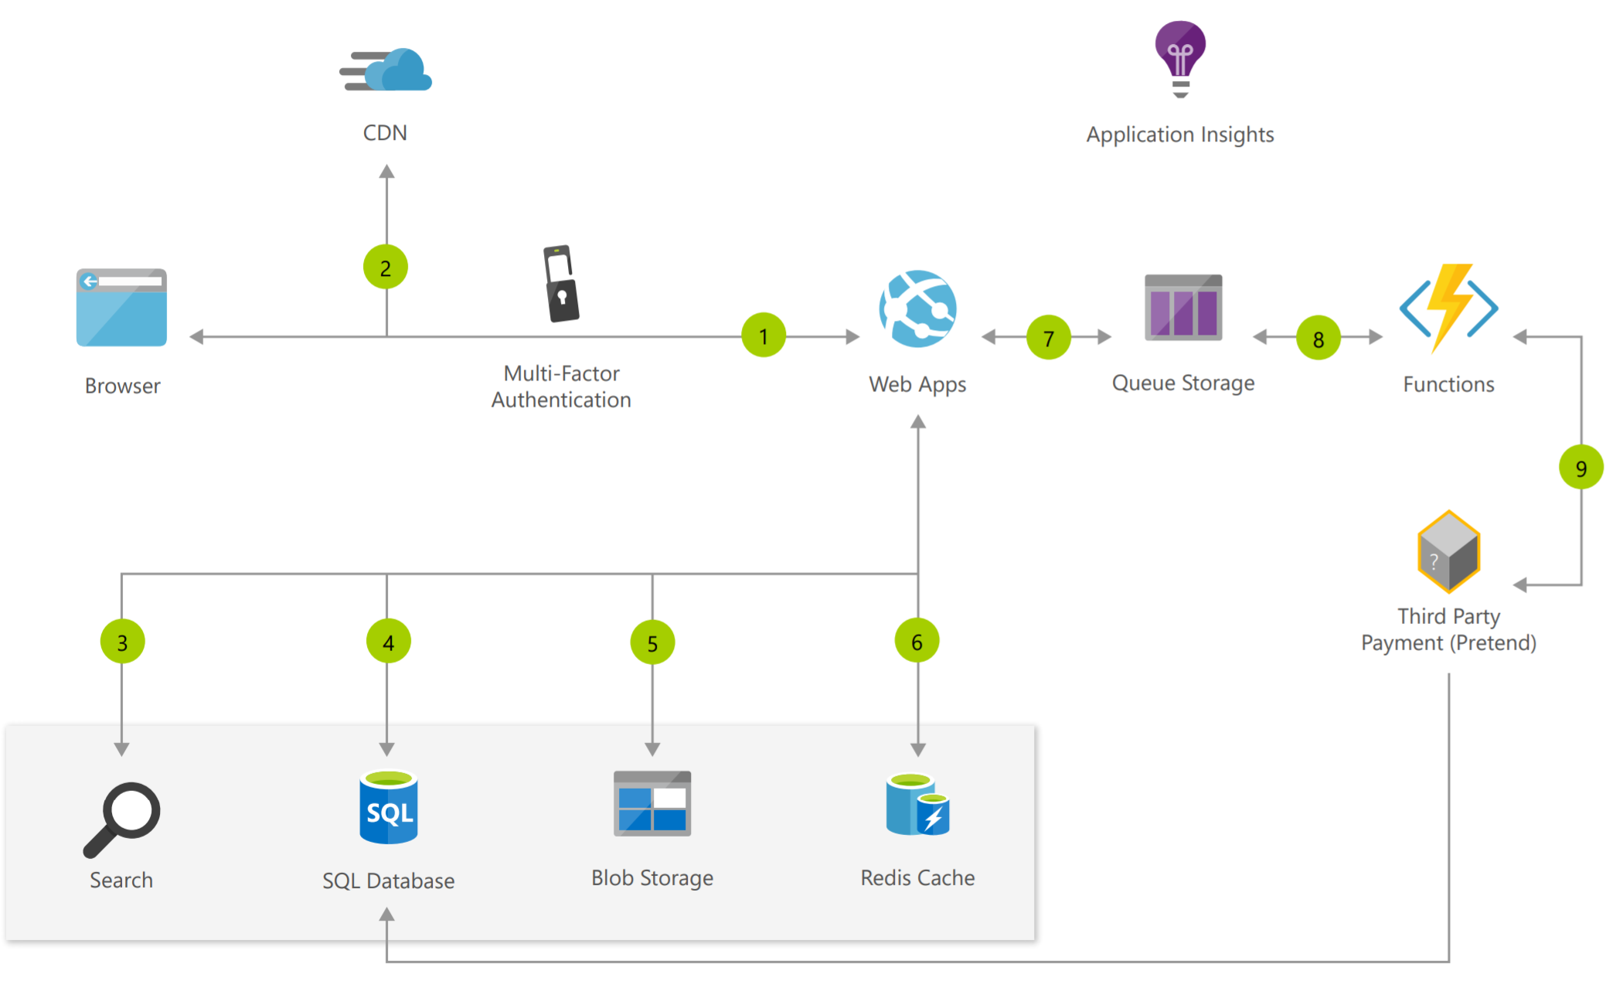
Scalable E-commerce Web App Architecture
https://docs.microsoft.com/en-us/azure/architecture/solution-ideas/articles/scalable-ecommerce-web-app
Notes:
The e-commerce website includes simple order processing workflows with the help of Azure services. Using Azure Functions and Web Apps, developers can focus on building personalized experiences and let Azure take care of the infrastructure.
User accesses the web app in browser and signs in.
Browser pulls static resources such as images from Azure Content Delivery Network.
User searches for products and queries SQL database.
Web site pulls product catalog from database.
Web app pulls product images from Blob Storage.
Page output is cached in Azure Redis Cache for better performance.
User submits order and order is placed in the queue.
Azure Functions processes order payment.
Azure Functions makes payment to third party and records payment in SQL database.

Slide 22
Azure Functions: Overview

Slide 23
What can Azure Functions do?
Run code based on HTTP requests
Schedule code to run at predefined times
Process new and modified:
Azure Cosmos DB documents
Azure Storage blobs
Azure Queue storage messages
Respond to Azure Event Grid events by using subscriptions and filters
Respond to high volumes of Azure Event Hubs events
Respond to Azure Service Bus queue and topic messages
Notes:
Azure Functions lets you develop serverless applications on Microsoft Azure. You can write just the code you need for the problem at hand, without worrying about a whole application or the infrastructure to run it.

Slide 24
Azure Functions
Solution for running small pieces of code, or "functions," in the cloud:
Write only code that is relevant to business logic
Removes the necessity to write “plumbing” code to connect or host application components
Build on open-source WebJobs code
Supports a wide variety of programming languages, for instance:
C#
JAVA
PHP
PY
JS
Even supports scripting languages, such as:
PS
SH
Notes:
What can I do with Functions?
Functions is a great solution for processing data, integrating systems, working with the internet-of-things (IoT), and building simple APIs and microservices. Consider Functions for tasks like image or order processing, file maintenance, or for any tasks that you want to run on a schedule. Functions provides templates to get you started with key scenarios.
Azure Functions supports triggers, which are ways to start execution of your code, and bindings, which are ways to simplify coding for input and output data.

Slide 25












Functions integrations
Notification Hubs
Event Grid
Event Hubs
Cosmos DB
Twilio
Azure
Functions
Storage
Service Bus
Queue
Blob
Table
Topics
Queues
Notes:
Integrations
Azure Functions integrates with various Azure and 3rd-party services. These services can trigger your function and start execution, or they can serve as input and output for your code. The following service integrations are supported by Azure Functions:
Azure Cosmos DB
Azure Event Hubs
Azure Event Grid
Azure Notification Hubs
Azure Service Bus (queues and topics)
Azure Storage (blob, queues, and tables)
On-premises (using Service Bus)

Slide 26
Scale and hosting
You can choose between two types of plans:
Consumption:
Instances are dynamically instanced and you are charged based on compute time
App Service plan:
Traditional App Services model used with Web Apps, API Apps, and Mobile Apps
The type of plan controls:
How host instances are scaled out
The resources that are available to each host
Notes:
When you create a function app in Azure, you must choose a hosting plan for your app. There are three hosting plans available for Azure Functions: Consumption plan, Premium plan, and App Service plan.
The hosting plan you choose dictates the following behaviors:
How your function app is scaled.
The resources available to each function app instance.
Support for advanced features, such as VNET connectivity.
Both Consumption and Premium plans automatically add compute power when your code is running. Your app is scaled out when needed to handle load, and scaled down when code stops running. For the Consumption plan, you also don't have to pay for idle VMs or reserve capacity in advance.
Premium plan provides additional features, such as premium compute instances, the ability to keep instances warm indefinitely, and VNet connectivity.
App Service plan allows you to take advantage of dedicated infrastructure, which you manage. Your function app doesn't scale based on events, which means is never scales down to zero. (Requires that Always on is enabled.)
Consumption plan
When you're using the Consumption plan, instances of the Azure Functions host are dynamically added and removed based on the number of incoming events. This serverless plan scales automatically, and you're charged for compute resources only when your functions are running. On a Consumption plan, a function execution times out after a configurable period of time.
Billing is based on number of executions, execution time, and memory used. Billing is aggregated across all functions within a function app.
The Consumption plan is the default hosting plan and offers the following benefits:
Pay only when your functions are running
Scale out automatically, even during periods of high load
Function apps in the same region can be assigned to the same Consumption plan. There's no downside or impact to having multiple apps running in the same Consumption plan. Assigning multiple apps to the same consumption plan has no impact on resilience, scalability, or reliability of each app.
Premium plan
When you're using the Premium plan, instances of the Azure Functions host are added and removed based on the number of incoming events just like the Consumption plan. Premium plan supports the following features:
Perpetually warm instances to avoid any cold start
VNet connectivity
Unlimited execution duration
Premium instance sizes (one core, two core, and four core instances)
More predictable pricing
High-density app allocation for plans with multiple function apps
Instead of billing per execution and memory consumed, billing for the Premium plan is based on the number of core seconds and memory used across needed and pre-warmed instances. At least one instance must be warm at all times per plan.
When running JavaScript functions on a Premium plan, you should choose an instance that has fewer vCPUs.
Dedicated (App Service) plan
Your function apps can also run on the same dedicated VMs as other App Service apps (Basic, Standard, Premium, and Isolated SKUs). Consider an App Service plan in the following situations:
You have existing, underutilized VMs that are already running other App Service instances.
You want to provide a custom image on which to run your functions.
You pay the same for function apps in an App Service Plan as you would for other App Service resources, like web apps. With an App Service plan, you can manually scale out by adding more VM instances. You can also enable autoscale. When running JavaScript functions on an App Service plan, you should choose a plan that has fewer vCPUs.

Slide 27





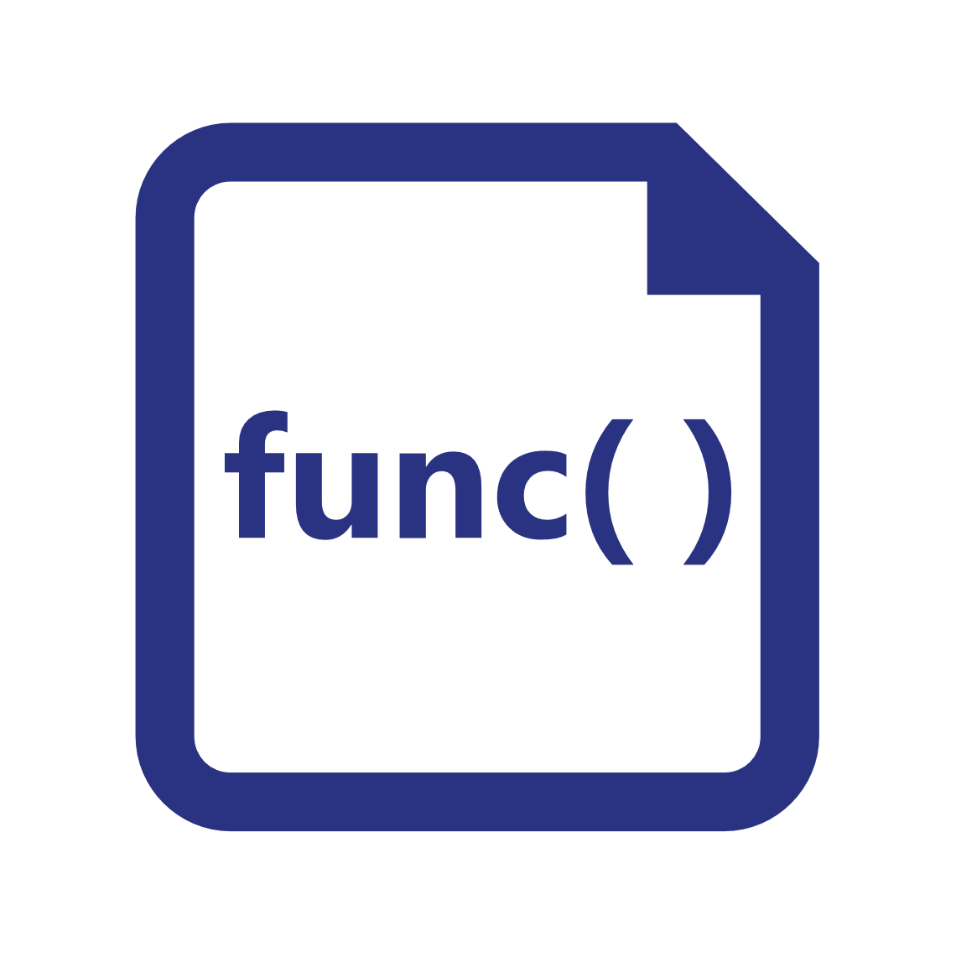




Azure Functions hosting
https://github.com/azure/azure-functions-host (+other repos)
Azure Functions host runtime
Azure Functions Core Tools
Azure Functions base Docker image
Azure Functions .NET Docker image
Azure Functions Node Docker image
●●●
Development
Hosting
Local dev machine
Azure Functions service
Azure Functions service
Azure Functions service
Core Tools + favorite editor
Consumption plan
App Service plan
Premium plan
Platform
+
●●●
Code or container
Code
Code or container
Code
App delivery
Windows, macOS, or Linux
Windows or Linux
Windows or Linux
Windows
OS
Notes:
Azure Functions are designed to be portable and to be hosted in a variety of places, including:
Azure Functions service by using Resource consumption, Premium, or App Service Plans
Internet of Things (IoT) devices

Slide 28



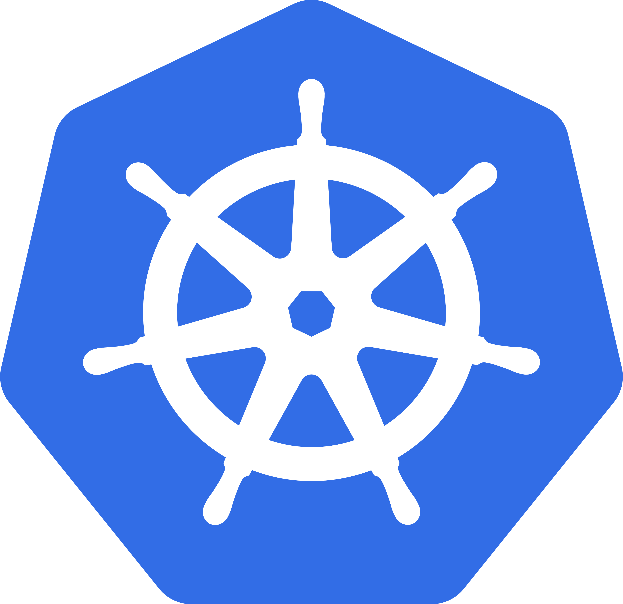
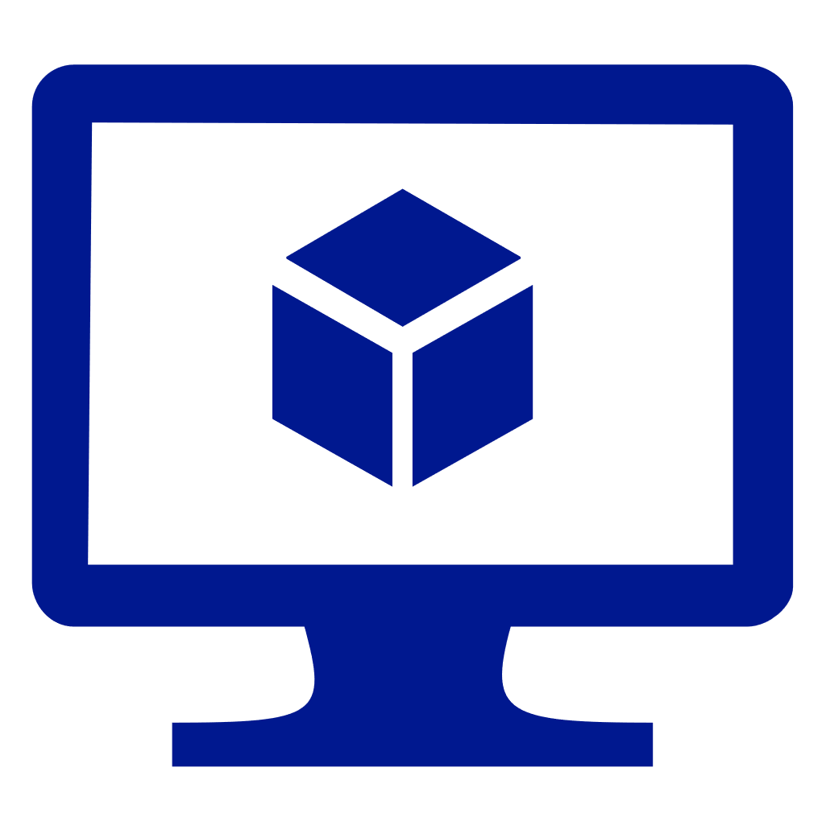

Azure Functions hosting (continued)
https://github.com/azure/azure-functions-host (+other repos)
Azure Functions host runtime
Azure Functions Core Tools
Azure Functions base Docker image
Azure Functions .NET Docker image
Azure Functions Node Docker image
●●●
Hosting
IoT devices
Additional Azure hosts
Non-Azure hosts
On-premises
Azure IoT Edge
AKS, Service Fabric Mesh, …
K8s, raw VMs, & more
App Service on Azure Stack
●●●
●●●
Platform
Container
Container
Container
Code
App delivery
Linux
Linux
Linux
Windows
OS
Notes:
Azure Functions are designed to be portable and to hosted in a variety of places, including:
Azure services that support containerization (Azure Kubernetes Service, Service Fabric, and Azure Container Instances)
Non-Azure container hosts (Kubernetes, Virtual Machines, other cloud providers)
On-premises by using App Service on Azure Stack

Slide 29
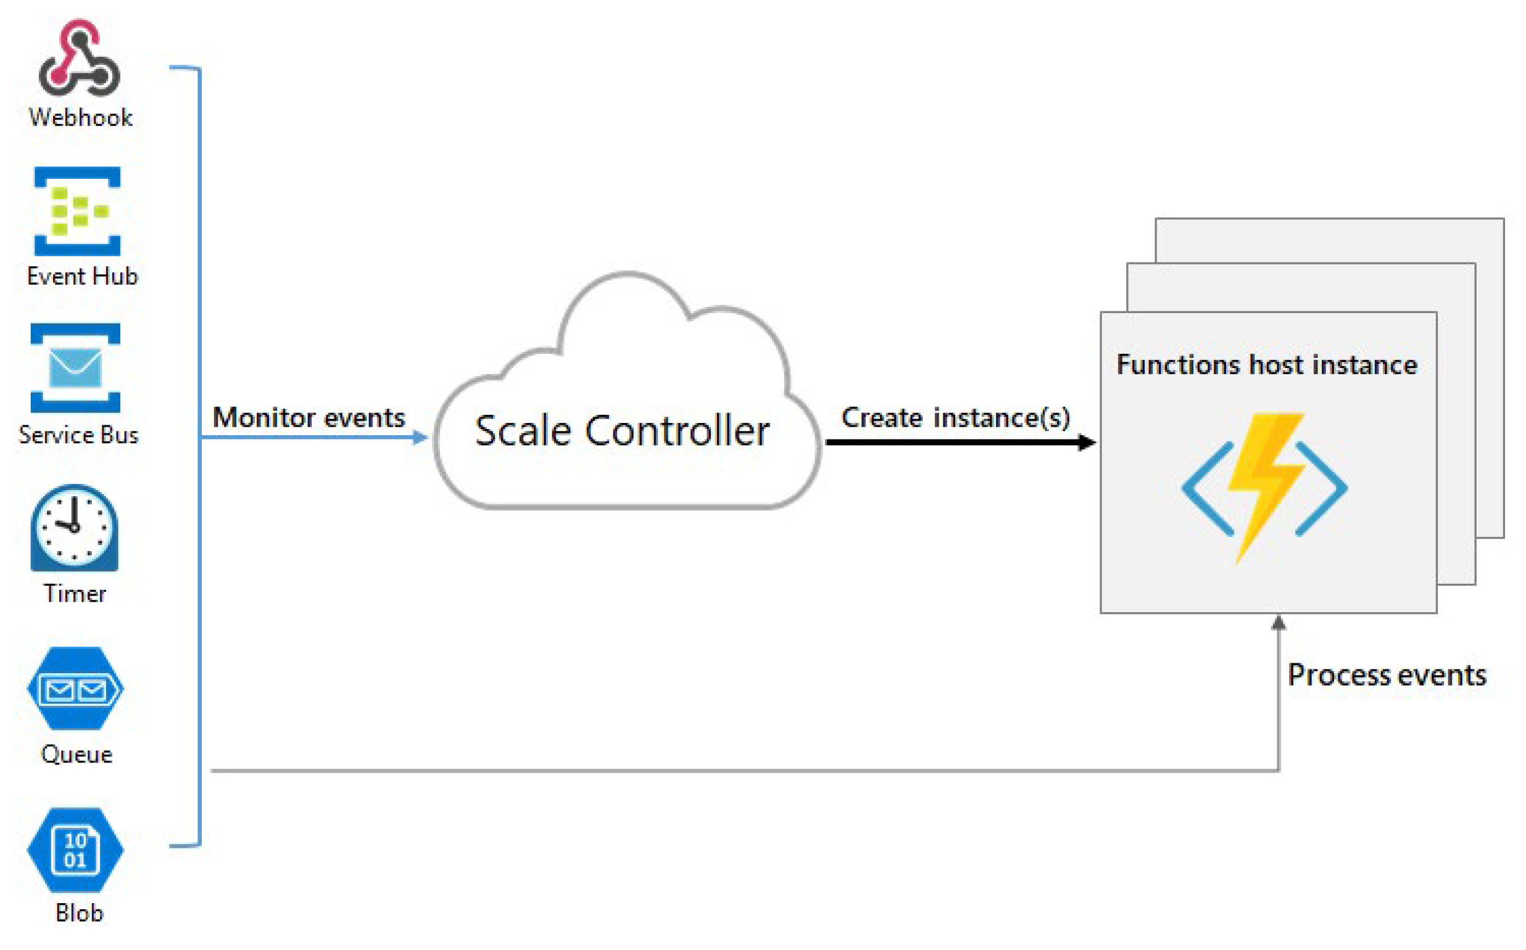
Runtime scaling
Notes:
Azure Functions uses a component called the scale controller to monitor the rate of events and determine whether to scale out or scale in. The scale controller uses heuristics for each trigger type. For example, when you're using an Azure Queue storage trigger, it scales based on the queue length and the age of the oldest queue message.
The unit of scale for Azure Functions is the function app. When the function app is scaled out, additional resources are allocated to run multiple instances of the Azure Functions host. Conversely, as compute demand is reduced, the scale controller removes function host instances. The number of instances is eventually scaled down to zero when no functions are running within a function app.
Scaling can vary on a number of factors, and scale differently based on the trigger and language selected. There are a few intricacies of scaling behaviors to be aware of:
A single function app only scales up to a maximum of 200 instances. A single instance may process more than one message or request at a time though, so there isn't a set limit on number of concurrent executions.
For HTTP triggers, new instances will only be allocated at most once every 1 second.
For non-HTTP triggers, new instances will only be allocated at most once every 30 seconds

Slide 30


Triggers
Execution
Service
Function app
Notes:
Triggers are what cause a function to run. A trigger defines how a function is invoked and a function must have exactly one trigger. Triggers have associated data, which is often provided as the payload of the function.

Slide 31
Trigger types
Triggers based on Azure services:
Cosmos DB
Blob and queues
Service Bus
Event Hub
Triggers based on common scenarios:
HTTP request
Scheduled timer
Triggers based on third-party services:
GitHub
And more…
Notes:
There are many types of triggers for Azure services including:
HTTPTrigger - Trigger the execution of your code by using an HTTP request.
TimerTrigger - Execute cleanup or other batch tasks on a predefined schedule.
GitHub webhook - Respond to events that occur in your GitHub repositories. Generic webhook - process webhook HTTP requests from any service that supports webhooks.
CosmosDBTrigger - Process Azure Cosmos DB documents when they are added or updated in collections in a NoSQL database.
BlobTrigger - Process Azure Storage blobs when they are added to containers. You might use this function for image resizing.
QueueTrigger - Respond to messages as they arrive in an Azure Storage queue.
EventHubTrigger - Respond to events delivered to an Azure Event Hub. Particularly useful in application instrumentation, user experience, or workflow processing, and Internet of Things (IoT) scenarios.
ServiceBusQueueTrigger - Connect your code to other Azure services or on-premises services by listening to message queues.
ServiceBusTopicTrigger - Connect your code to other Azure services or on-premises services by subscribing to topics.

Slide 32

Input and Output Bindings
Service
Input bindings
Output bindings
Output bindings
Trigger
Function app
Input bindings
Service
Service
Notes:
Input and output bindings provide a declarative way to connect to data from within your code. Bindings are optional and an Azure Function can have multiple input and output bindings.
Binding to a function is a way of declaratively connecting another resource to the function; bindings may be connected as input bindings, output bindings, or both. Data from bindings is provided to the function as parameters.

Slide 33
Bindings
Declarative way to connect to data from your code:
Connect to services without writing plumbing code
Service credentials are not stored in code
Bindings are optional
Function can have multiple input and output bindings
Output bindings can send data to Azure services such as:
Storage
Azure Cosmos DB
Service Bus
Notes:
Triggers and bindings let you avoid hard-coding the details of the services that you're working with. Your function receives data (for example, the content of a queue message) in function parameters. You send data (for example, to create a queue message) by using the return value of the function. In C# and C# script, alternative ways to send data are out parameters and collector objects.
All triggers and bindings have a direction property in the function.json file:
For triggers, the direction is always in
Input and output bindings use in and out
Some bindings support a special direction inout. If you use inout, only the Advanced editor is available via the Integrate tab in the portal.
When you use attributes in a class library to configure triggers and bindings, the direction is provided in an attribute constructor or inferred from the parameter type.

Slide 34



Trigger and Bindings example
L
Blobs
Azure Storage
Schedule trigger
Logs
Query docs
Function app
P
Cosmos DB trigger
Event Hubs
Notes:
In this example, the Function app is triggered by a recurring schedule (nightly) and queries Azure Cosmos DB for a set of documents. The function then processes the documents, outputs blobs to Azure Storage, and outputs logs to Event Hubs.

Slide 35


Integrating with Azure Virtual Network
Requires the Premium plan
Secures the inbound HTTP access to your app to one subnet in a Virtual Network
Allows secure outbound calls to resources in a Virtual Network
Internet
HTTP front-ends
Virtual Network
Functions runtime
Notes:
Under the Premium plan, Azure Functions has the same hosting capabilities as the Web Apps in Azure App Service. This means that Azure Functions also has the Virtual Network Integration feature.
When Virtual Network Integration is used with an Azure Virtual Network in the same region as your app, it requires you to use a delegated subnet with at least 32 addresses in it. You won’t be able to use the subnet for anything else. Outbound calls from your app will be made from the addresses in the delegated subnet. When you use this version of Virtual Network Integration, the calls are made from addresses in your Virtual Network.

Slide 36


Azure Virtual Network integration example
Premium App Service plan
Virtual Network Integration
Virtual Network
Internet
Virtual Machines
Function app
Notes:
Using addresses in your VNET enables your app to:
Make calls to service-endpoint secured services.
Access resources across Azure ExpressRoute connections.
Access resources in the Virtual Network that you are connected to.
Access resources across peered connections, including ExpressRoute connections.

Slide 37
Best practices
Avoid long-running functions:
Functions that run for a long time can time out
Use queues for cross-function communication:
If you require direct communication, consider Durable Functions or Azure Logic Apps
Write stateless functions:
Functions should be stateless and idempotent
State data should be associated with your input and output payloads
Code defensively:
Assume that your function might need to continue from a previous fail point
Notes:
Avoid long running functions
Large, long-running functions can cause unexpected time-out issues. A function can become large due to many Node.js dependencies. Importing dependencies can also cause increased load times that result in unexpected time-outs. Dependencies are loaded both explicitly and implicitly. A single module loaded by your code may load its own additional modules.
Cross function communication
Durable Functions and Azure Logic Apps are built to manage state transitions and communication between multiple functions. If you are not using Durable Functions or Logic Apps to integrate with multiple functions, it is generally a best practice to use storage queues for cross function communication. The main reason is storage queues are less costly and much easier to provision.
Write functions to be stateless
Functions should be stateless and idempotent if possible. Associate any required state information with your data. For example, an order being processed would likely have an associated state member. A function could process an order based on that state while the function itself remains stateless.
Write defensive functions
Assume that your function could encounter an exception at any time. Design your functions with the ability to continue from a previous fail point during the next execution.

Slide 38
Azure Functions: Developing Functions

Slide 39
Azure Functions in Visual Studio Code
Use the Azure Functions extension for Visual Studio Code to:
Build and run functions locally
Publish functions to Azure
Build C# pre-compiled class libraries
Build C# scripts by adjusting the extension settings
Use the many built-in features and extensions for Visual Studio Code to make development easier
Notes:
You can use the Azure Functions extension for Microsoft Visual Studio Code to locally develop functions and deploy them to Azure.
Using the Azure Functions extension, you can:
Edit, build, and run functions on your local development computer.
Publish your Azure Functions project directly to Azure.
Write your functions in various languages while utilizing the benefits of Visual Studio Code.

Slide 40
Azure Functions in Visual Studio
Visual Studio project type:
Develop, test, and deploy C# functions to Azure
Requires an Azure development workload installation
Use WebJobs attributes to configure functions in C#
Precompile C# functions:
Better cold-start performance
Notes:
Azure Functions is a built-in project type for Visual Studio that lets you develop, test, and deploy C# functions to Azure.
Using the Azure Functions project type enables you to:
Edit, build, and run functions on your local development computer.
Publish your Azure Functions project directly to Azure.
Use WebJobs attributes to declare function bindings directly in the C# code instead of maintaining a separate function.json for binding definitions.
Develop and deploy precompiled C# functions. Precompiled functions provide a better cold-start performance than C# script-based functions.
Code your functions in C# while retaining all the benefits of Visual Studio development.

Slide 41
DEMO
Creating an HTTP trigger function by using the Azure portal

Slide 42
Function code
using System;
using Microsoft.Azure.WebJobs;
using Microsoft.Azure.WebJobs.Host;
namespace FunctionApp1
{
public static class Function1
{
[FunctionName("QueueTriggerCSharp")]
public static void Run([QueueTrigger("myqueue-items", Connection = "QueueStorage")]string myQueueItem, TraceWriter log)
{
log.Info($"C# Queue trigger function processed: {myQueueItem}");
}
}
}
Notes:
The C# class represents a basic Queue storage triggered function.
A binding-specific attribute is applied to each binding parameter supplied to the entry point method. The attribute takes the binding information as parameters. In the previous example, the first parameter has a QueueTrigger attribute applied, indicating queue triggered function. The queue name and connection string setting name are passed as parameters to the QueueTrigger attribute.

Slide 43
Binding configuration
Name of input parameter
{
"bindings": [
{
"name": "order",
"type": "queueTrigger",
"direction": "in",
"queueName": "myqueue-items",
"connection": "MY_STORAGE_ACCT_APP_SETTING"
},
{
"name": "$return",
"type": "table",
"direction": "out",
"tableName": "outTable",
"connection": "MY_TABLE_STORAGE_ACCT_APP_SETTING"
}
]
}
Notes:
Suppose you want to write a new row to Azure Table storage whenever a new message appears in Azure Queue storage. You can implement this scenario by using an Azure Queue storage trigger and an Azure Table storage output binding.
The first element in the bindings array is the Queue storage trigger. The type and direction properties identify the trigger. The name property identifies the function parameter that receives the queue message content. The name of the queue to monitor is in queueName, and the connection string is in the app setting identified by connection.
The second element in the bindings array is the Azure Table Storage output binding. The type and direction properties identify the binding. The name property specifies how the function provides the new table row, in this case by using the function return value. The name of the table is in tableName, and the connection string is in the app setting identified by connection.
Note: The value of connection is the name of an app setting that contains the connection string, not the connection string itself. Bindings use connection strings stored in app settings to enforce the best practice, which is that function.json does not contain service secrets.

Slide 44
Binding-based code
#r "Newtonsoft.Json"
using Microsoft.Extensions.Logging;
using Newtonsoft.Json.Linq;
public static Person Run(JObject order, ILogger log)
{
return new Person() {
PartitionKey = "Orders",
RowKey = Guid.NewGuid().ToString(),
Name = order["Name"].ToString(),
MobileNumber = order["MobileNumber"].ToString()
};
}
Name of input parameter
Notes:
Here is C# script code that works with this trigger and binding. Notice that the name of the parameter that provides the queue message content is order. This name is required because the name property value in function.json is order.
The method takes an incoming queue message that is a JSON object, adds fields, and then writes to Table storage. The method's return value creates a new row in Table Storage.

Slide 45
Function folder structure
FunctionApp
host.json
FirstFunction
SecondFunction
SharedCode
function.json
run.csx
function.json
run.csx
bin
Notes:
The code for all the functions in a specific function app is located in a root project folder that contains a host configuration file and one or more subfolders.
Each subfolder contains the code for a separate function.
In version 2.x and newer of the Functions runtime, all functions in the function app must share the same language stack.

Slide 46
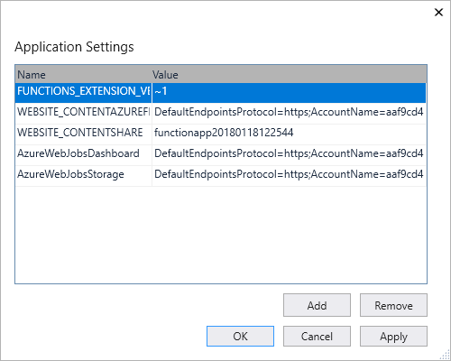
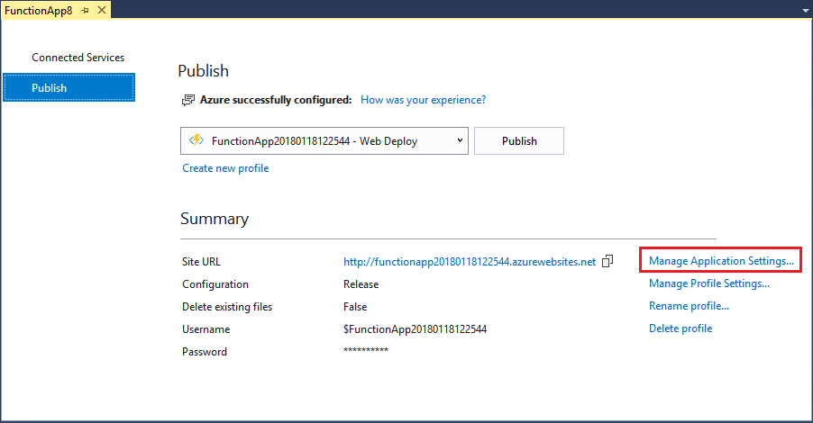
Function App settings
Notes:
Any settings that you added in the local.settings.json must be also added to the Function app in Azure. These settings are not uploaded automatically when you publish the project.
The easiest way to upload the required settings to your function app in Azure is to use the Manage Application Settings link that is displayed after you successfully publish your project.
You can also manage application settings in one of these other ways:
By using the Azure portal.
By using the --publish-local-settings publish option in the Azure Functions Core Tools.
By using the Azure CLI.

Slide 47
Azure Functions: Premium Plan

Slide 48
Functions Premium Plan Benefits
Perpetually warm instances to avoid any cold start
VNet connectivity
Unlimited execution duration (60 minutes guaranteed)
Premium instance sizes (one core, two core, and four core instances)
More predictable pricing
High-density app allocation for plans with multiple function apps
All function apps in a Premium plan share pre-warmed and active instances
When running JavaScript functions on a Premium plan, you should choose an instance that has fewer vCPUs
Notes:
The Azure Functions Premium plan (sometimes referred to as Elastic Premium plan) is a hosting option for function apps. The Premium plan provides features like VNet connectivity, no cold start, and premium hardware. Multiple function apps can be deployed to the same Premium plan, and the plan allows you to configure compute instance size, base plan size, and maximum plan size.
When you're using the Premium plan, instances of the Azure Functions host are added and removed based on the number of incoming events just like the Consumption plan. Premium plan supports the following features:
Perpetually warm instances to avoid any cold start
If no events and executions occur today in the Consumption plan, your app may scale in to zero instances. When new events come in, a new instance needs to be specialized with your app running on it. Specializing new instances may take some time depending on the app. This additional latency on the first call is often called app cold start.
In the Premium plan, you can have your app pre-warmed on a specified number of instances, up to your minimum plan size. Pre-warmed instances also let you pre-scale an app before high load. As the app scales out, it first scales into the pre-warmed instances. Additional instances continue to buffer out and warm immediately in preparation for the next scale operation. By having a buffer of pre-warmed instances, you can effectively avoid cold start latencies. Pre-warmed instances is a feature of the Premium plan, and you need to keep at least one instance running and available at all times the plan is active.
VNet connectivity
Azure Functions deployed to a Premium plan takes advantage of new VNet integration for web apps. When configured, your app can communicate with resources within your VNet or secured via service endpoints. IP restrictions are also available on the app to restrict incoming traffic.
When assigning a subnet to your function app in a Premium plan, you need a subnet with enough IP addresses for each potential instance. We require an IP block with at least 100 available addresses.
Unlimited execution duration (60 minutes guaranteed
Azure Functions in a Consumption plan are limited to 10 minutes for a single execution. In the Premium plan, the run duration defaults to 30 minutes to prevent runaway executions. However, you can modify the host.json configuration to make this unbounded for Premium plan apps (guaranteed 60 minutes)
Premium instance sizes (one core, two core, and four core instances)
When creating or scaling your plan, you can choose between three instance sizes. You will be billed for the total number of cores and memory consumed per second. Your app can automatically scale out to multiple instances as needed.
Running on a machine with more memory does not always mean that your function app will use all available memory.
For example, a JavaScript function app is constrained by the default memory limit in Node.js. To increase this fixed memory limit, add the app setting languageWorkers:node:arguments with a value of --max-old-space-size=<max memory in MB>.
More predictable pricing: in a Premium Plan, you pay for the vCPU duration and memory duration, rather than paying for a variable execution rate.
High-density app allocation for plans with multiple function apps
Instead of billing per execution and memory consumed, billing for the Premium plan is based on the number of core seconds and memory used across needed and pre-warmed instances. At least one instance must be warm at all times per plan. This means that there is a minimum monthly cost per active plan, regardless of the number of executions. Keep in mind that all function apps in a Premium plan share pre-warmed and active instances.
Consider the Azure Functions Premium plan in the following situations:
Your function apps run continuously, or nearly continuously.
You have a high number of small executions and have a high execution bill but low GB second bill in the Consumption plan.
You need more CPU or memory options than what is provided by the Consumption plan.
Your code needs to run longer than the maximum execution time allowed on the Consumption plan.
You require features that are only available on a Premium plan, such as virtual network connectivity.
When running JavaScript functions on a Premium plan, you should choose an instance that has fewer vCPUs

Slide 49
Azure Functions: Durable Functions

Slide 50
Durable Functions
Write stateful functions in a stateless environment
Manages state, checkpoints, and restarts
Defines an Orchestrator function
Workflows are defined in code
Calls other functions synchronously or asynchronously
Checkpoint progress whenever function awaits
Notes:
Durable Functions is an extension of Azure Functions and Azure WebJobs that lets you write stateful functions in a serverless environment. The extension manages state, checkpoints, and restarts for you.
The extension lets you define stateful workflows in a new type of function called an Orchestrator function. Here are some of the advantages of Orchestrator functions:
They define workflows in code. No JSON schemas or designers are needed.
They can call other functions synchronously and asynchronously. Output from called functions can be saved to local variables.
They automatically checkpoint their progress whenever the function awaits. Local state is never lost if the process recycles or the virtual machine (VM) reboots.
Note: Durable Functions is an advanced extension for Azure Functions that is not appropriate for all applications. The rest of this section assumes that you have a strong familiarity with Azure Functions concepts and the challenges involved in serverless application development.
The primary use case for Durable Functions is simplifying complex, stateful coordination problems in serverless applications. The following sections describe some typical application patterns that can benefit from Durable Functions.

Slide 51

Durable Function scenario - Chaining
Function chaining refers executing a sequence of functions in a particular order. Often, the output of one function needs to be applied to the input of another function.
F1
F2
F3
F4
Notes:
Function chaining refers to the pattern of executing a sequence of functions in a particular order. Often, the output of one function needs to be applied to the input of another function.

Slide 52
Durable Function scenario - Chaining code
public static async Task<object> Run(DurableOrchestrationContext ctx)
{
try
{
var x = await ctx.CallActivityAsync<object>("F1");
var y = await ctx.CallActivityAsync<object>("F2", x);
var z = await ctx.CallActivityAsync<object>("F3", y);
return await ctx.CallActivityAsync<object>("F4", z);
}
catch (Exception)
{
// error handling/compensation goes here
}
}
Notes:
The values "F1", "F2", "F3", and "F4" are the names of other functions in the function app. Control flow is implemented by using normal imperative coding constructs. That is, code executes top down and can involve existing language control flow semantics, like conditionals and loops. Error handling logic can be included in try/catch/finally blocks.
The ctx parameter (DurableOrchestrationContext) provides methods for invoking other functions by name, passing parameters, and returning function output. Each time the code calls await, the Durable Functions framework checkpoints the progress of the current function instance. If the process or VM recycles midway through the execution, the function instance resumes from the previous await call. We will cover more on this restart behavior later.

Slide 53
Durable Function scenario - Fan-out/fan-in
Fan-out/fan-in refers to the pattern of executing multiple functions in parallel, and then waiting for all to finish
F1
F3
F2
Notes:
Fan-out/fan-in refers to the pattern of executing multiple functions in parallel, and then waiting for all to finish. Often, some aggregation work is done on results returned from the functions.
With normal functions, fanning out can be done by having the function send multiple messages to a queue. However, fanning back in is much more challenging. You'd have to write code to track when the queue-triggered functions end and store function outputs. The Durable Functions extension handles this pattern with relatively simple code.

Slide 54
Durable Function scenario - Fan-out/fan-in code
public static async Task Run(DurableOrchestrationContext ctx)
{
var parallelTasks = new List<Task<int>>();
// get a list of N work items to process in parallel
object[] workBatch = await ctx.CallActivityAsync<object[]>("F1");
for (int i = 0; i < workBatch.Length; i++)
{
Task<int> task = ctx.CallActivityAsync<int>("F2", workBatch[i]);
parallelTasks.Add(task);
}
await Task.WhenAll(parallelTasks);
// aggregate all N outputs and send result to F3
int sum = parallelTasks.Sum(t => t.Result);
await ctx.CallActivityAsync("F3", sum);
}
Notes:
The fan-out work is distributed to multiple instances of function F2, and the work is tracked by using a dynamic list of tasks. The .NET Task.WhenAll API is called to wait for all the called functions to finish. Then the F2 function outputs are aggregated from the dynamic task list and passed on to the F3 function.
The automatic checkpointing that happens at the await call on Task.WhenAll ensures that any crash or reboot midway through does not require a restart of any already completed tasks.

Slide 55
Durable Function scenario - Async HTTP APIs
Durable Functions provides built-in APIs that simplify the code that you write for interacting with long-running function executions
Start
DoWork
GetStatus
Notes:
The third pattern is all about the problem of coordinating the state of long-running operations with external clients. A common way to implement this pattern is by having the long-running action triggered by an HTTP call, and then redirecting the client to a status endpoint that they can poll to learn when the operation completes.
Durable Functions provides built-in APIs that simplify the code you write for interacting with long-running function executions. After an instance is started, the extension exposes webhook HTTP APIs that query the Orchestrator function status. The following example shows the REST commands to start an Orchestrator and to query its status. For clarity, some details are omitted from the example.

Slide 56
Durable Function scenario - Async HTTP APIs response
> curl -X POST https://myfunc.azurewebsites.net/orchestrators/DoWork -H "Content-Length: 0" -i
HTTP/1.1 202 Accepted Content-Type: application/json
{ "id":"b79baf67f717453ca9e86c5da21e03ec", ... }
> curl https://myfunc.azurewebsites.net/admin/extensions/DurableTaskExtension/b79baf67f717453ca9e86c5da21e03ec -i
HTTP/1.1 202 Accepted Content-Type: application/json
{ "runtimeStatus":"Running", "lastUpdatedTime":"2017-03-16T21:20:47Z", ... }
> curl https://myfunc.azurewebsites.net/admin/extensions/DurableTaskExtension/b79baf67f717453ca9e86c5da21e03ec -i
HTTP/1.1 200 OK Content-Length: 175 Content-Type: application/json
{ "runtimeStatus":"Completed", "lastUpdatedTime":"2017-03-16T21:20:57Z", ... }
Notes:
Because the state is managed by the Durable Functions runtime, you don't have to implement your own status-tracking mechanism.

Slide 57
Durable Function scenario - Async HTTP APIs code
// HTTP-triggered function to start a new orchestrator function instance.
public static async Task<HttpResponseMessage> Run(
HttpRequestMessage req,
DurableOrchestrationClient starter,
string functionName,
ILogger log)
{
// Function name comes from the request URL.
// Function input comes from the request content.
dynamic eventData = await req.Content.ReadAsAsync<object>();
string instanceId = await starter.StartNewAsync(functionName, eventData);
log.LogInformation($"Started orchestration with ID = '{instanceId}'.");
return starter.CreateCheckStatusResponse(req, instanceId);
}
Notes:
Even though the Durable Functions extension has built-in webhooks for managing long-running orchestrations, you can implement this pattern yourself by using your own function triggers (such as HTTP, queue, or Event Hub) and the orchestrationClient binding. For example, you could use a queue message to trigger termination. Or you could use an HTTP trigger protected by an Azure Active Directory authentication policy instead of the built-in webhooks that use a generated key for authentication.
The DurableOrchestrationClient starter parameter is a value from the orchestrationClient output binding, which is part of the Durable Functions extension. It provides methods for starting, sending events to, terminating, and querying for new or existing Orchestrator function instances. In the previous example, an HTTP triggered-function takes in a functionName value from the incoming URL and passes that value to StartNewAsync. This binding API then returns a response that contains a Location header and additional information about the instance that can later be used to look up the status of the started instance or terminate it.

Slide 58
Durable Function scenario - Monitoring
The monitor pattern refers to a flexible recurring process in a workflow—for example, polling until certain conditions are met
Notes:
The monitor pattern refers to a flexible recurring process in a workflow—for example, polling until certain conditions are met. A regular timer-trigger can address a simple scenario, such as a periodic cleanup job, but its interval is static and managing instance lifetimes becomes complex. Durable Functions enables flexible recurrence intervals, task lifetime management, and the ability to create multiple monitor processes from a single orchestration.
An example would be reversing the earlier async HTTP API scenario. Instead of exposing an endpoint for an external client to monitor a long-running operation, the long-running monitor consumes an external endpoint, waiting for some state change.
Using Durable Functions, multiple monitors that observe arbitrary endpoints can be created in a few lines of code. The monitors can end execution when some condition is met, or be terminated by the DurableOrchestrationClient, and their wait interval can be changed based on some condition (that is, exponential backoff). The code on the next slide implements a basic monitor.

Slide 59
Durable Function scenario - Monitoring code
public static async Task Run(DurableOrchestrationContext ctx)
{
int jobId = ctx.GetInput<int>(); int pollingInterval = GetPollingInterval();
DateTime expiryTime = GetExpiryTime();
while (ctx.CurrentUtcDateTime < expiryTime)
{
var jobStatus = await ctx.CallActivityAsync<string>("GetJobStatus", jobId);
if (jobStatus == "Completed")
{ await ctx.CallActivityAsync("SendAlert", machineId); break; }
// Orchestration will sleep until this time
var nextCheck = ctx.CurrentUtcDateTime.AddSeconds(pollingInterval);
await ctx.CreateTimer(nextCheck, CancellationToken.None);
}
// Perform further work here, or let the orchestration end
}
Notes:
When a request is received, a new orchestration instance is created for that job ID. The instance polls a status until a condition is met and the loop is exited. A durable timer is used to control the polling interval. Further work can then be performed, or the orchestration can end. When the ctx.CurrentUtcDateTime exceeds the expiryTime, the monitor ends.

Slide 60



Durable Function scenario - Human interaction
Many processes involve human interaction. Automated processes must allow for human low availability, and they often do so by using time-outs and compensation logic.
ProcessApproval
RequestApproval
Escalate
Notes:
Many processes involve some kind of human interaction. The tricky thing about involving humans in an automated process is that people are not always as highly available and responsive as cloud services. Automated processes must allow for this, and they often do so by using timeouts and compensation logic.
One example of a business process that involves human interaction is an approval process. For example, approval from a manager might be required for an expense report that exceeds a certain amount. If the manager does not approve within 72 hours (maybe the manager went on vacation), an escalation process starts to get the approval from someone else (perhaps the manager's manager).
This pattern can be implemented by using an Orchestrator function. The Orchestrator would use a durable timer to request approval and escalate in case of timeout. It would wait for an external event, which would be the notification generated by some human interaction.

Slide 61
Durable Function scenario - Human interaction code
public static async Task Run(DurableOrchestrationContext ctx)
{
await ctx.CallActivityAsync("RequestApproval");
using (var timeoutCts = new CancellationTokenSource())
{
DateTime dueTime = ctx.CurrentUtcDateTime.AddHours(72);
Task durableTimeout = ctx.CreateTimer(dueTime, timeoutCts.Token);
Task<bool> approval = ctx.WaitForExternalEvent<bool>("ApprovalEvent");
if (approvalEvent == await Task.WhenAny(approvalEvent, durableTimeout))
{
timeoutCts.Cancel();
await ctx.CallActivityAsync("ProcessApproval", approval.Result);
} else
{ await ctx.CallActivityAsync("Escalate"); }
}
}
Notes:
The durable timer is created by calling ctx.CreateTimer. The notification is received by ctx.WaitForExternalEvent. And Task.WhenAny is called to decide whether to escalate (timeout happens first) or process approval (approval is received before time-out).

Slide 62
Durable Function scenario - Human interaction code (continued)
public static async Task Run(string instanceId, DurableOrchestrationClient client)
{
bool isApproved = true;
await client.RaiseEventAsync(instanceId, "ApprovalEvent", isApproved);
}
Notes:
An external client can deliver the event notification to a waiting Orchestrator function by using either the built-in HTTP APIs or by using DurableOrchestrationClient.RaiseEventAsync API from another function.

Slide 63
Azure Functions: Durable Entities

Slide 64
Entity functions
Tiny services that communicate via messages
All operations are guaranteed to execute serially
Function-based syntax entities
Class-based syntax entities
Notes:
Entities behave a bit like tiny services that communicate via messages. Each entity has a unique identity and an internal state (if it exists). Like services or objects, entities perform operations when prompted to do so. When an operation executes, it might update the internal state of the entity. It might also call external services and wait for a response. Entities communicate with other entities, orchestrations, and clients by using messages that are implicitly sent via reliable queues.
To prevent conflicts, all operations on a single entity are guaranteed to execute serially, that is, one after another.
Currently, the two distinct APIs for defining entities are:
Function-based syntax, where entities are represented as functions and operations are explicitly dispatched by the application. This syntax works well for entities with simple state, few operations, or a dynamic set of operations like in application frameworks. This syntax can be tedious to maintain because it doesn't catch type errors at compile time.
Class-based syntax (.NET only), where entities and operations are represented by classes and methods. This syntax produces more easily readable code and allows operations to be invoked in a type-safe way. The class-based syntax is a thin layer on top of the function-based syntax, so both variants can be used interchangeably in the same application.

Slide 65
Function-based syntax
[FunctionName("Counter")]
public static void Counter([EntityTrigger] IDurableEntityContext ctx)
{
switch (ctx.OperationName.ToLowerInvariant())
{
case "add":
ctx.SetState(ctx.GetState<int>() + ctx.GetInput<int>());
break;
case "reset":
ctx.SetState(0);
break;
case "get":
ctx.Return(ctx.GetState<int>());
break;
}
}
Notes:
The following code is an example of a simple Counter entity implemented as a durable function. This function defines three operations, add, reset, and get, each of which operates on an integer state.

Slide 66
Function-based syntax
[JsonObject(MemberSerialization.OptIn)]
public class Counter
{
[JsonProperty("value")]
public int CurrentValue { get; set; }
public void Add(int amount) => this.CurrentValue += amount;
public void Reset() => this.CurrentValue = 0;
public int Get() => this.CurrentValue;
[FunctionName(nameof(Counter))]
public static Task Run(
[EntityTrigger] IDurableEntityContext ctx) => ctx.DispatchAsync<Counter>();
}
Notes:
The following example is an equivalent implementation of the Counter entity using classes and methods.
The state of this entity is an object of type Counter, which contains a field that stores the current value of the counter. To persist this object in storage, it's serialized and deserialized by the Json.NET library.

Slide 67
Accessing entities
Calling vs. Signaling
Not all forms of communication are supported:
Clients: signal entities and read state
Orchestrations: signal entities and call entities
Within entites: signal entities
Notes:
Entities can be accessed using one-way or two-way communication. The following terminology distinguishes the two forms of communication:
Calling an entity uses two-way (round-trip) communication. You send an operation message to the entity, and then wait for the response message before you continue. The response message can provide a result value or an error result, such as a JavaScript error or a .NET exception. This result or error is then observed by the caller.
Signaling an entity uses one-way (fire and forget) communication. You send an operation message but don't wait for a response. While the message is guaranteed to be delivered eventually, the sender doesn't know when and can't observe any result value or errors.
Entities can be accessed from within client functions, from within orchestrator functions, or from within entity functions. Not all forms of communication are supported by all contexts:
From within clients, you can signal entities and you can read the entity state.
From within orchestrations, you can signal entities and you can call entities.
From within entities, you can signal entities.

Slide 68
Example: Client signals an entity
[FunctionName("AddFromQueue")]
public static Task Run(
[QueueTrigger("durable-function-trigger")] string input,
[DurableClient] IDurableEntityClient client)
{
// Entity operation input comes from the queue message content.
var entityId = new EntityId(nameof(Counter), "myCounter");
int amount = int.Parse(input); return client.SignalEntityAsync(entityId, "Add", amount);
}
Notes:
For simplicity, the following examples show the loosely typed syntax for accessing entities. In general, we recommend that you access entities through interfaces because it provides more type checking.
The term signal means that the entity API invocation is one-way and asynchronous. It's not possible for a client function to know when the entity has processed the operation. Also, the client function can't observe any result values or exceptions.

Slide 69
Example: Client reads an entity state
[FunctionName("QueryCounter")]
public static async Task<HttpResponseMessage> Run( [HttpTrigger(AuthorizationLevel.Function)] HttpRequestMessage req, [DurableClient] IDurableEntityClient client)
{
var entityId = new EntityId(nameof(Counter), "myCounter");
EntityStateResponse<JObject> stateResponse = await
client.ReadEntityStateAsync<JObject>(entityId);
return req.CreateResponse(HttpStatusCode.OK, stateResponse.EntityState); }
Notes:
Client functions can also query the state of an entity, as shown in the following example:
Entity state queries are sent to the Durable tracking store and return the entity's most recently persisted state. This state is always a "committed" state, that is, it's never a temporary intermediate state assumed in the middle of executing an operation. However, it's possible that this state is stale compared to the entity's in-memory state. Only orchestrations can read an entity's in-memory state, as described in the following section.

Slide 70
Example: Orchestration signals and calls an entity
[FunctionName("CounterOrchestration")]
public static async Task Run(
[OrchestrationTrigger] IDurableOrchestrationContext context)
{
var entityId = new EntityId(nameof(Counter), "myCounter");
// Two-way call to the entity which returns a value - awaits the response
int currentValue = await context.CallEntityAsync<int>(entityId, "Get"); if (currentValue < 10)
{
// One-way signal to the entity which updates the value - does not await a response
context.SignalEntity(entityId, "Add", 1);
}
}
Notes:
Orchestrator functions can access entities by using APIs on the orchestration trigger binding. The following example code shows an orchestrator function calling and signaling a Counter entity.
Only orchestrations are capable of calling entities and getting a response, which could be either a return value or an exception. Client functions that use the client binding can only signal entities.
Calling an entity from an orchestrator function is similar to calling an activity function from an orchestrator function. The main difference is that entity functions are durable objects with an address, which is the entity ID. Entity functions support specifying an operation name. Activity functions, on the other hand, are stateless and don't have the concept of operations.

Slide 71
Example: Entity signals an entity
case "add":
var currentValue = ctx.GetState<int>();
var amount = ctx.GetInput<int>();
if (currentValue < 100 && currentValue + amount >= 100)
{
ctx.SignalEntity(new EntityId("MonitorEntity", ""),
"milestone-reached", ctx.EntityKey);
}
ctx.SetState(currentValue + amount);
break;
Notes:
An entity function can send signals to other entities, or even itself, while it executes an operation. For example, we can modify the previous Counter entity example so that it sends a "milestone-reached" signal to some monitor entity when the counter reaches the value 100.

Slide 72
Entites vs. actors
Similarities
Use an entity ID
Serial
Created implicitly
Silently unloaded from memory
Differences
Prioritize durability
No timeouts
Messages sent reliably, in order
Only one-way messaging (aka signaling)
No deadlocks
Notes:
Many of the durable entities features are inspired by the actor model. If you're already familiar with actors, you might recognize many of the concepts described in this article. Durable entities are particularly similar to virtual actors, or grains, as popularized by the Orleans project. For example:
Durable entities are addressable via an entity ID.
Durable entity operations execute serially, one at a time, to prevent race conditions.
Durable entities are created implicitly when they're called or signaled.
When not executing operations, durable entities are silently unloaded from memory.
There are some important differences that are worth noting:
Durable entities prioritize durability over latency, and so might not be appropriate for applications with strict latency requirements.
Durable entities don't have built-in timeouts for messages. In Orleans, all messages time out after a configurable time. The default is 30 seconds.
Messages sent between entities are delivered reliably and in order. In Orleans, reliable or ordered delivery is supported for content sent through streams, but isn't guaranteed for all messages between grains.
Request-response patterns in entities are limited to orchestrations. From within entities, only one-way messaging (also known as signaling) is permitted, as in the original actor model, and unlike grains in Orleans.
Durable entities don't deadlock. In Orleans, deadlocks can occur and don't resolve until messages time out.
Durable entities can be used in conjunction with durable orchestrations and support distributed locking mechanisms.

Slide 73
Azure Functions: Security
Notes:
In many ways, planning for secure development, deployment, and operation of serverless functions is much the same as for any web-based or cloud hosted application. Azure App Service provides the hosting infrastructure for your function apps. This section provides security strategies for running your function code, and how App Service can help you secure your functions.
The platform components of App Service, including Azure VMs, storage, network connections, web frameworks, management and integration features, are actively secured and hardened. App Service goes through vigorous compliance checks on a continuous basis to make sure that:
Your app resources are secured from the other customers' Azure resources.
VM instances and runtime software are regularly updated to address newly discovered vulnerabilities.
Communication of secrets (such as connection strings) between your app and other Azure resources (such as SQL Database) stays within Azure and doesn't cross any network boundaries. Secrets are always encrypted when stored.
All communication over the App Service connectivity features, such as hybrid connection, is encrypted.
Connections with remote management tools like Azure PowerShell, Azure CLI, Azure SDKs, REST APIs, are all encrypted.
24-hour threat management protects the infrastructure and platform against malware, distributed denial-of-service (DDoS), man-in-the-middle (MITM), and other threats.

Slide 74
Operations: Security Center
Provides assessment of misconfiguration
Identifies widespread scanning and distributed attacks
https://docs.microsoft.com/en-us/azure/security-center/alerts-reference#alerts-azureappserv
Notes:
Security Center
Security Center integrates with your function app in the portal. It provides, for free, a quick assessment of potential configuration-related security vulnerabilities. Function apps running in a dedicated plan can also use the real-time security features of Security Center, for an additional cost.
Security Center uses the scale of the cloud to identify attacks targeting applications running over App Service. Attackers probe web applications to find and exploit weaknesses. Before being routed to specific environments, requests to applications running in Azure go through several gateways, where they're inspected and logged. This data is then used to identify exploits and attackers, and to learn new patterns that will be used later.
By using the visibility that Azure has as a cloud provider, Security Center analyzes App Service internal logs to identify attack methodology on multiple targets. For example, methodology includes widespread scanning and distributed attacks. This type of attack typically comes from a small subset of IPs, and shows patterns of crawling to similar endpoints on multiple hosts. The attacks are searching for a vulnerable page or plugin, and can't be identified from the standpoint of a single host.
If you're running a Windows-based App Service plan, Security Center also has access to the underlying sandboxes and VMs. Together with the log data mentioned above, the infrastructure can tell the story, from a new attack circulating in the wild to compromises in customer machines. Therefore, even if Security Center is deployed after a web app has been exploited, it may be able to detect ongoing attacks.
Log and monitor
One to detect attacks is through activity monitoring activity and logging analytics. Functions integrates with Application Insights to collects log, performance, and error data for your function app. Application Insights automatically detects performance anomalies and includes powerful analytics tools to help you diagnose issues and to understand how your functions are used.
Functions also integrates with Azure Monitor Logs to enable you to consolidate function app logs with system events for easier analysis. You can use diagnostic settings to configure streaming export of platform logs and metrics for your functions to the destination of your choice, such as a Logs Analytics workspace.
For enterprise-level threat detection and response automation, stream your logs and events to a Logs Analytics workspace. You can then connect Azure Sentinel to this workspace.
Require HTTPS
By default, clients can connect to function endpoints by using both HTTP or HTTPS. You should redirect HTTP to HTTPs because HTTPS uses the SSL/TLS protocol to provide a secure connection, which is both encrypted and authenticated.
When you require HTTPS, you should also Require the latest TLS version.
Function access keys
Functions lets you use keys to make it harder to access your HTTP function endpoints during development. Unless the HTTP access level on an HTTP triggered function is set to anonymous, requests must include an API access key in the request.
Authorization scopes (function-level)
There are two access scopes for function-level keys:
Function: These keys apply only to the specific functions under which they are defined. When used as an API key, these only allow access to that function.
Host: Keys with a host scope can be used to access all functions within the function app. When used as an API key, these allow access to any function within the function app.
Each key is named for reference, and there is a default key (named "default") at the function and host level. Function keys take precedence over host keys. When two keys are defined with the same name, the function key is always used.
Master key (admin-level)
Each function app also has an admin-level host key named _master. In addition to providing host-level access to all functions in the app, the master key also provides administrative access to the runtime REST APIs. This key cannot be revoked. When you set an access level of admin, requests must use the master key; any other key results in access failure.
Caution
Due to the elevated permissions in your function app granted by the master key, you should not share this key with third parties or distribute it in native client applications. Use caution when choosing the admin access level.
System key
Specific extensions may require a system-managed key to access webhook endpoints. System keys are designed for extension-specific function endpoints that called by internal components. For example, the Event Grid trigger requires that the subscription use a system key when calling the trigger endpoint. Durable Functions also uses system keys to call Durable Task extension APIs.
The scope of system keys is determined by the extension, but it generally applies to the entire function app. System keys can only be created by specific extensions, and you can't explicitly set their values. Like other keys, you can generate a new value for the key from the portal or by using the key APIs.
Keys comparison
The following table compares the uses for various kinds of access keys:
TABLE 1ActionScopeValid keysExecute a functionSpecific functionFunctionExecute a functionAny functionFunction or hostCall an admin endpointFunction appHost (master only)Call Durable Task extension APIsFunction app¹System²Call an extension-specific Webhook (internal)Function app¹system²
¹Scope determined by the extension. ²Specific names set by extension.
Authentication/authorization
While function keys can provide some mitigation for unwanted access, the only way to truly secure your function endpoints is by implementing positive authentication of clients accessing your functions. You can then make authorization decisions based on identity.
Enable App Service Authentication/Authorization
The App Service platform lets you use Azure Active Directory (AAD) and several third-party identity providers to authenticate clients. You can use this strategy to implement custom authorization rules for your functions, and you can work with user information from your function code.
Use Azure API Management (APIM) to authenticate requests
APIM provides a variety of API security options for incoming requests. With APIM in place, you can configure your function app to accept requests only from the IP address of your APIM instance.
Permissions
As with any application or service, the goal is run your function app with the lowest possible permissions.
User management permissions
Functions supports build-in Azure role-based access control (RBAC). RBAC roles supported by Functions are Contributor, Owner, and Reader.
Permissions are effective at the function app level. The Contributor role is required to perform most function app-level tasks. Only the Owner role can delete a function app.
Organize functions by privilege
Connection strings and other credentials stored in application settings gives all of the functions in the function app the same set of permissions in the associated resource. Consider minimizing the number of functions with access to specific credentials by moving functions that don't use those credentials to a separate function app. You can always use techniques such as function chaining to pass data between functions in different function apps.
Managed identities
A managed identity from Azure Active Directory (Azure AD) allows your app to easily access other Azure AD-protected resources such as Azure Key Vault. The identity is managed by the Azure platform and does not require you to provision or rotate any secrets.
Your application can be granted two types of identities:
A system-assigned identity is tied to your application and is deleted if your app is deleted. An app can only have one system-assigned identity.
A user-assigned identity is a standalone Azure resource that can be assigned to your app. An app can have multiple user-assigned identities.
Restrict CORS access
Cross-origin resource sharing (CORS) is a way to allow web apps running in another domain to make requests to your HTTP trigger endpoints. App Service provides built-in support for handing the required CORS headers in HTTP requests. CORS rules are defined on a function app level.
While it's tempting to use a wildcard that allows all sites to access your endpoint. But, this defeats the purpose of CORS, which is to help prevent cross-site scripting attacks. Instead, add a separate CORS entry for the domain of each web app that must access your endpoint.
Managing secrets
To be able to connect to the various services and resources need to run your code, function apps need to be able to access secrets, such as connection strings and service keys. This section describes how to store secrets required by your functions.
Never store secrets in your function code.
Application settings
By default, you store connection strings and secrets used by your function app and bindings as application settings. This makes these credentials available to both your function code and the various bindings used by the function. The application setting (key) name is used to retrieve the actual value, which is the secret.
For example, every function app requires an associated storage account, which is used by the runtime. By default, the connection to this storage account is stored in an application setting named AzureWebJobsStorage.
App settings and connection strings are stored encrypted in Azure. They're decrypted only before being injected into your app's process memory when the app starts. The encryption keys are rotated regularly. If you prefer to instead manage the secure storage of your secrets, the app setting should instead be references to Azure Key Vault.
Key Vault references
While application settings are sufficient for most many functions, you may want to share the same secrets across multiple services. In this case, redundant storage of secrets results in more potential vulnerabilities. A more secure approach is to a central secret storage service and use references to this service instead of the secrets themselves.
Azure Key Vault is a service that provides centralized secrets management, with full control over access policies and audit history. You can use a Key Vault reference in the place of a connection string or key in your application settings.
Set usage quotas
Consider setting a usage quota on functions running in a Consumption plan. When you set a daily GB-sec limit on the sum total execution of functions in your function app, execution is stopped when the limit is reached. This could potentially help mitigate against malicious code executing your functions.
The triggers and bindings used by your functions don't provide any additional data validation. Your code must validate any data received from a trigger or input binding. If an upstream service is compromised, you don't want unvalidated inputs flowing through your functions. For example, if your function stores data from an Azure Storage queue in a relational database, you must validate the data and parameterize your commands to avoid SQL injection attacks.
Don't assume that the data coming into your function has already been validated or sanitized. It's also a good idea to verify that the data being written to output bindings is valid.
Handle errors
While it seems basic, it's important to write good error handling in your functions. Unhandled errors bubble-up to the host and are handled by the runtime. Different bindings handle processing of errors differently.
Disable remote debugging
Make sure that remote debugging is disabled, except when you are actively debugging your functions. You can disable remote debugging in the General Settings tab of your function app Configuration in the portal.
Restrict CORS access
Azure Functions supports cross-origin resource sharing (CORS). CORS is configured in the portal and through the Azure CLI. The CORS allowed origins list applies at the function app level. With CORS enabled, responses include the Access-Control-Allow-Origin header. Don't use wildcards in your allowed origins list. Instead, list the specific domains from which you expect to get requests.
Store data encrypted
Azure Storage encrypts all data in a storage account at rest
By default, data is encrypted with Microsoft-managed keys. For additional control over encryption keys, you can supply customer-managed keys to use for encryption of blob and file data. These keys must be present in Azure Key Vault for Functions to be able to access the storage account.
Secure deployment
Azure Functions tooling an integration make it easy to publish local function project code to Azure. It's important to understand how deployment works when considering security for an Azure Functions topology.
Deployment credentials
App Service deployments require a set of deployment credentials. These deployment credentials are used to secure your function app deployments. Deployment credentials are managed by the App Service platform and are encrypted at rest.
There are two kinds of deployment credentials:
User-level credentials: one set of credentials for the entire Azure account. It can be used to deploy to App Service for any app, in any subscription, that the Azure account has permission to access. It's the default set that's surfaced in the portal GUI (such as the Overview and Properties of the app's resource page). When a user is granted app access via Role-Based Access Control (RBAC) or coadmin permissions, that user can use their own user-level credentials until the access is revoked. Do not share these credentials with other Azure users.
App-level credentials: one set of credentials for each app. It can be used to deploy to that app only. The credentials for each app are generated automatically at app creation. They can't be configured manually, but can be reset anytime. For a user to be granted access to app-level credentials via (RBAC), that user must be contributor or higher on the app (including Website Contributor built-in role). Readers are not allowed to publish, and can't access those credentials.
At this time, Key Vault isn't supported for deployment credentials.
Disable FTP
By default, each function app has an FTP endpoint enabled. The FTP endpoint is accessed using deployment credentials.
FTP isn't recommended for deploying your function code. FTP deployments are manual, and they require you to synchronize triggers.
When you're not planning on using FTP, you should disable it in the portal. If you do choose to use FTP, you should enforce FTPS.
Secure the scm endpoint
Every function app has a corresponding scm service endpoint that used by the Advanced Tools (Kudu) service for deployments and other App Service site extensions. The scm endpoint for a function app is always a URL in the form https://<FUNCTION_APP_NAME.scm.azurewebsites.net>. When you use network isolation to secure your functions, you must also account for this endpoint.
By having a separate scm endpoint, you can control deployments and other advanced tools functionalities for function app that are isolated or running in a virtual network. The scm endpoint supports both basic authentication (using deployment credentials) and single sign-on with your Azure portal credentials.
Continuous security validation
Since security needs to be considered a every step in the development process, it make sense to also implement security validations in a continuous deployment environment. This is sometimes called DevSecOps. Using Azure DevOps for your deployment pipeline let's you integrate validation into the deployment process.
Network security
Restricting network access to your function app lets you control who can access your functions endpoints. Functions leverages App Service infrastructure to enable your functions to access resources without using internet-routable addresses or to restrict internet access to a function endpoint.
Set access restrictions
Access restrictions allow you to define lists of allow/deny rules to control traffic to your app. Rules are evaluated in priority order. If there are no rules defined, then your app will accept traffic from any address.
Private site access
Private site access refers to making your app accessible only from a private network, such as an Azure virtual network.
Private site access is available in the Premium, Consumption, and App Service plans when service endpoints are configured.
Service endpoints can be configured on a per-app basis under Platform features > Networking > Configure Access Restrictions > Add Rule. Virtual networks can now be selected as a rule type.
For more information, see Virtual network service endpoints.
Keep in mind that with service endpoints, your function still has full outbound access to the internet, even with virtual network integration configured.
Private site access is also available within an App Service Environment that's configured with an internal load balancer (ILB). For more information, see Create and use an internal load balancer with an App Service Environment. Deploy your function app in isolation
Azure App Service Environment (ASE) provides a dedicated hosting environment in which to run your functions. ASE lets you configure a single front-end gateway that you can use to authenticate all incoming requests. For more information, see Configuring a Web Application Firewall (WAF) for App Service Environment.
Use a gateway service
Gateway services, such as Azure Application Gateway and Azure Front Door let you set up a Web Application Firewall (WAF). WAF rules are used to monitor or block detected attacks, which provide an extra layer of protection for your functions. To set up a WAF, your function app needs to be running in an ASE or using Private Endpoints (preview).

Slide 75
Operations: Log and monitor
Detect attacks through activity monitoring
Application Insights detects performance anomalies
Consolidate function app logs with system events
Azure Security Baseline for Functions
Notes:
Log and monitor
One to detect attacks is through activity monitoring activity and logging analytics. Functions integrates with Application Insights to collects log, performance, and error data for your function app. Application Insights automatically detects performance anomalies and includes powerful analytics tools to help you diagnose issues and to understand how your functions are used.
Functions also integrates with Azure Monitor Logs to enable you to consolidate function app logs with system events for easier analysis. You can use diagnostic settings to configure streaming export of platform logs and metrics for your functions to the destination of your choice, such as a Logs Analytics workspace.
For enterprise-level threat detection and response automation, stream your logs and events to a Logs Analytics workspace. You can then connect Azure Sentinel to this workspace.
Additionally, Microsoft offers security baselines for security recomendations: open https://docs.microsoft.com/en-us/azure/azure-functions/security-baseline#logging-and-monitoring
Require HTTPS
By default, clients can connect to function endpoints by using both HTTP or HTTPS. You should redirect HTTP to HTTPs because HTTPS uses the SSL/TLS protocol to provide a secure connection, which is both encrypted and authenticated.
When you require HTTPS, you should also Require the latest TLS version.
Function access keys
Functions lets you use keys to make it harder to access your HTTP function endpoints during development. Unless the HTTP access level on an HTTP triggered function is set to anonymous, requests must include an API access key in the request.
Authorization scopes (function-level)
There are two access scopes for function-level keys:
Function: These keys apply only to the specific functions under which they are defined. When used as an API key, these only allow access to that function.
Host: Keys with a host scope can be used to access all functions within the function app. When used as an API key, these allow access to any function within the function app.
Each key is named for reference, and there is a default key (named "default") at the function and host level. Function keys take precedence over host keys. When two keys are defined with the same name, the function key is always used.
Master key (admin-level)
Each function app also has an admin-level host key named _master. In addition to providing host-level access to all functions in the app, the master key also provides administrative access to the runtime REST APIs. This key cannot be revoked. When you set an access level of admin, requests must use the master key; any other key results in access failure.
Caution
Due to the elevated permissions in your function app granted by the master key, you should not share this key with third parties or distribute it in native client applications. Use caution when choosing the admin access level.
System key
Specific extensions may require a system-managed key to access webhook endpoints. System keys are designed for extension-specific function endpoints that called by internal components. For example, the Event Grid trigger requires that the subscription use a system key when calling the trigger endpoint. Durable Functions also uses system keys to call Durable Task extension APIs.
The scope of system keys is determined by the extension, but it generally applies to the entire function app. System keys can only be created by specific extensions, and you can't explicitly set their values. Like other keys, you can generate a new value for the key from the portal or by using the key APIs.
Keys comparison
The following table compares the uses for various kinds of access keys:
TABLE 1ActionScopeValid keysExecute a functionSpecific functionFunctionExecute a functionAny functionFunction or hostCall an admin endpointFunction appHost (master only)Call Durable Task extension APIsFunction app¹System²Call an extension-specific Webhook (internal)Function app¹system²
¹Scope determined by the extension. ²Specific names set by extension.
Authentication/authorization
While function keys can provide some mitigation for unwanted access, the only way to truly secure your function endpoints is by implementing positive authentication of clients accessing your functions. You can then make authorization decisions based on identity.
Enable App Service Authentication/Authorization
The App Service platform lets you use Azure Active Directory (AAD) and several third-party identity providers to authenticate clients. You can use this strategy to implement custom authorization rules for your functions, and you can work with user information from your function code.
Use Azure API Management (APIM) to authenticate requests
APIM provides a variety of API security options for incoming requests. With APIM in place, you can configure your function app to accept requests only from the IP address of your APIM instance.
Permissions
As with any application or service, the goal is run your function app with the lowest possible permissions.
User management permissions
Functions supports build-in Azure role-based access control (RBAC). RBAC roles supported by Functions are Contributor, Owner, and Reader.
Permissions are effective at the function app level. The Contributor role is required to perform most function app-level tasks. Only the Owner role can delete a function app.
Organize functions by privilege
Connection strings and other credentials stored in application settings gives all of the functions in the function app the same set of permissions in the associated resource. Consider minimizing the number of functions with access to specific credentials by moving functions that don't use those credentials to a separate function app. You can always use techniques such as function chaining to pass data between functions in different function apps.
Managed identities
A managed identity from Azure Active Directory (Azure AD) allows your app to easily access other Azure AD-protected resources such as Azure Key Vault. The identity is managed by the Azure platform and does not require you to provision or rotate any secrets.
Your application can be granted two types of identities:
A system-assigned identity is tied to your application and is deleted if your app is deleted. An app can only have one system-assigned identity.
A user-assigned identity is a standalone Azure resource that can be assigned to your app. An app can have multiple user-assigned identities.
Restrict CORS access
Cross-origin resource sharing (CORS) is a way to allow web apps running in another domain to make requests to your HTTP trigger endpoints. App Service provides built-in support for handing the required CORS headers in HTTP requests. CORS rules are defined on a function app level.
While it's tempting to use a wildcard that allows all sites to access your endpoint. But, this defeats the purpose of CORS, which is to help prevent cross-site scripting attacks. Instead, add a separate CORS entry for the domain of each web app that must access your endpoint.
Managing secrets
To be able to connect to the various services and resources need to run your code, function apps need to be able to access secrets, such as connection strings and service keys. This section describes how to store secrets required by your functions.
Never store secrets in your function code.
Application settings
By default, you store connection strings and secrets used by your function app and bindings as application settings. This makes these credentials available to both your function code and the various bindings used by the function. The application setting (key) name is used to retrieve the actual value, which is the secret.
For example, every function app requires an associated storage account, which is used by the runtime. By default, the connection to this storage account is stored in an application setting named AzureWebJobsStorage.
App settings and connection strings are stored encrypted in Azure. They're decrypted only before being injected into your app's process memory when the app starts. The encryption keys are rotated regularly. If you prefer to instead manage the secure storage of your secrets, the app setting should instead be references to Azure Key Vault.
Key Vault references
While application settings are sufficient for most many functions, you may want to share the same secrets across multiple services. In this case, redundant storage of secrets results in more potential vulnerabilities. A more secure approach is to a central secret storage service and use references to this service instead of the secrets themselves.
Azure Key Vault is a service that provides centralized secrets management, with full control over access policies and audit history. You can use a Key Vault reference in the place of a connection string or key in your application settings.
Set usage quotas
Consider setting a usage quota on functions running in a Consumption plan. When you set a daily GB-sec limit on the sum total execution of functions in your function app, execution is stopped when the limit is reached. This could potentially help mitigate against malicious code executing your functions.
The triggers and bindings used by your functions don't provide any additional data validation. Your code must validate any data received from a trigger or input binding. If an upstream service is compromised, you don't want unvalidated inputs flowing through your functions. For example, if your function stores data from an Azure Storage queue in a relational database, you must validate the data and parameterize your commands to avoid SQL injection attacks.
Don't assume that the data coming into your function has already been validated or sanitized. It's also a good idea to verify that the data being written to output bindings is valid.
Handle errors
While it seems basic, it's important to write good error handling in your functions. Unhandled errors bubble-up to the host and are handled by the runtime. Different bindings handle processing of errors differently.
Disable remote debugging
Make sure that remote debugging is disabled, except when you are actively debugging your functions. You can disable remote debugging in the General Settings tab of your function app Configuration in the portal.
Restrict CORS access
Azure Functions supports cross-origin resource sharing (CORS). CORS is configured in the portal and through the Azure CLI. The CORS allowed origins list applies at the function app level. With CORS enabled, responses include the Access-Control-Allow-Origin header. Don't use wildcards in your allowed origins list. Instead, list the specific domains from which you expect to get requests.
Store data encrypted
Azure Storage encrypts all data in a storage account at rest
By default, data is encrypted with Microsoft-managed keys. For additional control over encryption keys, you can supply customer-managed keys to use for encryption of blob and file data. These keys must be present in Azure Key Vault for Functions to be able to access the storage account.
Secure deployment
Azure Functions tooling an integration make it easy to publish local function project code to Azure. It's important to understand how deployment works when considering security for an Azure Functions topology.
Deployment credentials
App Service deployments require a set of deployment credentials. These deployment credentials are used to secure your function app deployments. Deployment credentials are managed by the App Service platform and are encrypted at rest.
There are two kinds of deployment credentials:
User-level credentials: one set of credentials for the entire Azure account. It can be used to deploy to App Service for any app, in any subscription, that the Azure account has permission to access. It's the default set that's surfaced in the portal GUI (such as the Overview and Properties of the app's resource page). When a user is granted app access via Role-Based Access Control (RBAC) or coadmin permissions, that user can use their own user-level credentials until the access is revoked. Do not share these credentials with other Azure users.
App-level credentials: one set of credentials for each app. It can be used to deploy to that app only. The credentials for each app are generated automatically at app creation. They can't be configured manually, but can be reset anytime. For a user to be granted access to app-level credentials via (RBAC), that user must be contributor or higher on the app (including Website Contributor built-in role). Readers are not allowed to publish, and can't access those credentials.
At this time, Key Vault isn't supported for deployment credentials.
Disable FTP
By default, each function app has an FTP endpoint enabled. The FTP endpoint is accessed using deployment credentials.
FTP isn't recommended for deploying your function code. FTP deployments are manual, and they require you to synchronize triggers.
When you're not planning on using FTP, you should disable it in the portal. If you do choose to use FTP, you should enforce FTPS.
Secure the scm endpoint
Every function app has a corresponding scm service endpoint that used by the Advanced Tools (Kudu) service for deployments and other App Service site extensions. The scm endpoint for a function app is always a URL in the form https://<FUNCTION_APP_NAME.scm.azurewebsites.net>. When you use network isolation to secure your functions, you must also account for this endpoint.
By having a separate scm endpoint, you can control deployments and other advanced tools functionalities for function app that are isolated or running in a virtual network. The scm endpoint supports both basic authentication (using deployment credentials) and single sign-on with your Azure portal credentials.
Continuous security validation
Since security needs to be considered a every step in the development process, it make sense to also implement security validations in a continuous deployment environment. This is sometimes called DevSecOps. Using Azure DevOps for your deployment pipeline let's you integrate validation into the deployment process.
Network security
Restricting network access to your function app lets you control who can access your functions endpoints. Functions leverages App Service infrastructure to enable your functions to access resources without using internet-routable addresses or to restrict internet access to a function endpoint.
Set access restrictions
Access restrictions allow you to define lists of allow/deny rules to control traffic to your app. Rules are evaluated in priority order. If there are no rules defined, then your app will accept traffic from any address.
Private site access
Private site access refers to making your app accessible only from a private network, such as an Azure virtual network.
Private site access is available in the Premium, Consumption, and App Service plans when service endpoints are configured.
Service endpoints can be configured on a per-app basis under Platform features > Networking > Configure Access Restrictions > Add Rule. Virtual networks can now be selected as a rule type.
For more information, see Virtual network service endpoints.
Keep in mind that with service endpoints, your function still has full outbound access to the internet, even with virtual network integration configured.
Private site access is also available within an App Service Environment that's configured with an internal load balancer (ILB). For more information, see Create and use an internal load balancer with an App Service Environment. Deploy your function app in isolation
Azure App Service Environment (ASE) provides a dedicated hosting environment in which to run your functions. ASE lets you configure a single front-end gateway that you can use to authenticate all incoming requests. For more information, see Configuring a Web Application Firewall (WAF) for App Service Environment.
Use a gateway service
Gateway services, such as Azure Application Gateway and Azure Front Door let you set up a Web Application Firewall (WAF). WAF rules are used to monitor or block detected attacks, which provide an extra layer of protection for your functions. To set up a WAF, your function app needs to be running in an ASE or using Private Endpoints (preview).

Slide 76
Operations: Require HTTPS
No need to use application middleware
Remember to enforce TLS version 1.2
App Service offers free SSL certificates
Pro-tip: importing certificates from Azure Key Vault eases resource movement
Notes:
Require HTTPS
By default, clients can connect to function endpoints by using both HTTP or HTTPS. You should redirect HTTP to HTTPs because HTTPS uses the SSL/TLS protocol to provide a secure connection, which is both encrypted and authenticated.
When you require HTTPS, you should also Require the latest TLS version.
App Service lets you secure your apps with HTTPS. When your app is created, its default domain name (<app_name>.azurewebsites.net) is already accessible using HTTPS. If you configure a custom domain for your app, you should also secure it with a TLS/SSL certificate so that client browsers can make secured HTTPS connections to your custom domain. There are several types of certificates supported by App Service:
Free App Service Managed Certificate
App Service certificate
Third-party certificate
Certificate imported from Azure Key Vault
Function access keys
Functions lets you use keys to make it harder to access your HTTP function endpoints during development. Unless the HTTP access level on an HTTP triggered function is set to anonymous, requests must include an API access key in the request.
Authorization scopes (function-level)
There are two access scopes for function-level keys:
Function: These keys apply only to the specific functions under which they are defined. When used as an API key, these only allow access to that function.
Host: Keys with a host scope can be used to access all functions within the function app. When used as an API key, these allow access to any function within the function app.
Each key is named for reference, and there is a default key (named "default") at the function and host level. Function keys take precedence over host keys. When two keys are defined with the same name, the function key is always used.
Master key (admin-level)
Each function app also has an admin-level host key named _master. In addition to providing host-level access to all functions in the app, the master key also provides administrative access to the runtime REST APIs. This key cannot be revoked. When you set an access level of admin, requests must use the master key; any other key results in access failure.
Caution
Due to the elevated permissions in your function app granted by the master key, you should not share this key with third parties or distribute it in native client applications. Use caution when choosing the admin access level.
System key
Specific extensions may require a system-managed key to access webhook endpoints. System keys are designed for extension-specific function endpoints that called by internal components. For example, the Event Grid trigger requires that the subscription use a system key when calling the trigger endpoint. Durable Functions also uses system keys to call Durable Task extension APIs.
The scope of system keys is determined by the extension, but it generally applies to the entire function app. System keys can only be created by specific extensions, and you can't explicitly set their values. Like other keys, you can generate a new value for the key from the portal or by using the key APIs.
Keys comparison
The following table compares the uses for various kinds of access keys:
TABLE 1ActionScopeValid keysExecute a functionSpecific functionFunctionExecute a functionAny functionFunction or hostCall an admin endpointFunction appHost (master only)Call Durable Task extension APIsFunction app¹System²Call an extension-specific Webhook (internal)Function app¹system²
¹Scope determined by the extension. ²Specific names set by extension.
Authentication/authorization
While function keys can provide some mitigation for unwanted access, the only way to truly secure your function endpoints is by implementing positive authentication of clients accessing your functions. You can then make authorization decisions based on identity.
Enable App Service Authentication/Authorization
The App Service platform lets you use Azure Active Directory (AAD) and several third-party identity providers to authenticate clients. You can use this strategy to implement custom authorization rules for your functions, and you can work with user information from your function code.
Use Azure API Management (APIM) to authenticate requests
APIM provides a variety of API security options for incoming requests. With APIM in place, you can configure your function app to accept requests only from the IP address of your APIM instance.
Permissions
As with any application or service, the goal is run your function app with the lowest possible permissions.
User management permissions
Functions supports build-in Azure role-based access control (RBAC). RBAC roles supported by Functions are Contributor, Owner, and Reader.
Permissions are effective at the function app level. The Contributor role is required to perform most function app-level tasks. Only the Owner role can delete a function app.
Organize functions by privilege
Connection strings and other credentials stored in application settings gives all of the functions in the function app the same set of permissions in the associated resource. Consider minimizing the number of functions with access to specific credentials by moving functions that don't use those credentials to a separate function app. You can always use techniques such as function chaining to pass data between functions in different function apps.
Managed identities
A managed identity from Azure Active Directory (Azure AD) allows your app to easily access other Azure AD-protected resources such as Azure Key Vault. The identity is managed by the Azure platform and does not require you to provision or rotate any secrets.
Your application can be granted two types of identities:
A system-assigned identity is tied to your application and is deleted if your app is deleted. An app can only have one system-assigned identity.
A user-assigned identity is a standalone Azure resource that can be assigned to your app. An app can have multiple user-assigned identities.
Restrict CORS access
Cross-origin resource sharing (CORS) is a way to allow web apps running in another domain to make requests to your HTTP trigger endpoints. App Service provides built-in support for handing the required CORS headers in HTTP requests. CORS rules are defined on a function app level.
While it's tempting to use a wildcard that allows all sites to access your endpoint. But, this defeats the purpose of CORS, which is to help prevent cross-site scripting attacks. Instead, add a separate CORS entry for the domain of each web app that must access your endpoint.
Managing secrets
To be able to connect to the various services and resources need to run your code, function apps need to be able to access secrets, such as connection strings and service keys. This section describes how to store secrets required by your functions.
Never store secrets in your function code.
Application settings
By default, you store connection strings and secrets used by your function app and bindings as application settings. This makes these credentials available to both your function code and the various bindings used by the function. The application setting (key) name is used to retrieve the actual value, which is the secret.
For example, every function app requires an associated storage account, which is used by the runtime. By default, the connection to this storage account is stored in an application setting named AzureWebJobsStorage.
App settings and connection strings are stored encrypted in Azure. They're decrypted only before being injected into your app's process memory when the app starts. The encryption keys are rotated regularly. If you prefer to instead manage the secure storage of your secrets, the app setting should instead be references to Azure Key Vault.
Key Vault references
While application settings are sufficient for most many functions, you may want to share the same secrets across multiple services. In this case, redundant storage of secrets results in more potential vulnerabilities. A more secure approach is to a central secret storage service and use references to this service instead of the secrets themselves.
Azure Key Vault is a service that provides centralized secrets management, with full control over access policies and audit history. You can use a Key Vault reference in the place of a connection string or key in your application settings.
Set usage quotas
Consider setting a usage quota on functions running in a Consumption plan. When you set a daily GB-sec limit on the sum total execution of functions in your function app, execution is stopped when the limit is reached. This could potentially help mitigate against malicious code executing your functions.
The triggers and bindings used by your functions don't provide any additional data validation. Your code must validate any data received from a trigger or input binding. If an upstream service is compromised, you don't want unvalidated inputs flowing through your functions. For example, if your function stores data from an Azure Storage queue in a relational database, you must validate the data and parameterize your commands to avoid SQL injection attacks.
Don't assume that the data coming into your function has already been validated or sanitized. It's also a good idea to verify that the data being written to output bindings is valid.
Handle errors
While it seems basic, it's important to write good error handling in your functions. Unhandled errors bubble-up to the host and are handled by the runtime. Different bindings handle processing of errors differently.
Disable remote debugging
Make sure that remote debugging is disabled, except when you are actively debugging your functions. You can disable remote debugging in the General Settings tab of your function app Configuration in the portal.
Restrict CORS access
Azure Functions supports cross-origin resource sharing (CORS). CORS is configured in the portal and through the Azure CLI. The CORS allowed origins list applies at the function app level. With CORS enabled, responses include the Access-Control-Allow-Origin header. Don't use wildcards in your allowed origins list. Instead, list the specific domains from which you expect to get requests.
Store data encrypted
Azure Storage encrypts all data in a storage account at rest
By default, data is encrypted with Microsoft-managed keys. For additional control over encryption keys, you can supply customer-managed keys to use for encryption of blob and file data. These keys must be present in Azure Key Vault for Functions to be able to access the storage account.
Secure deployment
Azure Functions tooling an integration make it easy to publish local function project code to Azure. It's important to understand how deployment works when considering security for an Azure Functions topology.
Deployment credentials
App Service deployments require a set of deployment credentials. These deployment credentials are used to secure your function app deployments. Deployment credentials are managed by the App Service platform and are encrypted at rest.
There are two kinds of deployment credentials:
User-level credentials: one set of credentials for the entire Azure account. It can be used to deploy to App Service for any app, in any subscription, that the Azure account has permission to access. It's the default set that's surfaced in the portal GUI (such as the Overview and Properties of the app's resource page). When a user is granted app access via Role-Based Access Control (RBAC) or coadmin permissions, that user can use their own user-level credentials until the access is revoked. Do not share these credentials with other Azure users.
App-level credentials: one set of credentials for each app. It can be used to deploy to that app only. The credentials for each app are generated automatically at app creation. They can't be configured manually, but can be reset anytime. For a user to be granted access to app-level credentials via (RBAC), that user must be contributor or higher on the app (including Website Contributor built-in role). Readers are not allowed to publish, and can't access those credentials.
At this time, Key Vault isn't supported for deployment credentials.
Disable FTP
By default, each function app has an FTP endpoint enabled. The FTP endpoint is accessed using deployment credentials.
FTP isn't recommended for deploying your function code. FTP deployments are manual, and they require you to synchronize triggers.
When you're not planning on using FTP, you should disable it in the portal. If you do choose to use FTP, you should enforce FTPS.
Secure the scm endpoint
Every function app has a corresponding scm service endpoint that used by the Advanced Tools (Kudu) service for deployments and other App Service site extensions. The scm endpoint for a function app is always a URL in the form https://<FUNCTION_APP_NAME.scm.azurewebsites.net>. When you use network isolation to secure your functions, you must also account for this endpoint.
By having a separate scm endpoint, you can control deployments and other advanced tools functionalities for function app that are isolated or running in a virtual network. The scm endpoint supports both basic authentication (using deployment credentials) and single sign-on with your Azure portal credentials.
Continuous security validation
Since security needs to be considered a every step in the development process, it make sense to also implement security validations in a continuous deployment environment. This is sometimes called DevSecOps. Using Azure DevOps for your deployment pipeline let's you integrate validation into the deployment process.
Network security
Restricting network access to your function app lets you control who can access your functions endpoints. Functions leverages App Service infrastructure to enable your functions to access resources without using internet-routable addresses or to restrict internet access to a function endpoint.
Set access restrictions
Access restrictions allow you to define lists of allow/deny rules to control traffic to your app. Rules are evaluated in priority order. If there are no rules defined, then your app will accept traffic from any address.
Private site access
Private site access refers to making your app accessible only from a private network, such as an Azure virtual network.
Private site access is available in the Premium, Consumption, and App Service plans when service endpoints are configured.
Service endpoints can be configured on a per-app basis under Platform features > Networking > Configure Access Restrictions > Add Rule. Virtual networks can now be selected as a rule type.
For more information, see Virtual network service endpoints.
Keep in mind that with service endpoints, your function still has full outbound access to the internet, even with virtual network integration configured.
Private site access is also available within an App Service Environment that's configured with an internal load balancer (ILB). For more information, see Create and use an internal load balancer with an App Service Environment. Deploy your function app in isolation
Azure App Service Environment (ASE) provides a dedicated hosting environment in which to run your functions. ASE lets you configure a single front-end gateway that you can use to authenticate all incoming requests. For more information, see Configuring a Web Application Firewall (WAF) for App Service Environment.
Use a gateway service
Gateway services, such as Azure Application Gateway and Azure Front Door let you set up a Web Application Firewall (WAF). WAF rules are used to monitor or block detected attacks, which provide an extra layer of protection for your functions. To set up a WAF, your function app needs to be running in an ASE or using Private Endpoints (preview).

Slide 77
Operations: Access keys
Function/host keys for external access
_master provides administrative access
System keys are for internal components
Notes:
Function access keys
Functions lets you use keys to make it harder to access your HTTP function endpoints during development. Unless the HTTP access level on an HTTP triggered function is set to anonymous, requests must include an API access key in the request.
Authorization scopes (function-level)
There are two access scopes for function-level keys:
Function: These keys apply only to the specific functions under which they are defined. When used as an API key, these only allow access to that function.
Host: Keys with a host scope can be used to access all functions within the function app. When used as an API key, these allow access to any function within the function app.
Each key is named for reference, and there is a default key (named "default") at the function and host level. Function keys take precedence over host keys. When two keys are defined with the same name, the function key is always used.
Master key (admin-level)
Each function app also has an admin-level host key named _master. In addition to providing host-level access to all functions in the app, the master key also provides administrative access to the runtime REST APIs. This key cannot be revoked. When you set an access level of admin, requests must use the master key; any other key results in access failure.
Caution
Due to the elevated permissions in your function app granted by the master key, you should not share this key with third parties or distribute it in native client applications. Use caution when choosing the admin access level.
System key
Specific extensions may require a system-managed key to access webhook endpoints. System keys are designed for extension-specific function endpoints that called by internal components. For example, the Event Grid trigger requires that the subscription use a system key when calling the trigger endpoint. Durable Functions also uses system keys to call Durable Task extension APIs.
The scope of system keys is determined by the extension, but it generally applies to the entire function app. System keys can only be created by specific extensions, and you can't explicitly set their values. Like other keys, you can generate a new value for the key from the portal or by using the key APIs.
Authentication/authorization
While function keys can provide some mitigation for unwanted access, the only way to truly secure your function endpoints is by implementing positive authentication of clients accessing your functions. You can then make authorization decisions based on identity.
Enable App Service Authentication/Authorization
The App Service platform lets you use Azure Active Directory (AAD) and several third-party identity providers to authenticate clients. You can use this strategy to implement custom authorization rules for your functions, and you can work with user information from your function code.
Use Azure API Management (APIM) to authenticate requests
APIM provides a variety of API security options for incoming requests. With APIM in place, you can configure your function app to accept requests only from the IP address of your APIM instance.
Permissions
As with any application or service, the goal is run your function app with the lowest possible permissions.
User management permissions
Functions supports build-in Azure role-based access control (RBAC). RBAC roles supported by Functions are Contributor, Owner, and Reader.
Permissions are effective at the function app level. The Contributor role is required to perform most function app-level tasks. Only the Owner role can delete a function app.
Organize functions by privilege
Connection strings and other credentials stored in application settings gives all of the functions in the function app the same set of permissions in the associated resource. Consider minimizing the number of functions with access to specific credentials by moving functions that don't use those credentials to a separate function app. You can always use techniques such as function chaining to pass data between functions in different function apps.
Managed identities
A managed identity from Azure Active Directory (Azure AD) allows your app to easily access other Azure AD-protected resources such as Azure Key Vault. The identity is managed by the Azure platform and does not require you to provision or rotate any secrets.
Your application can be granted two types of identities:
A system-assigned identity is tied to your application and is deleted if your app is deleted. An app can only have one system-assigned identity.
A user-assigned identity is a standalone Azure resource that can be assigned to your app. An app can have multiple user-assigned identities.
Restrict CORS access
Cross-origin resource sharing (CORS) is a way to allow web apps running in another domain to make requests to your HTTP trigger endpoints. App Service provides built-in support for handing the required CORS headers in HTTP requests. CORS rules are defined on a function app level.
While it's tempting to use a wildcard that allows all sites to access your endpoint. But, this defeats the purpose of CORS, which is to help prevent cross-site scripting attacks. Instead, add a separate CORS entry for the domain of each web app that must access your endpoint.
Managing secrets
To be able to connect to the various services and resources need to run your code, function apps need to be able to access secrets, such as connection strings and service keys. This section describes how to store secrets required by your functions.
Never store secrets in your function code.
Application settings
By default, you store connection strings and secrets used by your function app and bindings as application settings. This makes these credentials available to both your function code and the various bindings used by the function. The application setting (key) name is used to retrieve the actual value, which is the secret.
For example, every function app requires an associated storage account, which is used by the runtime. By default, the connection to this storage account is stored in an application setting named AzureWebJobsStorage.
App settings and connection strings are stored encrypted in Azure. They're decrypted only before being injected into your app's process memory when the app starts. The encryption keys are rotated regularly. If you prefer to instead manage the secure storage of your secrets, the app setting should instead be references to Azure Key Vault.
Key Vault references
While application settings are sufficient for most many functions, you may want to share the same secrets across multiple services. In this case, redundant storage of secrets results in more potential vulnerabilities. A more secure approach is to a central secret storage service and use references to this service instead of the secrets themselves.
Azure Key Vault is a service that provides centralized secrets management, with full control over access policies and audit history. You can use a Key Vault reference in the place of a connection string or key in your application settings.
Set usage quotas
Consider setting a usage quota on functions running in a Consumption plan. When you set a daily GB-sec limit on the sum total execution of functions in your function app, execution is stopped when the limit is reached. This could potentially help mitigate against malicious code executing your functions.
The triggers and bindings used by your functions don't provide any additional data validation. Your code must validate any data received from a trigger or input binding. If an upstream service is compromised, you don't want unvalidated inputs flowing through your functions. For example, if your function stores data from an Azure Storage queue in a relational database, you must validate the data and parameterize your commands to avoid SQL injection attacks.
Don't assume that the data coming into your function has already been validated or sanitized. It's also a good idea to verify that the data being written to output bindings is valid.
Handle errors
While it seems basic, it's important to write good error handling in your functions. Unhandled errors bubble-up to the host and are handled by the runtime. Different bindings handle processing of errors differently.
Disable remote debugging
Make sure that remote debugging is disabled, except when you are actively debugging your functions. You can disable remote debugging in the General Settings tab of your function app Configuration in the portal.
Restrict CORS access
Azure Functions supports cross-origin resource sharing (CORS). CORS is configured in the portal and through the Azure CLI. The CORS allowed origins list applies at the function app level. With CORS enabled, responses include the Access-Control-Allow-Origin header. Don't use wildcards in your allowed origins list. Instead, list the specific domains from which you expect to get requests.
Store data encrypted
Azure Storage encrypts all data in a storage account at rest
By default, data is encrypted with Microsoft-managed keys. For additional control over encryption keys, you can supply customer-managed keys to use for encryption of blob and file data. These keys must be present in Azure Key Vault for Functions to be able to access the storage account.
Secure deployment
Azure Functions tooling an integration make it easy to publish local function project code to Azure. It's important to understand how deployment works when considering security for an Azure Functions topology.
Deployment credentials
App Service deployments require a set of deployment credentials. These deployment credentials are used to secure your function app deployments. Deployment credentials are managed by the App Service platform and are encrypted at rest.
There are two kinds of deployment credentials:
User-level credentials: one set of credentials for the entire Azure account. It can be used to deploy to App Service for any app, in any subscription, that the Azure account has permission to access. It's the default set that's surfaced in the portal GUI (such as the Overview and Properties of the app's resource page). When a user is granted app access via Role-Based Access Control (RBAC) or coadmin permissions, that user can use their own user-level credentials until the access is revoked. Do not share these credentials with other Azure users.
App-level credentials: one set of credentials for each app. It can be used to deploy to that app only. The credentials for each app are generated automatically at app creation. They can't be configured manually, but can be reset anytime. For a user to be granted access to app-level credentials via (RBAC), that user must be contributor or higher on the app (including Website Contributor built-in role). Readers are not allowed to publish, and can't access those credentials.
At this time, Key Vault isn't supported for deployment credentials.
Disable FTP
By default, each function app has an FTP endpoint enabled. The FTP endpoint is accessed using deployment credentials.
FTP isn't recommended for deploying your function code. FTP deployments are manual, and they require you to synchronize triggers.
When you're not planning on using FTP, you should disable it in the portal. If you do choose to use FTP, you should enforce FTPS.
Secure the scm endpoint
Every function app has a corresponding scm service endpoint that used by the Advanced Tools (Kudu) service for deployments and other App Service site extensions. The scm endpoint for a function app is always a URL in the form https://<FUNCTION_APP_NAME.scm.azurewebsites.net>. When you use network isolation to secure your functions, you must also account for this endpoint.
By having a separate scm endpoint, you can control deployments and other advanced tools functionalities for function app that are isolated or running in a virtual network. The scm endpoint supports both basic authentication (using deployment credentials) and single sign-on with your Azure portal credentials.
Continuous security validation
Since security needs to be considered a every step in the development process, it make sense to also implement security validations in a continuous deployment environment. This is sometimes called DevSecOps. Using Azure DevOps for your deployment pipeline let's you integrate validation into the deployment process.
Network security
Restricting network access to your function app lets you control who can access your functions endpoints. Functions leverages App Service infrastructure to enable your functions to access resources without using internet-routable addresses or to restrict internet access to a function endpoint.
Set access restrictions
Access restrictions allow you to define lists of allow/deny rules to control traffic to your app. Rules are evaluated in priority order. If there are no rules defined, then your app will accept traffic from any address.
Private site access
Private site access refers to making your app accessible only from a private network, such as an Azure virtual network.
Private site access is available in the Premium, Consumption, and App Service plans when service endpoints are configured.
Service endpoints can be configured on a per-app basis under Platform features > Networking > Configure Access Restrictions > Add Rule. Virtual networks can now be selected as a rule type.
For more information, see Virtual network service endpoints.
Keep in mind that with service endpoints, your function still has full outbound access to the internet, even with virtual network integration configured.
Private site access is also available within an App Service Environment that's configured with an internal load balancer (ILB). For more information, see Create and use an internal load balancer with an App Service Environment. Deploy your function app in isolation
Azure App Service Environment (ASE) provides a dedicated hosting environment in which to run your functions. ASE lets you configure a single front-end gateway that you can use to authenticate all incoming requests. For more information, see Configuring a Web Application Firewall (WAF) for App Service Environment.
Use a gateway service
Gateway services, such as Azure Application Gateway and Azure Front Door let you set up a Web Application Firewall (WAF). WAF rules are used to monitor or block detected attacks, which provide an extra layer of protection for your functions. To set up a WAF, your function app needs to be running in an ASE or using Private Endpoints (preview).

Slide 78
Operations: Access keys comparison
Scenario | Scope | Possible keys to use
Execute a function | Specific function | Function
Execute a function | Any function | Function or host
Call an admin endpoint | Function app | Master key
Call Durable Task extension APIs | Function app | System
Call an extension-specific webhook (internal) | Function app | System
Notes:
Authentication/authorization
While function keys can provide some mitigation for unwanted access, the only way to truly secure your function endpoints is by implementing positive authentication of clients accessing your functions. You can then make authorization decisions based on identity.
Enable App Service Authentication/Authorization
The App Service platform lets you use Azure Active Directory (AAD) and several third-party identity providers to authenticate clients. You can use this strategy to implement custom authorization rules for your functions, and you can work with user information from your function code.
Use Azure API Management (APIM) to authenticate requests
APIM provides a variety of API security options for incoming requests. With APIM in place, you can configure your function app to accept requests only from the IP address of your APIM instance.
Permissions
As with any application or service, the goal is run your function app with the lowest possible permissions.
User management permissions
Functions supports build-in Azure role-based access control (RBAC). RBAC roles supported by Functions are Contributor, Owner, and Reader.
Permissions are effective at the function app level. The Contributor role is required to perform most function app-level tasks. Only the Owner role can delete a function app.
Organize functions by privilege
Connection strings and other credentials stored in application settings gives all of the functions in the function app the same set of permissions in the associated resource. Consider minimizing the number of functions with access to specific credentials by moving functions that don't use those credentials to a separate function app. You can always use techniques such as function chaining to pass data between functions in different function apps.
Managed identities
A managed identity from Azure Active Directory (Azure AD) allows your app to easily access other Azure AD-protected resources such as Azure Key Vault. The identity is managed by the Azure platform and does not require you to provision or rotate any secrets.
Your application can be granted two types of identities:
A system-assigned identity is tied to your application and is deleted if your app is deleted. An app can only have one system-assigned identity.
A user-assigned identity is a standalone Azure resource that can be assigned to your app. An app can have multiple user-assigned identities.
Restrict CORS access
Cross-origin resource sharing (CORS) is a way to allow web apps running in another domain to make requests to your HTTP trigger endpoints. App Service provides built-in support for handing the required CORS headers in HTTP requests. CORS rules are defined on a function app level.
While it's tempting to use a wildcard that allows all sites to access your endpoint. But, this defeats the purpose of CORS, which is to help prevent cross-site scripting attacks. Instead, add a separate CORS entry for the domain of each web app that must access your endpoint.
Managing secrets
To be able to connect to the various services and resources need to run your code, function apps need to be able to access secrets, such as connection strings and service keys. This section describes how to store secrets required by your functions.
Never store secrets in your function code.
Application settings
By default, you store connection strings and secrets used by your function app and bindings as application settings. This makes these credentials available to both your function code and the various bindings used by the function. The application setting (key) name is used to retrieve the actual value, which is the secret.
For example, every function app requires an associated storage account, which is used by the runtime. By default, the connection to this storage account is stored in an application setting named AzureWebJobsStorage.
App settings and connection strings are stored encrypted in Azure. They're decrypted only before being injected into your app's process memory when the app starts. The encryption keys are rotated regularly. If you prefer to instead manage the secure storage of your secrets, the app setting should instead be references to Azure Key Vault.
Key Vault references
While application settings are sufficient for most many functions, you may want to share the same secrets across multiple services. In this case, redundant storage of secrets results in more potential vulnerabilities. A more secure approach is to a central secret storage service and use references to this service instead of the secrets themselves.
Azure Key Vault is a service that provides centralized secrets management, with full control over access policies and audit history. You can use a Key Vault reference in the place of a connection string or key in your application settings.
Set usage quotas
Consider setting a usage quota on functions running in a Consumption plan. When you set a daily GB-sec limit on the sum total execution of functions in your function app, execution is stopped when the limit is reached. This could potentially help mitigate against malicious code executing your functions.
The triggers and bindings used by your functions don't provide any additional data validation. Your code must validate any data received from a trigger or input binding. If an upstream service is compromised, you don't want unvalidated inputs flowing through your functions. For example, if your function stores data from an Azure Storage queue in a relational database, you must validate the data and parameterize your commands to avoid SQL injection attacks.
Don't assume that the data coming into your function has already been validated or sanitized. It's also a good idea to verify that the data being written to output bindings is valid.
Handle errors
While it seems basic, it's important to write good error handling in your functions. Unhandled errors bubble-up to the host and are handled by the runtime. Different bindings handle processing of errors differently.
Disable remote debugging
Make sure that remote debugging is disabled, except when you are actively debugging your functions. You can disable remote debugging in the General Settings tab of your function app Configuration in the portal.
Restrict CORS access
Azure Functions supports cross-origin resource sharing (CORS). CORS is configured in the portal and through the Azure CLI. The CORS allowed origins list applies at the function app level. With CORS enabled, responses include the Access-Control-Allow-Origin header. Don't use wildcards in your allowed origins list. Instead, list the specific domains from which you expect to get requests.
Store data encrypted
Azure Storage encrypts all data in a storage account at rest
By default, data is encrypted with Microsoft-managed keys. For additional control over encryption keys, you can supply customer-managed keys to use for encryption of blob and file data. These keys must be present in Azure Key Vault for Functions to be able to access the storage account.
Secure deployment
Azure Functions tooling an integration make it easy to publish local function project code to Azure. It's important to understand how deployment works when considering security for an Azure Functions topology.
Deployment credentials
App Service deployments require a set of deployment credentials. These deployment credentials are used to secure your function app deployments. Deployment credentials are managed by the App Service platform and are encrypted at rest.
There are two kinds of deployment credentials:
User-level credentials: one set of credentials for the entire Azure account. It can be used to deploy to App Service for any app, in any subscription, that the Azure account has permission to access. It's the default set that's surfaced in the portal GUI (such as the Overview and Properties of the app's resource page). When a user is granted app access via Role-Based Access Control (RBAC) or coadmin permissions, that user can use their own user-level credentials until the access is revoked. Do not share these credentials with other Azure users.
App-level credentials: one set of credentials for each app. It can be used to deploy to that app only. The credentials for each app are generated automatically at app creation. They can't be configured manually, but can be reset anytime. For a user to be granted access to app-level credentials via (RBAC), that user must be contributor or higher on the app (including Website Contributor built-in role). Readers are not allowed to publish, and can't access those credentials.
At this time, Key Vault isn't supported for deployment credentials.
Disable FTP
By default, each function app has an FTP endpoint enabled. The FTP endpoint is accessed using deployment credentials.
FTP isn't recommended for deploying your function code. FTP deployments are manual, and they require you to synchronize triggers.
When you're not planning on using FTP, you should disable it in the portal. If you do choose to use FTP, you should enforce FTPS.
Secure the scm endpoint
Every function app has a corresponding scm service endpoint that used by the Advanced Tools (Kudu) service for deployments and other App Service site extensions. The scm endpoint for a function app is always a URL in the form https://<FUNCTION_APP_NAME.scm.azurewebsites.net>. When you use network isolation to secure your functions, you must also account for this endpoint.
By having a separate scm endpoint, you can control deployments and other advanced tools functionalities for function app that are isolated or running in a virtual network. The scm endpoint supports both basic authentication (using deployment credentials) and single sign-on with your Azure portal credentials.
Continuous security validation
Since security needs to be considered a every step in the development process, it make sense to also implement security validations in a continuous deployment environment. This is sometimes called DevSecOps. Using Azure DevOps for your deployment pipeline let's you integrate validation into the deployment process.
Network security
Restricting network access to your function app lets you control who can access your functions endpoints. Functions leverages App Service infrastructure to enable your functions to access resources without using internet-routable addresses or to restrict internet access to a function endpoint.
Set access restrictions
Access restrictions allow you to define lists of allow/deny rules to control traffic to your app. Rules are evaluated in priority order. If there are no rules defined, then your app will accept traffic from any address.
Private site access
Private site access refers to making your app accessible only from a private network, such as an Azure virtual network.
Private site access is available in the Premium, Consumption, and App Service plans when service endpoints are configured.
Service endpoints can be configured on a per-app basis under Platform features > Networking > Configure Access Restrictions > Add Rule. Virtual networks can now be selected as a rule type.
For more information, see Virtual network service endpoints.
Keep in mind that with service endpoints, your function still has full outbound access to the internet, even with virtual network integration configured.
Private site access is also available within an App Service Environment that's configured with an internal load balancer (ILB). For more information, see Create and use an internal load balancer with an App Service Environment. Deploy your function app in isolation
Azure App Service Environment (ASE) provides a dedicated hosting environment in which to run your functions. ASE lets you configure a single front-end gateway that you can use to authenticate all incoming requests. For more information, see Configuring a Web Application Firewall (WAF) for App Service Environment.
Use a gateway service
Gateway services, such as Azure Application Gateway and Azure Front Door let you set up a Web Application Firewall (WAF). WAF rules are used to monitor or block detected attacks, which provide an extra layer of protection for your functions. To set up a WAF, your function app needs to be running in an ASE or using Private Endpoints (preview).

Slide 79
Operations: Authentication
Enable App Service Authentication/Authorization
Use Azure API Management
Notes:
Authentication/authorization
While function keys can provide some mitigation for unwanted access, the only way to truly secure your function endpoints is by implementing positive authentication of clients accessing your functions. You can then make authorization decisions based on identity.
Enable App Service Authentication/Authorization
The App Service platform lets you use Azure Active Directory (AAD) and several third-party identity providers to authenticate clients. You can use this strategy to implement custom authorization rules for your functions, and you can work with user information from your function code.
Let me show you a code snippet on how you may work with the client identities: https://docs.microsoft.com/en-us/azure/azure-functions/functions-bindings-http-webhook-trigger?tabs=csharp#working-with-client-identities
Use Azure API Management (APIM) to authenticate requests
APIM provides a variety of API security options for incoming requests. With APIM in place, you can configure your function app to accept requests only from the IP address of your APIM instance and also add a plethora of policies to limit request rate and much more.
Permissions
As with any application or service, the goal is run your function app with the lowest possible permissions.
User management permissions
Functions supports build-in Azure role-based access control (RBAC). RBAC roles supported by Functions are Contributor, Owner, and Reader.
Permissions are effective at the function app level. The Contributor role is required to perform most function app-level tasks. Only the Owner role can delete a function app.
Organize functions by privilege
Connection strings and other credentials stored in application settings gives all of the functions in the function app the same set of permissions in the associated resource. Consider minimizing the number of functions with access to specific credentials by moving functions that don't use those credentials to a separate function app. You can always use techniques such as function chaining to pass data between functions in different function apps.
Managed identities
A managed identity from Azure Active Directory (Azure AD) allows your app to easily access other Azure AD-protected resources such as Azure Key Vault. The identity is managed by the Azure platform and does not require you to provision or rotate any secrets.
Your application can be granted two types of identities:
A system-assigned identity is tied to your application and is deleted if your app is deleted. An app can only have one system-assigned identity.
A user-assigned identity is a standalone Azure resource that can be assigned to your app. An app can have multiple user-assigned identities.
Restrict CORS access
Cross-origin resource sharing (CORS) is a way to allow web apps running in another domain to make requests to your HTTP trigger endpoints. App Service provides built-in support for handing the required CORS headers in HTTP requests. CORS rules are defined on a function app level.
While it's tempting to use a wildcard that allows all sites to access your endpoint. But, this defeats the purpose of CORS, which is to help prevent cross-site scripting attacks. Instead, add a separate CORS entry for the domain of each web app that must access your endpoint.
Managing secrets
To be able to connect to the various services and resources need to run your code, function apps need to be able to access secrets, such as connection strings and service keys. This section describes how to store secrets required by your functions.
Never store secrets in your function code.
Application settings
By default, you store connection strings and secrets used by your function app and bindings as application settings. This makes these credentials available to both your function code and the various bindings used by the function. The application setting (key) name is used to retrieve the actual value, which is the secret.
For example, every function app requires an associated storage account, which is used by the runtime. By default, the connection to this storage account is stored in an application setting named AzureWebJobsStorage.
App settings and connection strings are stored encrypted in Azure. They're decrypted only before being injected into your app's process memory when the app starts. The encryption keys are rotated regularly. If you prefer to instead manage the secure storage of your secrets, the app setting should instead be references to Azure Key Vault.
Key Vault references
While application settings are sufficient for most many functions, you may want to share the same secrets across multiple services. In this case, redundant storage of secrets results in more potential vulnerabilities. A more secure approach is to a central secret storage service and use references to this service instead of the secrets themselves.
Azure Key Vault is a service that provides centralized secrets management, with full control over access policies and audit history. You can use a Key Vault reference in the place of a connection string or key in your application settings.
Set usage quotas
Consider setting a usage quota on functions running in a Consumption plan. When you set a daily GB-sec limit on the sum total execution of functions in your function app, execution is stopped when the limit is reached. This could potentially help mitigate against malicious code executing your functions.
The triggers and bindings used by your functions don't provide any additional data validation. Your code must validate any data received from a trigger or input binding. If an upstream service is compromised, you don't want unvalidated inputs flowing through your functions. For example, if your function stores data from an Azure Storage queue in a relational database, you must validate the data and parameterize your commands to avoid SQL injection attacks.
Don't assume that the data coming into your function has already been validated or sanitized. It's also a good idea to verify that the data being written to output bindings is valid.
Handle errors
While it seems basic, it's important to write good error handling in your functions. Unhandled errors bubble-up to the host and are handled by the runtime. Different bindings handle processing of errors differently.
Disable remote debugging
Make sure that remote debugging is disabled, except when you are actively debugging your functions. You can disable remote debugging in the General Settings tab of your function app Configuration in the portal.
Restrict CORS access
Azure Functions supports cross-origin resource sharing (CORS). CORS is configured in the portal and through the Azure CLI. The CORS allowed origins list applies at the function app level. With CORS enabled, responses include the Access-Control-Allow-Origin header. Don't use wildcards in your allowed origins list. Instead, list the specific domains from which you expect to get requests.
Store data encrypted
Azure Storage encrypts all data in a storage account at rest
By default, data is encrypted with Microsoft-managed keys. For additional control over encryption keys, you can supply customer-managed keys to use for encryption of blob and file data. These keys must be present in Azure Key Vault for Functions to be able to access the storage account.
Secure deployment
Azure Functions tooling an integration make it easy to publish local function project code to Azure. It's important to understand how deployment works when considering security for an Azure Functions topology.
Deployment credentials
App Service deployments require a set of deployment credentials. These deployment credentials are used to secure your function app deployments. Deployment credentials are managed by the App Service platform and are encrypted at rest.
There are two kinds of deployment credentials:
User-level credentials: one set of credentials for the entire Azure account. It can be used to deploy to App Service for any app, in any subscription, that the Azure account has permission to access. It's the default set that's surfaced in the portal GUI (such as the Overview and Properties of the app's resource page). When a user is granted app access via Role-Based Access Control (RBAC) or coadmin permissions, that user can use their own user-level credentials until the access is revoked. Do not share these credentials with other Azure users.
App-level credentials: one set of credentials for each app. It can be used to deploy to that app only. The credentials for each app are generated automatically at app creation. They can't be configured manually, but can be reset anytime. For a user to be granted access to app-level credentials via (RBAC), that user must be contributor or higher on the app (including Website Contributor built-in role). Readers are not allowed to publish, and can't access those credentials.
At this time, Key Vault isn't supported for deployment credentials.
Disable FTP
By default, each function app has an FTP endpoint enabled. The FTP endpoint is accessed using deployment credentials.
FTP isn't recommended for deploying your function code. FTP deployments are manual, and they require you to synchronize triggers.
When you're not planning on using FTP, you should disable it in the portal. If you do choose to use FTP, you should enforce FTPS.
Secure the scm endpoint
Every function app has a corresponding scm service endpoint that used by the Advanced Tools (Kudu) service for deployments and other App Service site extensions. The scm endpoint for a function app is always a URL in the form https://<FUNCTION_APP_NAME.scm.azurewebsites.net>. When you use network isolation to secure your functions, you must also account for this endpoint.
By having a separate scm endpoint, you can control deployments and other advanced tools functionalities for function app that are isolated or running in a virtual network. The scm endpoint supports both basic authentication (using deployment credentials) and single sign-on with your Azure portal credentials.
Continuous security validation
Since security needs to be considered a every step in the development process, it make sense to also implement security validations in a continuous deployment environment. This is sometimes called DevSecOps. Using Azure DevOps for your deployment pipeline let's you integrate validation into the deployment process.
Network security
Restricting network access to your function app lets you control who can access your functions endpoints. Functions leverages App Service infrastructure to enable your functions to access resources without using internet-routable addresses or to restrict internet access to a function endpoint.
Set access restrictions
Access restrictions allow you to define lists of allow/deny rules to control traffic to your app. Rules are evaluated in priority order. If there are no rules defined, then your app will accept traffic from any address.
Private site access
Private site access refers to making your app accessible only from a private network, such as an Azure virtual network.
Private site access is available in the Premium, Consumption, and App Service plans when service endpoints are configured.
Service endpoints can be configured on a per-app basis under Platform features > Networking > Configure Access Restrictions > Add Rule. Virtual networks can now be selected as a rule type.
For more information, see Virtual network service endpoints.
Keep in mind that with service endpoints, your function still has full outbound access to the internet, even with virtual network integration configured.
Private site access is also available within an App Service Environment that's configured with an internal load balancer (ILB). For more information, see Create and use an internal load balancer with an App Service Environment. Deploy your function app in isolation
Azure App Service Environment (ASE) provides a dedicated hosting environment in which to run your functions. ASE lets you configure a single front-end gateway that you can use to authenticate all incoming requests. For more information, see Configuring a Web Application Firewall (WAF) for App Service Environment.
Use a gateway service
Gateway services, such as Azure Application Gateway and Azure Front Door let you set up a Web Application Firewall (WAF). WAF rules are used to monitor or block detected attacks, which provide an extra layer of protection for your functions. To set up a WAF, your function app needs to be running in an ASE or using Private Endpoints (preview).

Slide 80
Operations: Permissions
Run with the lowest possible permissions
Organize functions by privilege
Use managed identities
Restrict cross-origin request sharing (CORS)
Notes:
Permissions
As with any application or service, the goal is run your function app with the lowest possible permissions.
User management permissions
Functions supports built-in Azure role-based access control (RBAC). RBAC roles supported by Functions are Contributor, Owner, and Reader.
Permissions are effective at the function app level. The Contributor role is required to perform most function app-level tasks. Only the Owner role can delete a function app.
Organize functions by privilege
Connection strings and other credentials stored in application settings gives all of the functions in the function app the same set of permissions in the associated resource. Consider minimizing the number of functions with access to specific credentials by moving functions that don't use those credentials to a separate function app. You can always use techniques such as function chaining to pass data between functions in different function apps.
Managed identities
A managed identity from Azure Active Directory (Azure AD) allows your app to easily access other Azure AD-protected resources such as Azure Key Vault. The identity is managed by the Azure platform and does not require you to provision or rotate any secrets.
Your application can be granted two types of identities:
A system-assigned identity is tied to your application and is deleted if your app is deleted. An app can only have one system-assigned identity.
A user-assigned identity is a standalone Azure resource that can be assigned to your app. An app can have multiple user-assigned identities.
Restrict CORS access
Cross-origin resource sharing (CORS) is a way to allow web apps running in another domain to make requests to your HTTP trigger endpoints. App Service provides built-in support for handing the required CORS headers in HTTP requests. CORS rules are defined on a function app level.
While it's tempting to use a wildcard that allows all sites to access your endpoint. But, this defeats the purpose of CORS, which is to help prevent cross-site scripting attacks. Instead, add a separate CORS entry for the domain of each web app that must access your endpoint.
Managing secrets
To be able to connect to the various services and resources need to run your code, function apps need to be able to access secrets, such as connection strings and service keys. This section describes how to store secrets required by your functions.
Never store secrets in your function code.
Application settings
By default, you store connection strings and secrets used by your function app and bindings as application settings. This makes these credentials available to both your function code and the various bindings used by the function. The application setting (key) name is used to retrieve the actual value, which is the secret.
For example, every function app requires an associated storage account, which is used by the runtime. By default, the connection to this storage account is stored in an application setting named AzureWebJobsStorage.
App settings and connection strings are stored encrypted in Azure. They're decrypted only before being injected into your app's process memory when the app starts. The encryption keys are rotated regularly. If you prefer to instead manage the secure storage of your secrets, the app setting should instead be references to Azure Key Vault.
Key Vault references
While application settings are sufficient for most many functions, you may want to share the same secrets across multiple services. In this case, redundant storage of secrets results in more potential vulnerabilities. A more secure approach is to a central secret storage service and use references to this service instead of the secrets themselves.
Azure Key Vault is a service that provides centralized secrets management, with full control over access policies and audit history. You can use a Key Vault reference in the place of a connection string or key in your application settings.
Set usage quotas
Consider setting a usage quota on functions running in a Consumption plan. When you set a daily GB-sec limit on the sum total execution of functions in your function app, execution is stopped when the limit is reached. This could potentially help mitigate against malicious code executing your functions.
The triggers and bindings used by your functions don't provide any additional data validation. Your code must validate any data received from a trigger or input binding. If an upstream service is compromised, you don't want unvalidated inputs flowing through your functions. For example, if your function stores data from an Azure Storage queue in a relational database, you must validate the data and parameterize your commands to avoid SQL injection attacks.
Don't assume that the data coming into your function has already been validated or sanitized. It's also a good idea to verify that the data being written to output bindings is valid.
Handle errors
While it seems basic, it's important to write good error handling in your functions. Unhandled errors bubble-up to the host and are handled by the runtime. Different bindings handle processing of errors differently.
Disable remote debugging
Make sure that remote debugging is disabled, except when you are actively debugging your functions. You can disable remote debugging in the General Settings tab of your function app Configuration in the portal.
Restrict CORS access
Azure Functions supports cross-origin resource sharing (CORS). CORS is configured in the portal and through the Azure CLI. The CORS allowed origins list applies at the function app level. With CORS enabled, responses include the Access-Control-Allow-Origin header. Don't use wildcards in your allowed origins list. Instead, list the specific domains from which you expect to get requests.
Store data encrypted
Azure Storage encrypts all data in a storage account at rest
By default, data is encrypted with Microsoft-managed keys. For additional control over encryption keys, you can supply customer-managed keys to use for encryption of blob and file data. These keys must be present in Azure Key Vault for Functions to be able to access the storage account.
Secure deployment
Azure Functions tooling an integration make it easy to publish local function project code to Azure. It's important to understand how deployment works when considering security for an Azure Functions topology.
Deployment credentials
App Service deployments require a set of deployment credentials. These deployment credentials are used to secure your function app deployments. Deployment credentials are managed by the App Service platform and are encrypted at rest.
There are two kinds of deployment credentials:
User-level credentials: one set of credentials for the entire Azure account. It can be used to deploy to App Service for any app, in any subscription, that the Azure account has permission to access. It's the default set that's surfaced in the portal GUI (such as the Overview and Properties of the app's resource page). When a user is granted app access via Role-Based Access Control (RBAC) or coadmin permissions, that user can use their own user-level credentials until the access is revoked. Do not share these credentials with other Azure users.
App-level credentials: one set of credentials for each app. It can be used to deploy to that app only. The credentials for each app are generated automatically at app creation. They can't be configured manually, but can be reset anytime. For a user to be granted access to app-level credentials via (RBAC), that user must be contributor or higher on the app (including Website Contributor built-in role). Readers are not allowed to publish, and can't access those credentials.
At this time, Key Vault isn't supported for deployment credentials.
Disable FTP
By default, each function app has an FTP endpoint enabled. The FTP endpoint is accessed using deployment credentials.
FTP isn't recommended for deploying your function code. FTP deployments are manual, and they require you to synchronize triggers.
When you're not planning on using FTP, you should disable it in the portal. If you do choose to use FTP, you should enforce FTPS.
Secure the scm endpoint
Every function app has a corresponding scm service endpoint that used by the Advanced Tools (Kudu) service for deployments and other App Service site extensions. The scm endpoint for a function app is always a URL in the form https://<FUNCTION_APP_NAME.scm.azurewebsites.net>. When you use network isolation to secure your functions, you must also account for this endpoint.
By having a separate scm endpoint, you can control deployments and other advanced tools functionalities for function app that are isolated or running in a virtual network. The scm endpoint supports both basic authentication (using deployment credentials) and single sign-on with your Azure portal credentials.
Continuous security validation
Since security needs to be considered a every step in the development process, it make sense to also implement security validations in a continuous deployment environment. This is sometimes called DevSecOps. Using Azure DevOps for your deployment pipeline let's you integrate validation into the deployment process.
Network security
Restricting network access to your function app lets you control who can access your functions endpoints. Functions leverages App Service infrastructure to enable your functions to access resources without using internet-routable addresses or to restrict internet access to a function endpoint.
Set access restrictions
Access restrictions allow you to define lists of allow/deny rules to control traffic to your app. Rules are evaluated in priority order. If there are no rules defined, then your app will accept traffic from any address.
Private site access
Private site access refers to making your app accessible only from a private network, such as an Azure virtual network.
Private site access is available in the Premium, Consumption, and App Service plans when service endpoints are configured.
Service endpoints can be configured on a per-app basis under Platform features > Networking > Configure Access Restrictions > Add Rule. Virtual networks can now be selected as a rule type.
For more information, see Virtual network service endpoints.
Keep in mind that with service endpoints, your function still has full outbound access to the internet, even with virtual network integration configured.
Private site access is also available within an App Service Environment that's configured with an internal load balancer (ILB). For more information, see Create and use an internal load balancer with an App Service Environment. Deploy your function app in isolation
Azure App Service Environment (ASE) provides a dedicated hosting environment in which to run your functions. ASE lets you configure a single front-end gateway that you can use to authenticate all incoming requests. For more information, see Configuring a Web Application Firewall (WAF) for App Service Environment.
Use a gateway service
Gateway services, such as Azure Application Gateway and Azure Front Door let you set up a Web Application Firewall (WAF). WAF rules are used to monitor or block detected attacks, which provide an extra layer of protection for your functions. To set up a WAF, your function app needs to be running in an ASE or using Private Endpoints (preview).

Slide 81
Operations: Secret management
Application settings is an easy-to-use but limited option
Key Vault toughens security exponentially
Notes:
Managing secrets
To be able to connect to the various services and resources need to run your code, function apps need to be able to access secrets, such as connection strings and service keys. This section describes how to store secrets required by your functions.
Never store secrets in your function code.
Application settings
By default, you store connection strings and secrets used by your function app and bindings as application settings. This makes these credentials available to both your function code and the various bindings used by the function. The application setting (key) name is used to retrieve the actual value, which is the secret.
For example, every function app requires an associated storage account, which is used by the runtime. By default, the connection to this storage account is stored in an application setting named AzureWebJobsStorage.
App settings and connection strings are stored encrypted in Azure. They're decrypted only before being injected into your app's process memory when the app starts. The encryption keys are rotated regularly. By default, data is encrypted with Microsoft-managed keys. For additional control over encryption keys, you can supply customer-managed keys to use for encryption of blob and file data. These keys must be present in Azure Key Vault for Functions to be able to access the storage account.
If you prefer to instead manage the secure storage of your secrets, the app setting should instead be references to Azure Key Vault.
Key Vault references
While application settings are sufficient for most many functions, you may want to share the same secrets across multiple services. In this case, redundant storage of secrets results in more potential vulnerabilities. A more secure approach is to a central secret storage service and use references to this service instead of the secrets themselves.
Azure Key Vault is a service that provides centralized secrets management, with full control over access policies and audit history. You can use a Key Vault reference in the place of a connection string or key in your application settings.
Set usage quotas
Consider setting a usage quota on functions running in a Consumption plan. When you set a daily GB-sec limit on the sum total execution of functions in your function app, execution is stopped when the limit is reached. This could potentially help mitigate against malicious code executing your functions.
The triggers and bindings used by your functions don't provide any additional data validation. Your code must validate any data received from a trigger or input binding. If an upstream service is compromised, you don't want unvalidated inputs flowing through your functions. For example, if your function stores data from an Azure Storage queue in a relational database, you must validate the data and parameterize your commands to avoid SQL injection attacks.
Don't assume that the data coming into your function has already been validated or sanitized. It's also a good idea to verify that the data being written to output bindings is valid.
Handle errors
While it seems basic, it's important to write good error handling in your functions. Unhandled errors bubble-up to the host and are handled by the runtime. Different bindings handle processing of errors differently.
Disable remote debugging
Make sure that remote debugging is disabled, except when you are actively debugging your functions. You can disable remote debugging in the General Settings tab of your function app Configuration in the portal.
Restrict CORS access
Azure Functions supports cross-origin resource sharing (CORS). CORS is configured in the portal and through the Azure CLI. The CORS allowed origins list applies at the function app level. With CORS enabled, responses include the Access-Control-Allow-Origin header. Don't use wildcards in your allowed origins list. Instead, list the specific domains from which you expect to get requests.
Store data encrypted
Azure Storage encrypts all data in a storage account at rest
By default, data is encrypted with Microsoft-managed keys. For additional control over encryption keys, you can supply customer-managed keys to use for encryption of blob and file data. These keys must be present in Azure Key Vault for Functions to be able to access the storage account.
Secure deployment
Azure Functions tooling an integration make it easy to publish local function project code to Azure. It's important to understand how deployment works when considering security for an Azure Functions topology.
Deployment credentials
App Service deployments require a set of deployment credentials. These deployment credentials are used to secure your function app deployments. Deployment credentials are managed by the App Service platform and are encrypted at rest.
There are two kinds of deployment credentials:
User-level credentials: one set of credentials for the entire Azure account. It can be used to deploy to App Service for any app, in any subscription, that the Azure account has permission to access. It's the default set that's surfaced in the portal GUI (such as the Overview and Properties of the app's resource page). When a user is granted app access via Role-Based Access Control (RBAC) or coadmin permissions, that user can use their own user-level credentials until the access is revoked. Do not share these credentials with other Azure users.
App-level credentials: one set of credentials for each app. It can be used to deploy to that app only. The credentials for each app are generated automatically at app creation. They can't be configured manually, but can be reset anytime. For a user to be granted access to app-level credentials via (RBAC), that user must be contributor or higher on the app (including Website Contributor built-in role). Readers are not allowed to publish, and can't access those credentials.
At this time, Key Vault isn't supported for deployment credentials.
Disable FTP
By default, each function app has an FTP endpoint enabled. The FTP endpoint is accessed using deployment credentials.
FTP isn't recommended for deploying your function code. FTP deployments are manual, and they require you to synchronize triggers.
When you're not planning on using FTP, you should disable it in the portal. If you do choose to use FTP, you should enforce FTPS.
Secure the scm endpoint
Every function app has a corresponding scm service endpoint that used by the Advanced Tools (Kudu) service for deployments and other App Service site extensions. The scm endpoint for a function app is always a URL in the form https://<FUNCTION_APP_NAME.scm.azurewebsites.net>. When you use network isolation to secure your functions, you must also account for this endpoint.
By having a separate scm endpoint, you can control deployments and other advanced tools functionalities for function app that are isolated or running in a virtual network. The scm endpoint supports both basic authentication (using deployment credentials) and single sign-on with your Azure portal credentials.
Continuous security validation
Since security needs to be considered a every step in the development process, it make sense to also implement security validations in a continuous deployment environment. This is sometimes called DevSecOps. Using Azure DevOps for your deployment pipeline let's you integrate validation into the deployment process.
Network security
Restricting network access to your function app lets you control who can access your functions endpoints. Functions leverages App Service infrastructure to enable your functions to access resources without using internet-routable addresses or to restrict internet access to a function endpoint.
Set access restrictions
Access restrictions allow you to define lists of allow/deny rules to control traffic to your app. Rules are evaluated in priority order. If there are no rules defined, then your app will accept traffic from any address.
Private site access
Private site access refers to making your app accessible only from a private network, such as an Azure virtual network.
Private site access is available in the Premium, Consumption, and App Service plans when service endpoints are configured.
Service endpoints can be configured on a per-app basis under Platform features > Networking > Configure Access Restrictions > Add Rule. Virtual networks can now be selected as a rule type.
For more information, see Virtual network service endpoints.
Keep in mind that with service endpoints, your function still has full outbound access to the internet, even with virtual network integration configured.
Private site access is also available within an App Service Environment that's configured with an internal load balancer (ILB). For more information, see Create and use an internal load balancer with an App Service Environment. Deploy your function app in isolation
Azure App Service Environment (ASE) provides a dedicated hosting environment in which to run your functions. ASE lets you configure a single front-end gateway that you can use to authenticate all incoming requests. For more information, see Configuring a Web Application Firewall (WAF) for App Service Environment.
Use a gateway service
Gateway services, such as Azure Application Gateway and Azure Front Door let you set up a Web Application Firewall (WAF). WAF rules are used to monitor or block detected attacks, which provide an extra layer of protection for your functions. To set up a WAF, your function app needs to be running in an ASE or using Private Endpoints (preview).

Slide 82
Operations: Usage quotas
Configure a daily GB-sec to prevent denial-of-wallet attacks
Mix this technique with APIM’s rate limiting
Notes:
Set usage quotas
Consider setting a usage quota on functions running in a Consumption plan. When you set a daily GB-sec limit on the sum total execution of functions in your function app, execution is stopped when the limit is reached. This could potentially help mitigate against malicious code executing your functions.
Data validation
The triggers and bindings used by your functions don't provide any additional data validation. Your code must validate any data received from a trigger or input binding. If an upstream service is compromised, you don't want unvalidated inputs flowing through your functions. For example, if your function stores data from an Azure Storage queue in a relational database, you must validate the data and parameterize your commands to avoid SQL injection attacks.
Don't assume that the data coming into your function has already been validated or sanitized. It's also a good idea to verify that the data being written to output bindings is valid.
Handle errors
While it seems basic, it's important to write good error handling in your functions. Unhandled errors bubble-up to the host and are handled by the runtime. Different bindings handle processing of errors differently.
Disable remote debugging
Make sure that remote debugging is disabled, except when you are actively debugging your functions. You can disable remote debugging in the General Settings tab of your function app Configuration in the portal.
Restrict CORS access
Azure Functions supports cross-origin resource sharing (CORS). CORS is configured in the portal and through the Azure CLI. The CORS allowed origins list applies at the function app level. With CORS enabled, responses include the Access-Control-Allow-Origin header. Don't use wildcards in your allowed origins list. Instead, list the specific domains from which you expect to get requests.
Store data encrypted
Azure Storage encrypts all data in a storage account at rest
By default, data is encrypted with Microsoft-managed keys. For additional control over encryption keys, you can supply customer-managed keys to use for encryption of blob and file data. These keys must be present in Azure Key Vault for Functions to be able to access the storage account.
Secure deployment
Azure Functions tooling an integration make it easy to publish local function project code to Azure. It's important to understand how deployment works when considering security for an Azure Functions topology.
Deployment credentials
App Service deployments require a set of deployment credentials. These deployment credentials are used to secure your function app deployments. Deployment credentials are managed by the App Service platform and are encrypted at rest.
There are two kinds of deployment credentials:
User-level credentials: one set of credentials for the entire Azure account. It can be used to deploy to App Service for any app, in any subscription, that the Azure account has permission to access. It's the default set that's surfaced in the portal GUI (such as the Overview and Properties of the app's resource page). When a user is granted app access via Role-Based Access Control (RBAC) or coadmin permissions, that user can use their own user-level credentials until the access is revoked. Do not share these credentials with other Azure users.
App-level credentials: one set of credentials for each app. It can be used to deploy to that app only. The credentials for each app are generated automatically at app creation. They can't be configured manually, but can be reset anytime. For a user to be granted access to app-level credentials via (RBAC), that user must be contributor or higher on the app (including Website Contributor built-in role). Readers are not allowed to publish, and can't access those credentials.
At this time, Key Vault isn't supported for deployment credentials.
Disable FTP
By default, each function app has an FTP endpoint enabled. The FTP endpoint is accessed using deployment credentials.
FTP isn't recommended for deploying your function code. FTP deployments are manual, and they require you to synchronize triggers.
When you're not planning on using FTP, you should disable it in the portal. If you do choose to use FTP, you should enforce FTPS.
Secure the scm endpoint
Every function app has a corresponding scm service endpoint that used by the Advanced Tools (Kudu) service for deployments and other App Service site extensions. The scm endpoint for a function app is always a URL in the form https://<FUNCTION_APP_NAME.scm.azurewebsites.net>. When you use network isolation to secure your functions, you must also account for this endpoint.
By having a separate scm endpoint, you can control deployments and other advanced tools functionalities for function app that are isolated or running in a virtual network. The scm endpoint supports both basic authentication (using deployment credentials) and single sign-on with your Azure portal credentials.
Continuous security validation
Since security needs to be considered a every step in the development process, it make sense to also implement security validations in a continuous deployment environment. This is sometimes called DevSecOps. Using Azure DevOps for your deployment pipeline let's you integrate validation into the deployment process.
Network security
Restricting network access to your function app lets you control who can access your functions endpoints. Functions leverages App Service infrastructure to enable your functions to access resources without using internet-routable addresses or to restrict internet access to a function endpoint.
Set access restrictions
Access restrictions allow you to define lists of allow/deny rules to control traffic to your app. Rules are evaluated in priority order. If there are no rules defined, then your app will accept traffic from any address.
Private site access
Private site access refers to making your app accessible only from a private network, such as an Azure virtual network.
Private site access is available in the Premium, Consumption, and App Service plans when service endpoints are configured.
Service endpoints can be configured on a per-app basis under Platform features > Networking > Configure Access Restrictions > Add Rule. Virtual networks can now be selected as a rule type.
For more information, see Virtual network service endpoints.
Keep in mind that with service endpoints, your function still has full outbound access to the internet, even with virtual network integration configured.
Private site access is also available within an App Service Environment that's configured with an internal load balancer (ILB). For more information, see Create and use an internal load balancer with an App Service Environment. Deploy your function app in isolation
Azure App Service Environment (ASE) provides a dedicated hosting environment in which to run your functions. ASE lets you configure a single front-end gateway that you can use to authenticate all incoming requests. For more information, see Configuring a Web Application Firewall (WAF) for App Service Environment.
Use a gateway service
Gateway services, such as Azure Application Gateway and Azure Front Door let you set up a Web Application Firewall (WAF). WAF rules are used to monitor or block detected attacks, which provide an extra layer of protection for your functions. To set up a WAF, your function app needs to be running in an ASE or using Private Endpoints (preview).

Slide 83
Operations: Data validation
Common mistake not to validate bound data
Notes:
Data validation
The triggers and bindings used by your functions don't provide any additional data validation. Your code must validate any data received from a trigger or input binding. If an upstream service is compromised, you don't want unvalidated inputs flowing through your functions. For example, if your function stores data from an Azure Storage queue in a relational database, you must validate the data and parameterize your commands to avoid SQL injection attacks.
Don't assume that the data coming into your function has already been validated or sanitized. It's also a good idea to verify that the data being written to output bindings is valid.
Handle errors
While it seems basic, it's important to write good error handling in your functions. Unhandled errors bubble-up to the host and are handled by the runtime. Different bindings handle processing of errors differently.
Disable remote debugging
Make sure that remote debugging is disabled, except when you are actively debugging your functions. You can disable remote debugging in the General Settings tab of your function app Configuration in the portal.
Restrict CORS access
Azure Functions supports cross-origin resource sharing (CORS). CORS is configured in the portal and through the Azure CLI. The CORS allowed origins list applies at the function app level. With CORS enabled, responses include the Access-Control-Allow-Origin header. Don't use wildcards in your allowed origins list. Instead, list the specific domains from which you expect to get requests.
Store data encrypted
Azure Storage encrypts all data in a storage account at rest
By default, data is encrypted with Microsoft-managed keys. For additional control over encryption keys, you can supply customer-managed keys to use for encryption of blob and file data. These keys must be present in Azure Key Vault for Functions to be able to access the storage account.
Secure deployment
Azure Functions tooling an integration make it easy to publish local function project code to Azure. It's important to understand how deployment works when considering security for an Azure Functions topology.
Deployment credentials
App Service deployments require a set of deployment credentials. These deployment credentials are used to secure your function app deployments. Deployment credentials are managed by the App Service platform and are encrypted at rest.
There are two kinds of deployment credentials:
User-level credentials: one set of credentials for the entire Azure account. It can be used to deploy to App Service for any app, in any subscription, that the Azure account has permission to access. It's the default set that's surfaced in the portal GUI (such as the Overview and Properties of the app's resource page). When a user is granted app access via Role-Based Access Control (RBAC) or coadmin permissions, that user can use their own user-level credentials until the access is revoked. Do not share these credentials with other Azure users.
App-level credentials: one set of credentials for each app. It can be used to deploy to that app only. The credentials for each app are generated automatically at app creation. They can't be configured manually, but can be reset anytime. For a user to be granted access to app-level credentials via (RBAC), that user must be contributor or higher on the app (including Website Contributor built-in role). Readers are not allowed to publish, and can't access those credentials.
At this time, Key Vault isn't supported for deployment credentials.
Disable FTP
By default, each function app has an FTP endpoint enabled. The FTP endpoint is accessed using deployment credentials.
FTP isn't recommended for deploying your function code. FTP deployments are manual, and they require you to synchronize triggers.
When you're not planning on using FTP, you should disable it in the portal. If you do choose to use FTP, you should enforce FTPS.
Secure the scm endpoint
Every function app has a corresponding scm service endpoint that used by the Advanced Tools (Kudu) service for deployments and other App Service site extensions. The scm endpoint for a function app is always a URL in the form https://<FUNCTION_APP_NAME.scm.azurewebsites.net>. When you use network isolation to secure your functions, you must also account for this endpoint.
By having a separate scm endpoint, you can control deployments and other advanced tools functionalities for function app that are isolated or running in a virtual network. The scm endpoint supports both basic authentication (using deployment credentials) and single sign-on with your Azure portal credentials.
Continuous security validation
Since security needs to be considered a every step in the development process, it make sense to also implement security validations in a continuous deployment environment. This is sometimes called DevSecOps. Using Azure DevOps for your deployment pipeline let's you integrate validation into the deployment process.
Network security
Restricting network access to your function app lets you control who can access your functions endpoints. Functions leverages App Service infrastructure to enable your functions to access resources without using internet-routable addresses or to restrict internet access to a function endpoint.
Set access restrictions
Access restrictions allow you to define lists of allow/deny rules to control traffic to your app. Rules are evaluated in priority order. If there are no rules defined, then your app will accept traffic from any address.
Private site access
Private site access refers to making your app accessible only from a private network, such as an Azure virtual network.
Private site access is available in the Premium, Consumption, and App Service plans when service endpoints are configured.
Service endpoints can be configured on a per-app basis under Platform features > Networking > Configure Access Restrictions > Add Rule. Virtual networks can now be selected as a rule type.
For more information, see Virtual network service endpoints.
Keep in mind that with service endpoints, your function still has full outbound access to the internet, even with virtual network integration configured.
Private site access is also available within an App Service Environment that's configured with an internal load balancer (ILB). For more information, see Create and use an internal load balancer with an App Service Environment. Deploy your function app in isolation
Azure App Service Environment (ASE) provides a dedicated hosting environment in which to run your functions. ASE lets you configure a single front-end gateway that you can use to authenticate all incoming requests. For more information, see Configuring a Web Application Firewall (WAF) for App Service Environment.
Use a gateway service
Gateway services, such as Azure Application Gateway and Azure Front Door let you set up a Web Application Firewall (WAF). WAF rules are used to monitor or block detected attacks, which provide an extra layer of protection for your functions. To set up a WAF, your function app needs to be running in an ASE or using Private Endpoints (preview).

Slide 84
Operations: Error handling
Errors can also occur with triggers and bindings
Use structured error handling
Log errors in Application Insights
Notes:
Handle errors
While it seems basic, it's important to write good error handling in your functions. Unhandled errors bubble-up to the host and are handled by the runtime. Different bindings handle processing of errors differently.
Errors raised in an Azure Functions can come from any of the following origins:
Use of built-in Azure Functions triggers and bindings
Calls to APIs of underlying Azure services
Calls to REST endpoints
Calls to client libraries, packages, or third-party APIs
Following solid error handling practices is important to avoid loss of data or missed messages. Recommended error handling practices include the following actions:
Enable Application Insights
Use structured error handling
Design for idempotency
Implement retry policies (where appropriate)
Use structured error handling
Capturing and publishing errors is critical to monitoring the health of your application. The top-most level of any function code should include a try/catch block. In the catch block, you can capture and publish errors.
Disable remote debugging
Make sure that remote debugging is disabled, except when you are actively debugging your functions. You can disable remote debugging in the General Settings tab of your function app Configuration in the portal.
Restrict CORS access
Azure Functions supports cross-origin resource sharing (CORS). CORS is configured in the portal and through the Azure CLI. The CORS allowed origins list applies at the function app level. With CORS enabled, responses include the Access-Control-Allow-Origin header. Don't use wildcards in your allowed origins list. Instead, list the specific domains from which you expect to get requests.
Store data encrypted
Azure Storage encrypts all data in a storage account at rest
By default, data is encrypted with Microsoft-managed keys. For additional control over encryption keys, you can supply customer-managed keys to use for encryption of blob and file data. These keys must be present in Azure Key Vault for Functions to be able to access the storage account.
Secure deployment
Azure Functions tooling an integration make it easy to publish local function project code to Azure. It's important to understand how deployment works when considering security for an Azure Functions topology.
Deployment credentials
App Service deployments require a set of deployment credentials. These deployment credentials are used to secure your function app deployments. Deployment credentials are managed by the App Service platform and are encrypted at rest.
There are two kinds of deployment credentials:
User-level credentials: one set of credentials for the entire Azure account. It can be used to deploy to App Service for any app, in any subscription, that the Azure account has permission to access. It's the default set that's surfaced in the portal GUI (such as the Overview and Properties of the app's resource page). When a user is granted app access via Role-Based Access Control (RBAC) or coadmin permissions, that user can use their own user-level credentials until the access is revoked. Do not share these credentials with other Azure users.
App-level credentials: one set of credentials for each app. It can be used to deploy to that app only. The credentials for each app are generated automatically at app creation. They can't be configured manually, but can be reset anytime. For a user to be granted access to app-level credentials via (RBAC), that user must be contributor or higher on the app (including Website Contributor built-in role). Readers are not allowed to publish, and can't access those credentials.
At this time, Key Vault isn't supported for deployment credentials.
Disable FTP
By default, each function app has an FTP endpoint enabled. The FTP endpoint is accessed using deployment credentials.
FTP isn't recommended for deploying your function code. FTP deployments are manual, and they require you to synchronize triggers.
When you're not planning on using FTP, you should disable it in the portal. If you do choose to use FTP, you should enforce FTPS.
Secure the scm endpoint
Every function app has a corresponding scm service endpoint that used by the Advanced Tools (Kudu) service for deployments and other App Service site extensions. The scm endpoint for a function app is always a URL in the form https://<FUNCTION_APP_NAME.scm.azurewebsites.net>. When you use network isolation to secure your functions, you must also account for this endpoint.
By having a separate scm endpoint, you can control deployments and other advanced tools functionalities for function app that are isolated or running in a virtual network. The scm endpoint supports both basic authentication (using deployment credentials) and single sign-on with your Azure portal credentials.
Continuous security validation
Since security needs to be considered a every step in the development process, it make sense to also implement security validations in a continuous deployment environment. This is sometimes called DevSecOps. Using Azure DevOps for your deployment pipeline let's you integrate validation into the deployment process.
Network security
Restricting network access to your function app lets you control who can access your functions endpoints. Functions leverages App Service infrastructure to enable your functions to access resources without using internet-routable addresses or to restrict internet access to a function endpoint.
Set access restrictions
Access restrictions allow you to define lists of allow/deny rules to control traffic to your app. Rules are evaluated in priority order. If there are no rules defined, then your app will accept traffic from any address.
Private site access
Private site access refers to making your app accessible only from a private network, such as an Azure virtual network.
Private site access is available in the Premium, Consumption, and App Service plans when service endpoints are configured.
Service endpoints can be configured on a per-app basis under Platform features > Networking > Configure Access Restrictions > Add Rule. Virtual networks can now be selected as a rule type.
For more information, see Virtual network service endpoints.
Keep in mind that with service endpoints, your function still has full outbound access to the internet, even with virtual network integration configured.
Private site access is also available within an App Service Environment that's configured with an internal load balancer (ILB). For more information, see Create and use an internal load balancer with an App Service Environment. Deploy your function app in isolation
Azure App Service Environment (ASE) provides a dedicated hosting environment in which to run your functions. ASE lets you configure a single front-end gateway that you can use to authenticate all incoming requests. For more information, see Configuring a Web Application Firewall (WAF) for App Service Environment.
Use a gateway service
Gateway services, such as Azure Application Gateway and Azure Front Door let you set up a Web Application Firewall (WAF). WAF rules are used to monitor or block detected attacks, which provide an extra layer of protection for your functions. To set up a WAF, your function app needs to be running in an ASE or using Private Endpoints (preview).

Slide 85
Operations: Disable remote debugging
Disable remote debugging
Use policies to ensure it is disabled
Create alerts when it gets re-enabled
Notes:
Disable remote debugging
Make sure that remote debugging is disabled, except when you are actively debugging your functions. You can disable remote debugging in the General Settings tab of your function app Configuration in the portal.
Restrict CORS access
Azure Functions supports cross-origin resource sharing (CORS). CORS is configured in the portal and through the Azure CLI. The CORS allowed origins list applies at the function app level. With CORS enabled, responses include the Access-Control-Allow-Origin header. Don't use wildcards in your allowed origins list. Instead, list the specific domains from which you expect to get requests.
Store data encrypted
Azure Storage encrypts all data in a storage account at rest
By default, data is encrypted with Microsoft-managed keys. For additional control over encryption keys, you can supply customer-managed keys to use for encryption of blob and file data. These keys must be present in Azure Key Vault for Functions to be able to access the storage account.
Secure deployment
Azure Functions tooling an integration make it easy to publish local function project code to Azure. It's important to understand how deployment works when considering security for an Azure Functions topology.
Deployment credentials
App Service deployments require a set of deployment credentials. These deployment credentials are used to secure your function app deployments. Deployment credentials are managed by the App Service platform and are encrypted at rest.
There are two kinds of deployment credentials:
User-level credentials: one set of credentials for the entire Azure account. It can be used to deploy to App Service for any app, in any subscription, that the Azure account has permission to access. It's the default set that's surfaced in the portal GUI (such as the Overview and Properties of the app's resource page). When a user is granted app access via Role-Based Access Control (RBAC) or coadmin permissions, that user can use their own user-level credentials until the access is revoked. Do not share these credentials with other Azure users.
App-level credentials: one set of credentials for each app. It can be used to deploy to that app only. The credentials for each app are generated automatically at app creation. They can't be configured manually, but can be reset anytime. For a user to be granted access to app-level credentials via (RBAC), that user must be contributor or higher on the app (including Website Contributor built-in role). Readers are not allowed to publish, and can't access those credentials.
At this time, Key Vault isn't supported for deployment credentials.
Disable FTP
By default, each function app has an FTP endpoint enabled. The FTP endpoint is accessed using deployment credentials.
FTP isn't recommended for deploying your function code. FTP deployments are manual, and they require you to synchronize triggers.
When you're not planning on using FTP, you should disable it in the portal. If you do choose to use FTP, you should enforce FTPS.
Secure the scm endpoint
Every function app has a corresponding scm service endpoint that used by the Advanced Tools (Kudu) service for deployments and other App Service site extensions. The scm endpoint for a function app is always a URL in the form https://<FUNCTION_APP_NAME.scm.azurewebsites.net>. When you use network isolation to secure your functions, you must also account for this endpoint.
By having a separate scm endpoint, you can control deployments and other advanced tools functionalities for function app that are isolated or running in a virtual network. The scm endpoint supports both basic authentication (using deployment credentials) and single sign-on with your Azure portal credentials.
Continuous security validation
Since security needs to be considered a every step in the development process, it make sense to also implement security validations in a continuous deployment environment. This is sometimes called DevSecOps. Using Azure DevOps for your deployment pipeline let's you integrate validation into the deployment process.
Network security
Restricting network access to your function app lets you control who can access your functions endpoints. Functions leverages App Service infrastructure to enable your functions to access resources without using internet-routable addresses or to restrict internet access to a function endpoint.
Set access restrictions
Access restrictions allow you to define lists of allow/deny rules to control traffic to your app. Rules are evaluated in priority order. If there are no rules defined, then your app will accept traffic from any address.
Private site access
Private site access refers to making your app accessible only from a private network, such as an Azure virtual network.
Private site access is available in the Premium, Consumption, and App Service plans when service endpoints are configured.
Service endpoints can be configured on a per-app basis under Platform features > Networking > Configure Access Restrictions > Add Rule. Virtual networks can now be selected as a rule type.
For more information, see Virtual network service endpoints.
Keep in mind that with service endpoints, your function still has full outbound access to the internet, even with virtual network integration configured.
Private site access is also available within an App Service Environment that's configured with an internal load balancer (ILB). For more information, see Create and use an internal load balancer with an App Service Environment. Deploy your function app in isolation
Azure App Service Environment (ASE) provides a dedicated hosting environment in which to run your functions. ASE lets you configure a single front-end gateway that you can use to authenticate all incoming requests. For more information, see Configuring a Web Application Firewall (WAF) for App Service Environment.
Use a gateway service
Gateway services, such as Azure Application Gateway and Azure Front Door let you set up a Web Application Firewall (WAF). WAF rules are used to monitor or block detected attacks, which provide an extra layer of protection for your functions. To set up a WAF, your function app needs to be running in an ASE or using Private Endpoints (preview).

Slide 86
Operations: Disable FTP and secure SCM
FTP should not be used; alternatively, opt for FTPS
Alternative deployment models: external package, Zip deploy, Docker container, MSDeploy, Source Control, Cloud Sync, in-portal editing
Local Git also an option, but equally insecure
SCM allows for advanced administrative functionalities
Continuous security validation
Notes:
Disable FTP
By default, each function app has an FTP endpoint enabled. The FTP endpoint is accessed using deployment credentials.
FTP isn't recommended for deploying your function code. FTP deployments are manual, and they require you to synchronize triggers. You should use any of the alternatives, from the security point of view. And there are many <read from slide>.
When you're not planning on using FTP, you should disable it in the portal. If you do choose to use FTP, you should enforce FTPS.
Secure deployment
Azure Functions tooling an integration make it easy to publish local function project code to Azure. It's important to understand how deployment works when considering security for an Azure Functions topology.
Deployment credentials
App Service deployments require a set of deployment credentials. These deployment credentials are used to secure your function app deployments. Deployment credentials are managed by the App Service platform and are encrypted at rest. These are used for local Git deployment and FTP/S deployment
If you really need to use either of these two deployment options, please know that there are two kinds of deployment credentials:
User-level credentials: one set of credentials for the entire Azure account. It can be used to deploy to App Service for any app, in any subscription, that the Azure account has permission to access. It's the default set that's surfaced in the portal GUI (such as the Overview and Properties of the app's resource page). When a user is granted app access via Role-Based Access Control (RBAC) or coadmin permissions, that user can use their own user-level credentials until the access is revoked. Do not share these credentials with other Azure users.
App-level credentials: one set of credentials for each app. It can be used to deploy to that app only. The credentials for each app are generated automatically at app creation. They can't be configured manually, but can be reset anytime. For a user to be granted access to app-level credentials via (RBAC), that user must be contributor or higher on the app (including Website Contributor built-in role). Readers are not allowed to publish, and can't access those credentials.
At this time, Key Vault isn't supported for deployment credentials.
Secure the scm endpoint
Every function app has a corresponding scm service endpoint that used by the Advanced Tools (Kudu) service for deployments and other App Service site extensions. The scm endpoint for a function app is always a URL in the form https://<FUNCTION_APP_NAME.scm.azurewebsites.net>. When you use network isolation to secure your functions, you must also account for this endpoint.
By having a separate scm endpoint, you can control deployments and other advanced tools functionalities for function app that are isolated or running in a virtual network. The scm endpoint supports both basic authentication (using deployment credentials) and single sign-on with your Azure portal credentials.
Continuous security validation
Since security needs to be considered a every step in the development process, it make sense to also implement security validations in a continuous deployment environment. This is sometimes called DevSecOps. Using Azure DevOps for your deployment pipeline let's you integrate validation into the deployment process.
Network security
Restricting network access to your function app lets you control who can access your functions endpoints. Functions leverages App Service infrastructure to enable your functions to access resources without using internet-routable addresses or to restrict internet access to a function endpoint.
Set access restrictions
Access restrictions allow you to define lists of allow/deny rules to control traffic to your app. Rules are evaluated in priority order. If there are no rules defined, then your app will accept traffic from any address.
Private site access
Private site access refers to making your app accessible only from a private network, such as an Azure virtual network.
Private site access is available in the Premium, Consumption, and App Service plans when service endpoints are configured.
Service endpoints can be configured on a per-app basis under Platform features > Networking > Configure Access Restrictions > Add Rule. Virtual networks can now be selected as a rule type.
For more information, see Virtual network service endpoints.
Keep in mind that with service endpoints, your function still has full outbound access to the internet, even with virtual network integration configured.
Private site access is also available within an App Service Environment that's configured with an internal load balancer (ILB). For more information, see Create and use an internal load balancer with an App Service Environment. Deploy your function app in isolation
Azure App Service Environment (ASE) provides a dedicated hosting environment in which to run your functions. ASE lets you configure a single front-end gateway that you can use to authenticate all incoming requests. For more information, see Configuring a Web Application Firewall (WAF) for App Service Environment.
Use a gateway service
Gateway services, such as Azure Application Gateway and Azure Front Door let you set up a Web Application Firewall (WAF). WAF rules are used to monitor or block detected attacks, which provide an extra layer of protection for your functions. To set up a WAF, your function app needs to be running in an ASE or using Private Endpoints (preview).

Slide 87
Operations: Network security
Set access restrictions
Configure accessibility via virtual network only
Configure Private Endpoint to eliminate public Internet exposure
Deploy function app in isolation with ASE
Use a gateway service
Notes:
Network security
Restricting network access to your function app lets you control who can access your functions endpoints. Functions leverages App Service infrastructure to enable your functions to access resources without using internet-routable addresses or to restrict internet access to a function endpoint.
Set access restrictions
Access restrictions allow you to define lists of allow/deny rules to control traffic to your app. Rules are evaluated in priority order. If there are no rules defined, then your app will accept traffic from any address.
Private site access
Private site access refers to making your app accessible only from a private network, such as an Azure virtual network.
Private site access is available in the Premium, Consumption, and App Service plans when service endpoints are configured.
Service endpoints can be configured on a per-app basis under Platform features > Networking > Configure Access Restrictions > Add Rule. Virtual networks can now be selected as a rule type.
For more information, see Virtual network service endpoints.
Keep in mind that with service endpoints, your function still has full outbound access to the internet, even with virtual network integration configured.
Private site access is also available within an App Service Environment that's configured with an internal load balancer (ILB). For more information, see Create and use an internal load balancer with an App Service Environment.
Deploy your function app in isolation
Azure App Service Environment (ASE) provides a dedicated hosting environment in which to run your functions. ASE lets you configure a single front-end gateway that you can use to authenticate all incoming requests. For more information, see Configuring a Web Application Firewall (WAF) for App Service Environment.
Use a gateway service
Gateway services, such as Azure Application Gateway and Azure Front Door let you set up a Web Application Firewall (WAF). WAF rules are used to monitor or block detected attacks, which provide an extra layer of protection for your functions. To set up a WAF, your function app needs to be running in an ASE or using Private Endpoints (preview).

Slide 88
Serverless challenge

Slide 89
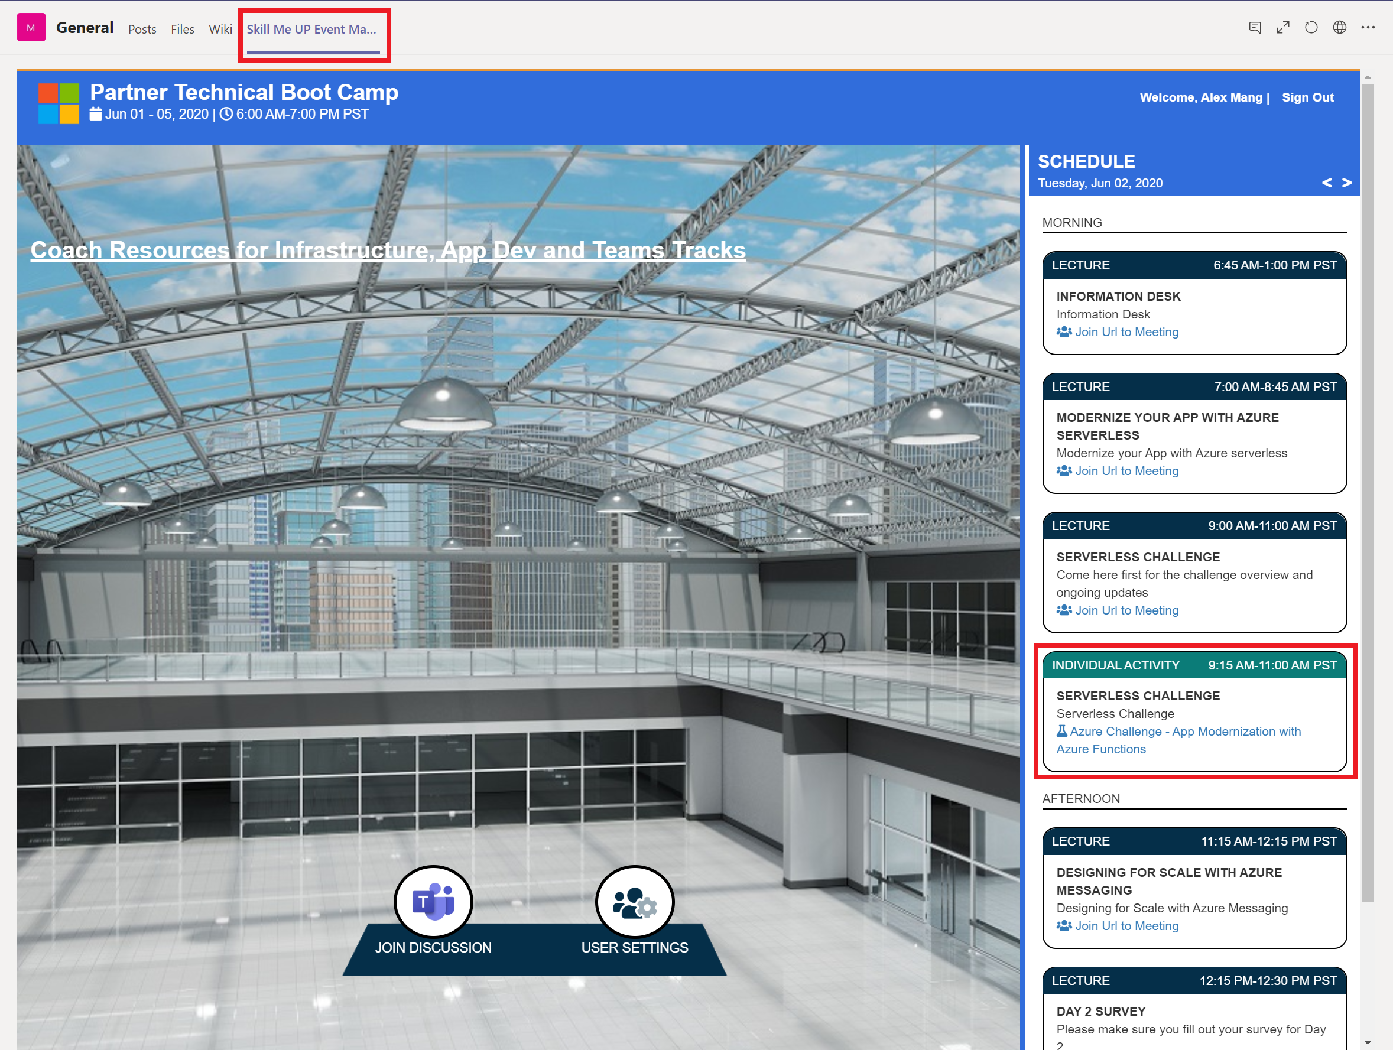
Start Challenge Environment Now

Slide 90
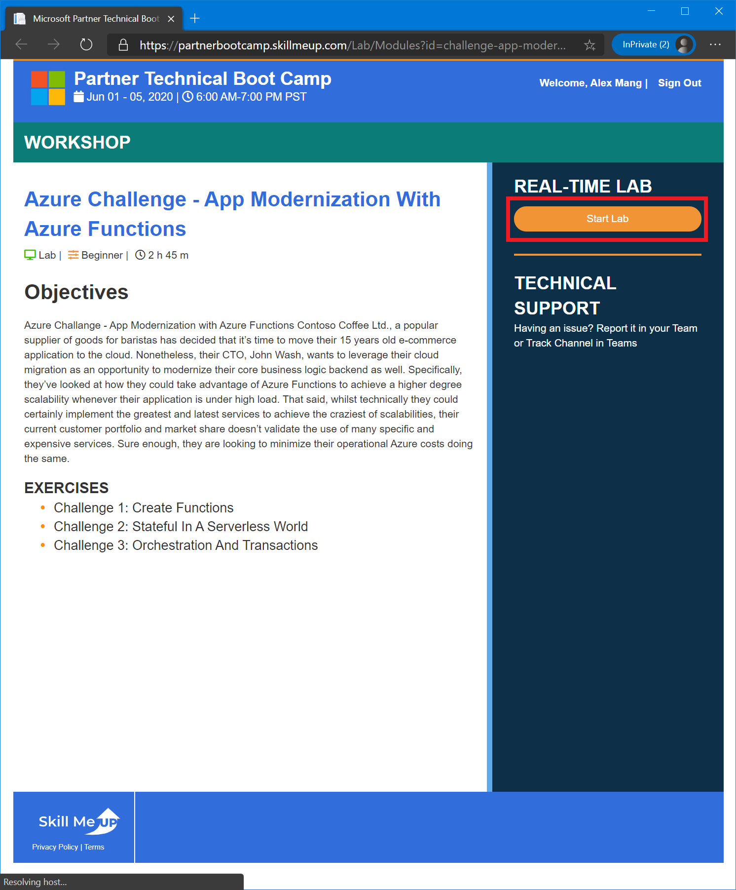
Start Challenge Environment Now

Slide 91
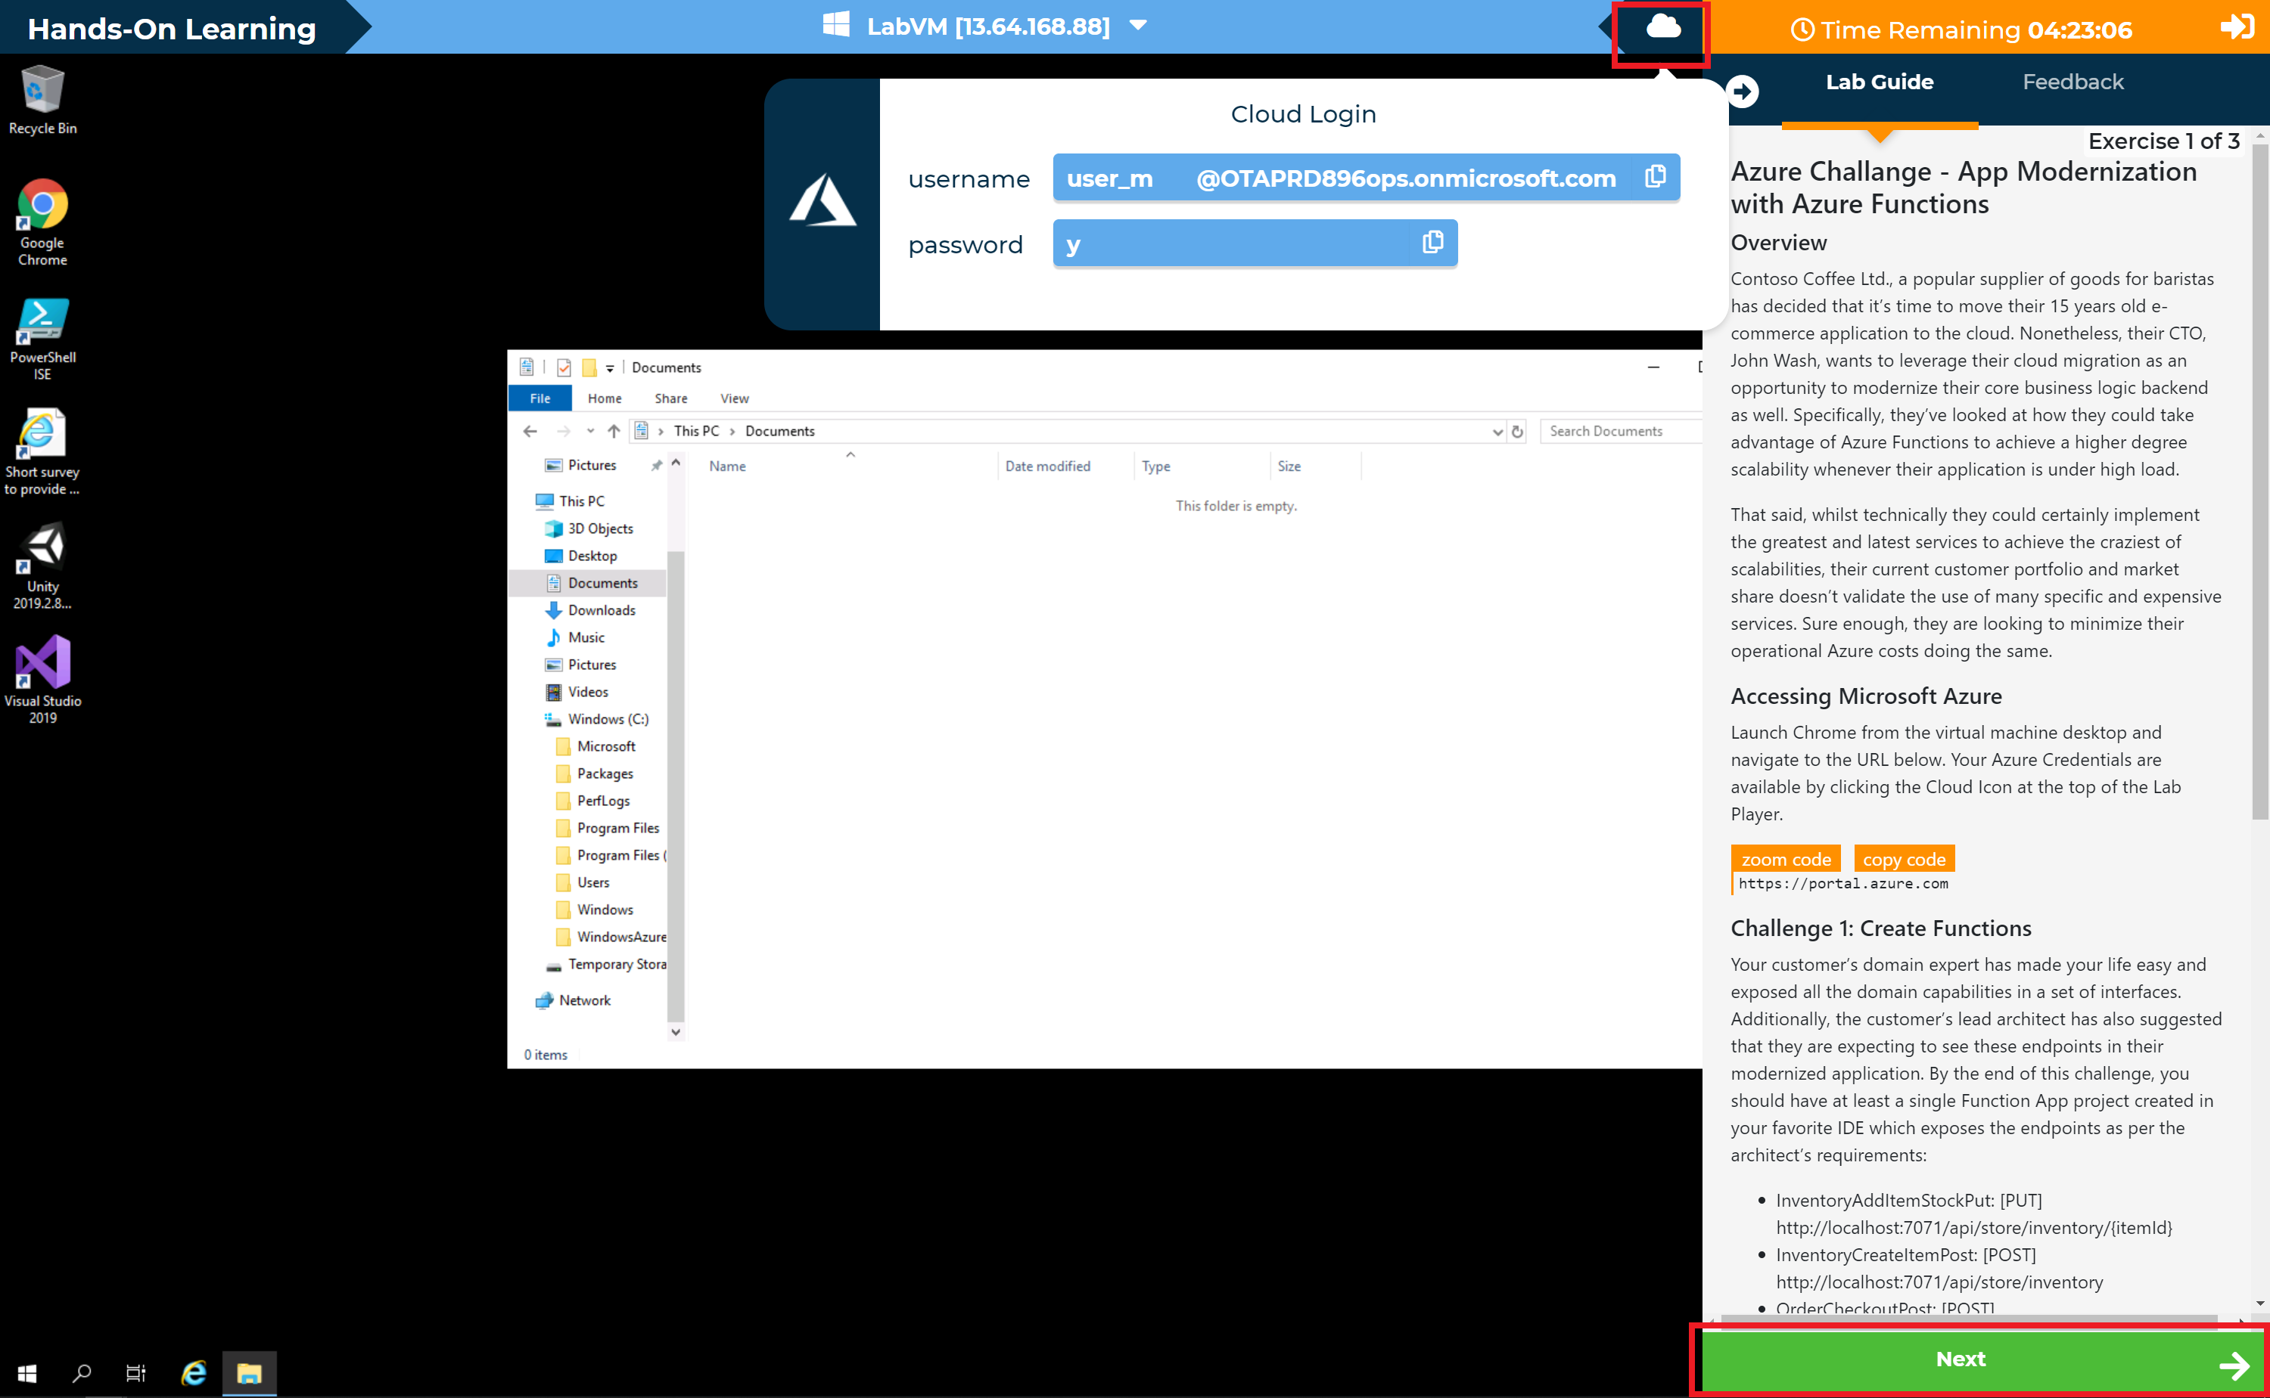
Start Challenge Environment Now

Slide 92

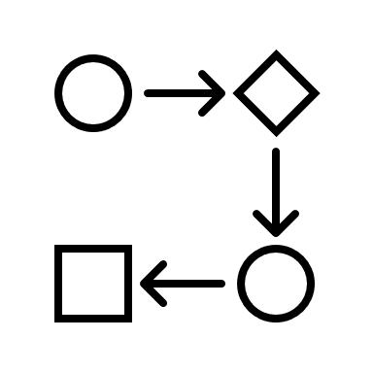
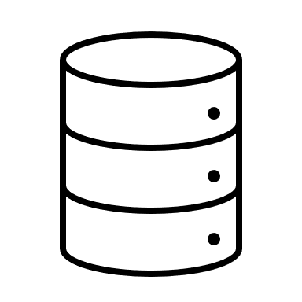

Challenge Application High-level Diagram
Prior to modernization: 3-tier architecture
Front-end website
API
Data
Notes:
Contoso Coffee Ltd., a popular supplier of goods for baristas has decided that it's time to move their 15 years old e-commerce application to the cloud. Nonetheless, their CTO, John Wash, wants to leverage their cloud migration as an opportunity to modernize their core business logic backend as well. Specifically, they've looked at how they could take advantage of Azure Functions to achieve a higher degree scalability whenever their application is under high load.
That said, whilst technically they could certainly implement the greatest and latest services to achieve the craziest of scalabilities, their current customer portfolio and market share doesn't validate the use of many specific and expensive services. Sure enough, they are looking to minimize their operational Azure costs doing the same.

Slide 93


Challenge Application High-level Diagram
After modernization: microservices-based APIs running in Azure Functions
Front-end website
API
Data

Slide 94
Challenge Application High-level Diagram
After modernization: microservices-based APIs running in Azure Functions
[GET] /api/store
[POST] /api/store/inventory
[PUT] /api/store/inventory/{itemId}
[GET] /api/user/{userId}/shoppingCart
[POST] /api/user/{userId}/shoppingCart/{itemId}
[DELETE] /api/user/{userId}/shoppingCart/{itemId}
[POST] /api/user/{userId}/order/checkout
[GET] /api/user/{userId}/order/{orderId}

Slide 95
Key Pointers
Whilst it would be possible to use data-specific repository services, we encourage you to experiment with Durable Entities
We expect the product catalog to be a singleton entity (single context, single identity, available to both clients, orchestrator and other entities)
Shopping carts ought to be designed as entities
Checkout operations should be transactional workflows
You’re not expected to provide a UI – using Postman/Fiddler/cURL is desirable
Realistic scenario… but up to a point

Slide 96
Wrap-up

Slide 97
Review
Application Modernization
Azure Serverless
Reference Serverless Application
Functions
Durable Functions
Durable Entities
Security

Slide 98
Thank you.

